Slide 1
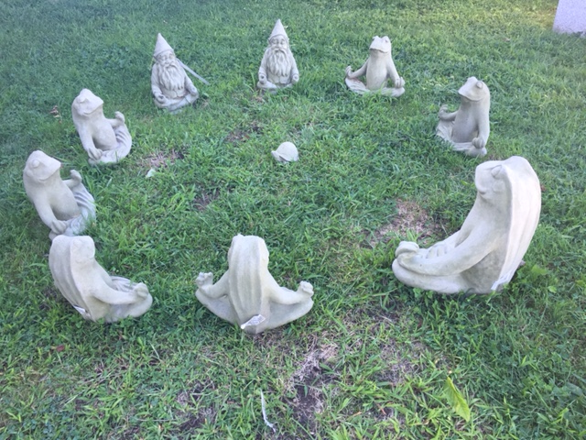
Welcome To Health
Ms. Maline
smaline@fairfieldschools.org

Slide 2
My teaching background
34th year teaching ☺
American School Foundation – Monterrey Mexico
Multicultural Magnet Bpt.
Mill Hill- Wellness Workshop for Parents
Total 26 years Elementary
Education : Bachelors in Education , Masters in Reading, 6th year various classes, 7th year in Health
I teach two 6th grade classes
two 7th grade classes
one 8th grade class

Slide 3
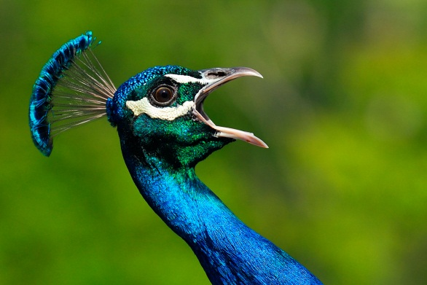
My Philosophy
I believe that our ultimate goal as educators and parents is to guide our children in becoming
Socially competent, Happy, Self loving, Resilient individuals
Who will be able to independently maintain a healthy lifestyle physically, mentally and emotionally.

Slide 4
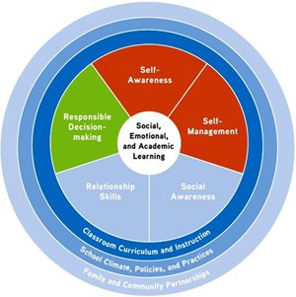
Five Social and Emotional Learning Core Competencies:
* Develops long term HEALTH and WELL- BEING~ for a healthy, positive, successful life

Slide 5
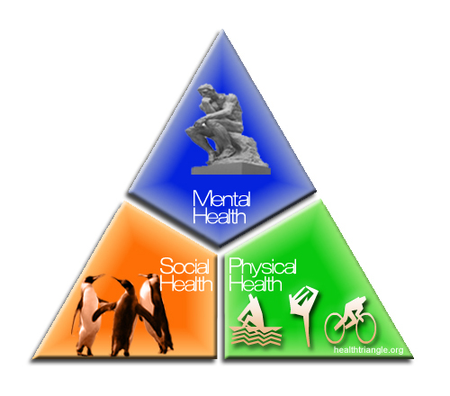
Health Triangle
VALUE your whole self
English word “Health” comes from the Old English word hale, meaning “wholeness”.
We strive for Wellness, the integration of all 3.
Wellness involves continually learning and making changes to enhance our state of wellness and keep it in balance.
Happy Healthy Successful
HhHappy
Notes:
Laughing- sense of humor
Project: Self esteem – sense of belonging, recognize and accept one’s strengths.

Slide 6
Health GOALS:
• To think critically and apply effective problem-solving and decision-making skills
• Effectively contribute to positive group discussions
• Demonstrate effective communication skills necessary for positive interpersonal relationships
• Identify valid sources of information that will be useful and necessary for maintaining a healthy lifestyle
• Show respect for other students' opinions

Slide 7

6th Grade – *Friendships- good, bad, empathy, peer pressure and bullying , *Stress/Time Management; Anger Management; Decision Making Skills
* Substance Abuse/ Prevention- Marijuana, Inhalants, Alcohol and Smoking
* Communicable Diseases- HIV/AIDS, Lyme
* Puberty and Body Image

Slide 8
7th Grade – ME Project
*Self Talk ; Popularity; Rumors and Accusations
Coping with Death/Loss> Focus on how to live.
Eating Disorders
Substance Abuse Prevention; Decision Making Skills
Family Life- Pregnancy/Birth; Body Image
Diversity/Tolerance
Goal Setting

Slide 9
8th Grade – “WHO I AM” Presentation
*Relationships: Healthy, Unhealthy, Abusive ; Dating
*Love and Infatuation
*Abstinence
*Alcohol -Binge Drinking, Cycle; *Depression and Suicide Prevention, *Sexual Harassment and Assault
*Date Rape Drugs
Support Systems; Decision Making Skills; Substance Abuse Prevention; Body Image; HIV/AIDS; Stress and Anger Management

Slide 10

Materials

Slide 11
GRADING/HOMEWORK POLICY: 10% Homework
90% Tests /Quizzes/Project
EXTRA HELP: Available Monday and Thursday 2:50-3:10, or otherwise scheduled with teacher
EXPECTATIONS: Do your best : self advocate for your needs : Follow the expectations : Participate
Have a positive attitude
Be Responsible , Respectful and Aware of Your Actions

Slide 12

Communication
Infinite Campus
Messenger: A heads up
Upcoming Tests, Projects
Email: Smaline@fairfieldschools.org
Telephone

Slide 13
Books:
Blessings of a Skinned Knee-Wendy Mogel
Emotional Intelligence- Lantieri, Goleman
* Please feel free to contact me with other book or website suggestions.

Slide 14

Thank you !
I look forward to a very successful marking period
Shari Maline
Smaline@Fairfieldschools.org

Slide 15

>What one food never spoils and is made without any artificial preservatives or chemicals?
“Be thankful for what you have; you'll end up having more.
If you concentrate on what you don't have, you will never, ever have enough.”
~ Oprah Winfrey

