Slide 1
Section 2
Atmospheric Heating

Slide 2
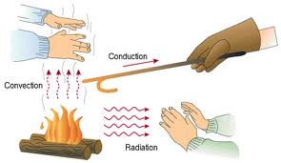
→ Describe what happens to solar energy that reaches the Earth.
Earth and it’s atmosphere are warmed by energy from the sun.
The earth is heated in 3 ways:
1) Radiation
2) Conduction
3) Convection

Slide 3
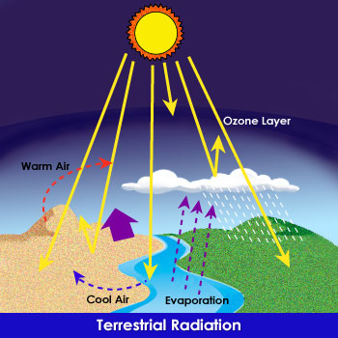
Radiation
Radiation: The transfer of energy as electromagnetic waves from the sun.
Drives the water cycle and makes it so we can live on earth.

Slide 4
Conduction
Thermal Conduction: The transfer of thermal energy (heat) through a material.
Always transferred from warm to cold objects.
When air molecules come into direct contact with the warm earth thermal energy is transferred to the atmosphere.
Air is heated near the earth’s surface and rises into the atmosphere.

Slide 5
Convection
Convection: The transfer of thermal energy by the movement of a liquid or a gas.
Warm air rises then it cools, becomes more
Dense, and sinks
The cycle of warm air rising and cool air sinking is called a convection current.

Slide 6
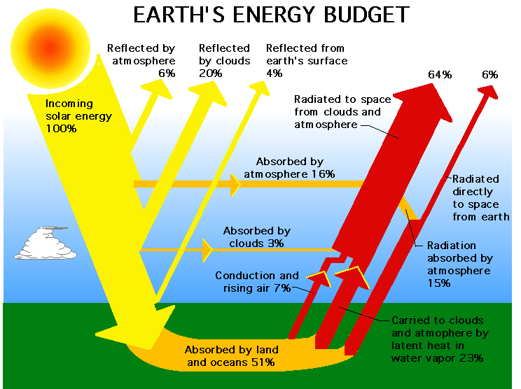

Slide 7
Explain how radiation, convection and conduction heat the earth.

Slide 8
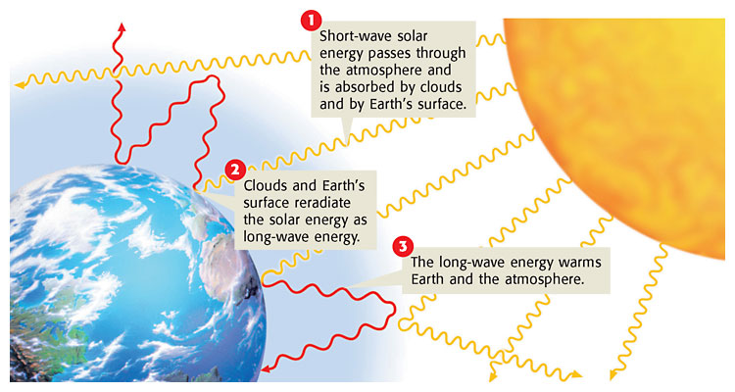
→ Explain the relationship between the greenhouse effect and global warming
Greenhouse Effect: The warming of the surface and lower atmosphere of earth that occurs when water vapor, carbon dioxide, and other gasses absorb and reradiate thermal energy (heat).

Slide 9
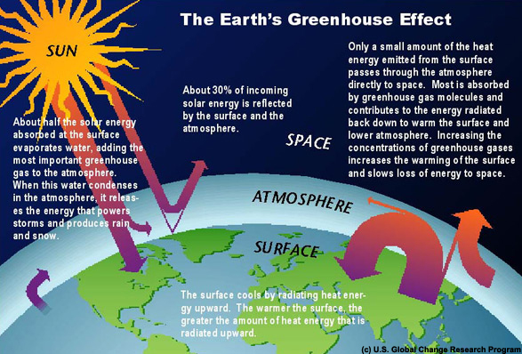

Slide 10
Global Warming: A slow increase in average global temperature.
Human activity like burning fossil fuels and deforestation can increase the amounts of greenhouse gasses in the atmosphere.
Some scientists believe that the increase of these gasses may cause global warming.

Slide 11
