Slide 1
Water in the Air

Slide 2
WATER IN THE AIR
Weather-
The Water Cycle
Water in a liquid, solid, gaseous state being recycled through the water cycle
Water cycle- is the continuous movement of water from sources on Earth’s surface such as lakes, oceans, and plants-into the air, onto and over land, into the ground, and back to the surface.

Slide 3
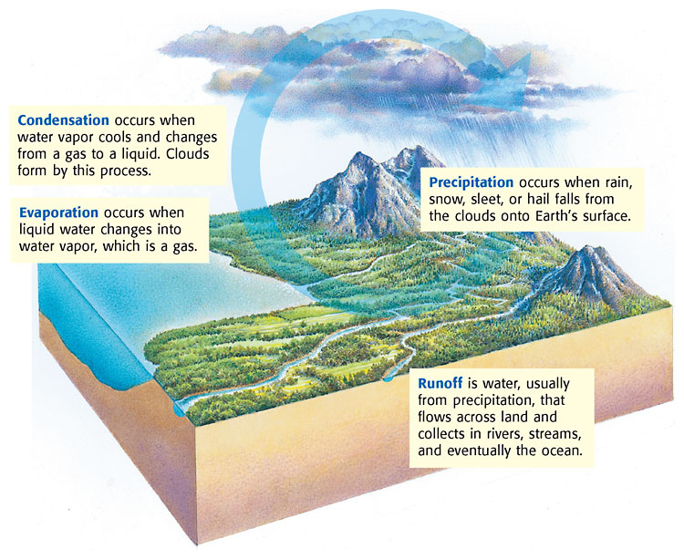

Slide 4
Humidity
Water vapor- moisture in the air
Water vapor is invisible
Humidity-amount of water vapor in the air.
Water evaporates, becomes humidity & humidity in the air increases
As temperature of the air increases, air’s ability to hold water vapor also increases

Slide 5
Relative humidity
Relative humidity-
Given as a percentage
Saturated- when air holds all the water that it can at a given temperature
Saturated air has a relative humidity of 100%

Slide 6
Factors affecting relative humidity
2 factors that affect relative humidity are:
Amount of water
Temperature
More water vapor in the air, the higher the relative humidity
if amount of water vapor in the air stays the same but temperature changes, relative humidity changes
relative humidity decreases at the temperature rises and increases as temperature drops

Slide 7
Condensation
Condensation-the process by which a gas, such as water vapor, becomes a liquid.
Air must be saturated before condensation can occur (100% relative humidity)
Condensation occurs once saturated air cools to its dew point
Dew point
Temperature at which a gas condenses into a liquid.
Air is saturated
Must have a surface to condense on; glass/ice water

Slide 8
Clouds
Cloud-collection of millions of tiny water droplets or ice crystals
Clouds form as warm air rises & cools
rising air cools and becomes saturated
saturated air water vapor changes to a liquid or a solid depending on air temperature
above freezing-water droplets; below freezing-ice crystals
Clouds are classified by form and by altitude

Slide 9
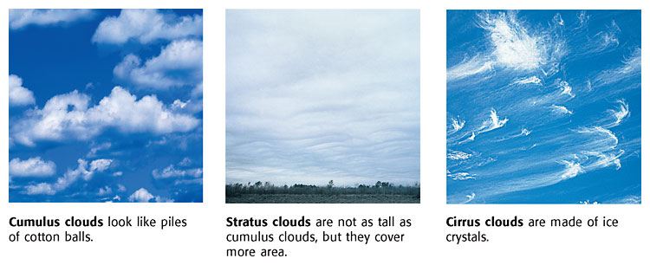
Cumulus clouds
Puffy, white clouds with flat bottoms
Form when warm air rises
Indicate fair weather
If clouds get larger, they produce thunderstorms
Stratus clouds
formed in layers
cover large areas of sky and block out sun
caused by large body of air lifting into atmosphere
fog is a stratus cloud that formed near the ground
Cirrus clouds
thin, feathery, white clouds
found at high altitudes
form when wind is strong
thickening of clouds means a change in weather is coming

Slide 10
Clouds and altitude
Clouds are classified by the altitude at which they form
Cirro- describes clouds that form at high altitudes (cirrocumulus cloud)
Alto- describes clouds that form at middle altitudes (altocumulus cloud)
Clouds that form at low altitudes do not have a specific prefix

Slide 11
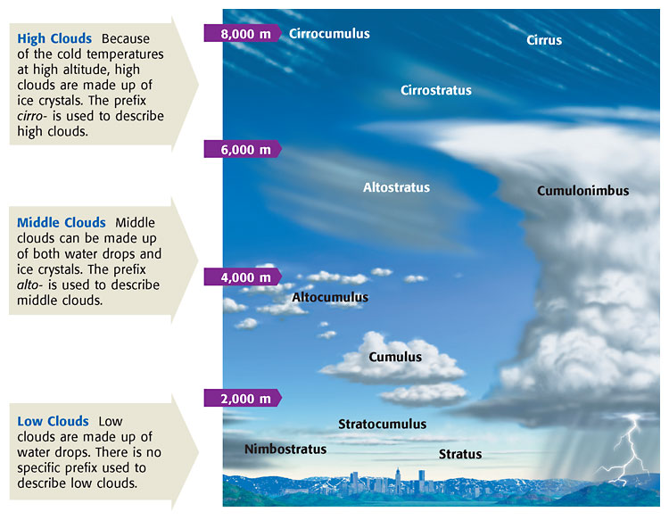

Slide 12
Precipitation
Precipitation- water in solid or
liquid form, that falls from the air to earth
SLEET & SNOW
sleet forms when rain falls through a layer of freezing air-falling ice
snow forms when water vapor changes directly to a solid due to cold temperatures
can fall as single ice crystals or join to form snowflakes
RAIN
Most common form of precipitation
Water drops in cloud becomes a certain size
it must become 100 times it original size to be rain
HAIL
balls or lumps of ice that fall from clouds
forms in cumulonimbus clouds
Updrafts of air carry raindrops high in the clouds, raindrop freezes; process is repeated and when drop is to heavy it falls to Earth’s surface

