Slide 1
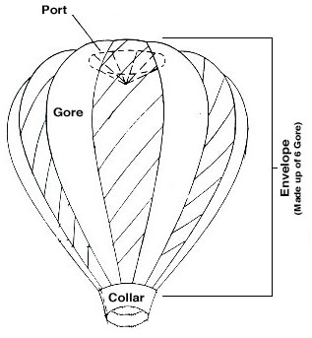
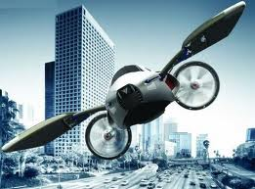
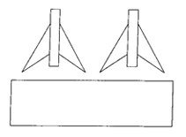
Welcome to TRANS TECH 8. IN THIS CLASS Students will have the opportunity to create various land, and air transportation vehicles.
[ ]
TRANS Tech
TRANSPORTATION TECHNOLOGY

Slide 2
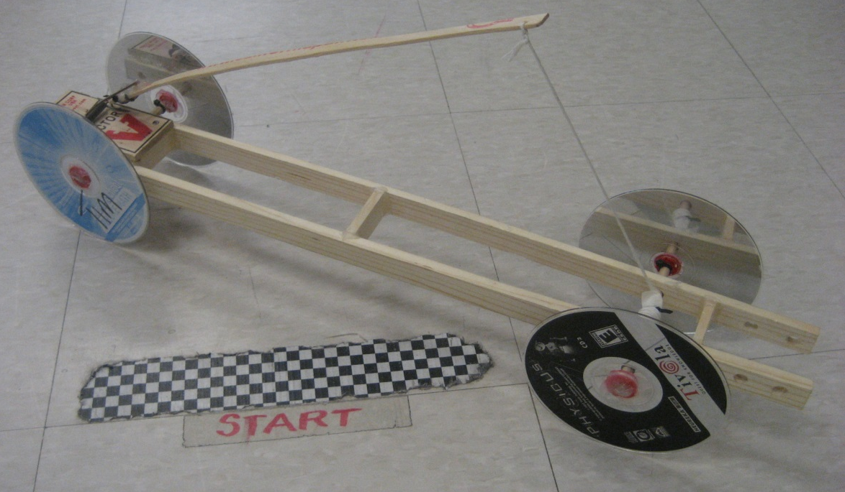
LAND VEHICLES Mouse Trap Racer: Students will work in teams of two to concept, design, and create a model car propelled by a mouse trap.
[ ]
TRANS Tech
Materials include: two paint sticks, ONE mouse trap, dowels, wood glue, hot glue, string, FOUR CD’s, CD wheel inserts, wire coat hanger, and cable zip ties.

Slide 3
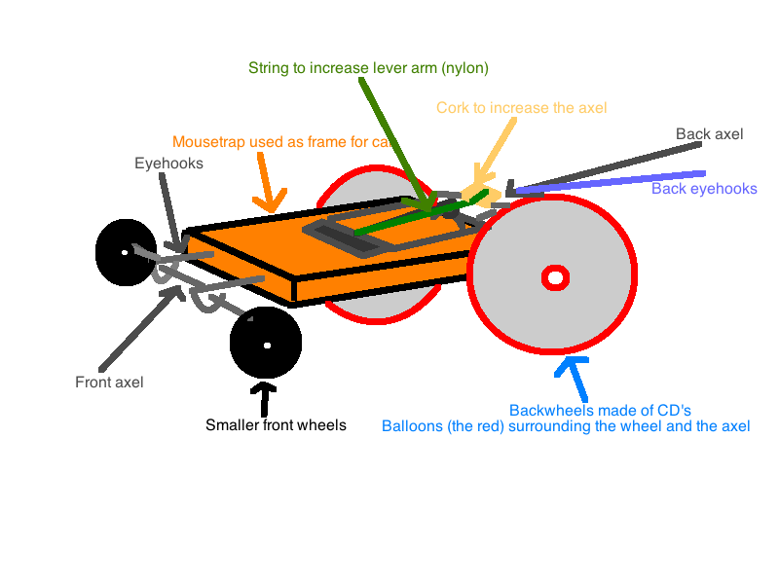
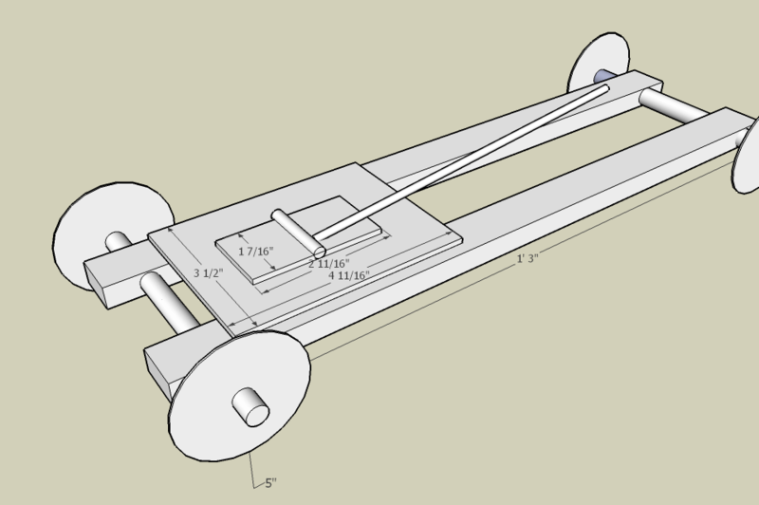
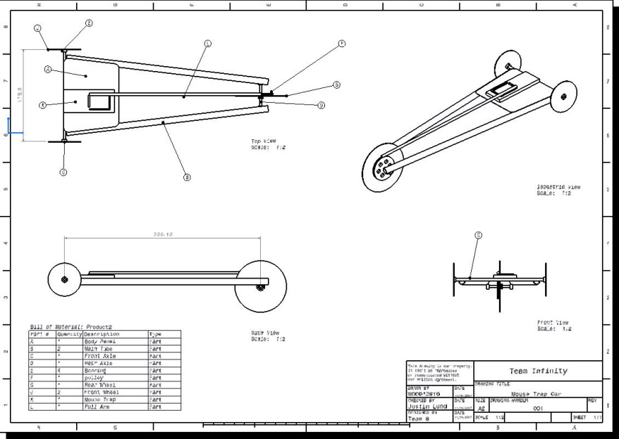
LAND VEHICLES Mouse Trap Racer:
[ ]
TRANS Tech

Slide 4
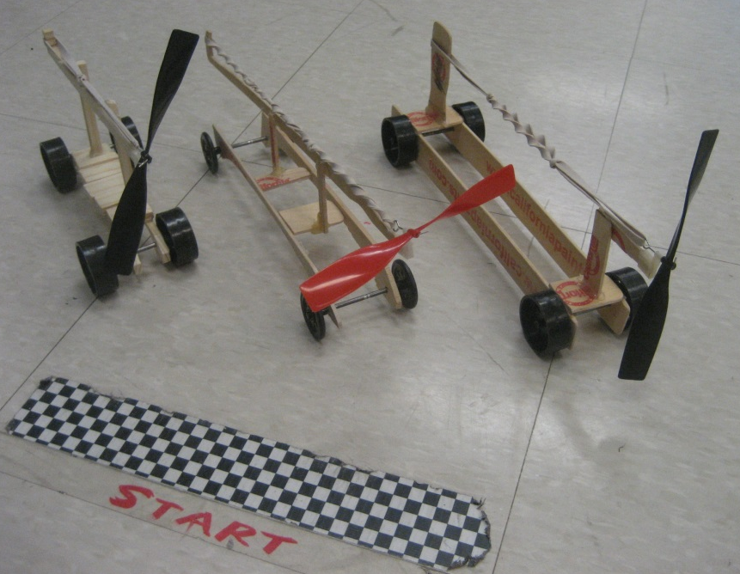
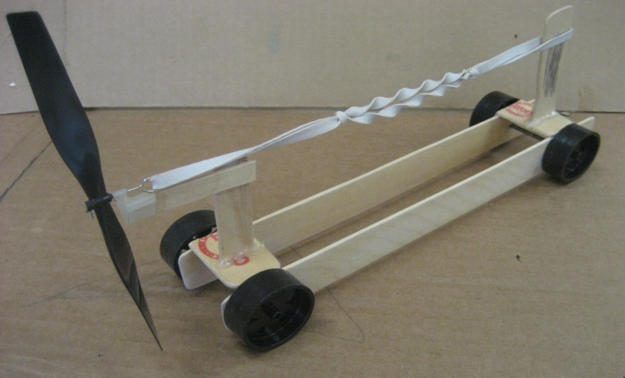
LAND VEHICLES RUBBER BAND RACERS: Students will work individually to concept, design, and create a model car propelled by a RUBBER BAND AND Propeller.
[ ]
TRANS Tech
Materials include: ONE Propeller, FOUR WHEELS, dowels, wood, RUBBER BANDS, hot glue, AND OTHER (?).

Slide 5
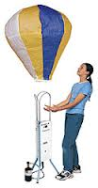
AIR VEHICLES (l.t.a.) HOT AIR BALLOONs: Students will work in teams of two to create a hot air balloon.
[ ]
TRANS Tech
Materials include: tissue paper, gore templates, manilLa paper collar, glue stick, and scissors.

Slide 6
AIR VEHICLES (h.t.a.) STRAW AND PNEUMATIC ROCKETS: Students will understand the basic principles of flight and utilize NEWTON’S LAWS AND Bernoulli’s Principle to create air transportation vehicle’S from paper.
[ ]
TRANS Tech
Materials include: PAPER, TAPE, DRINKING STRAW, AND A WOODEN DOWEL.

Slide 7
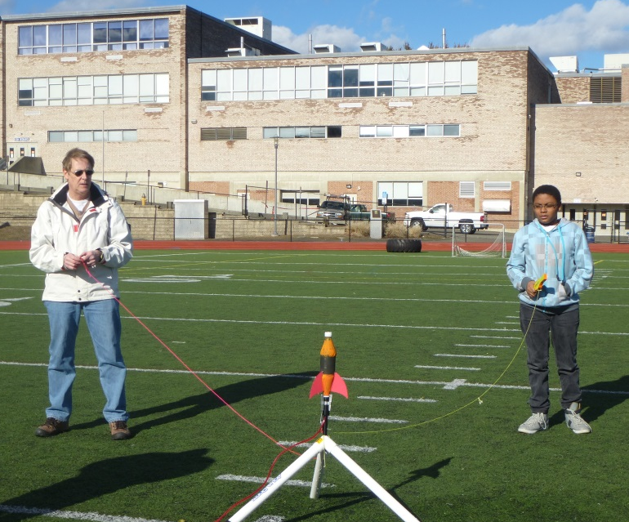
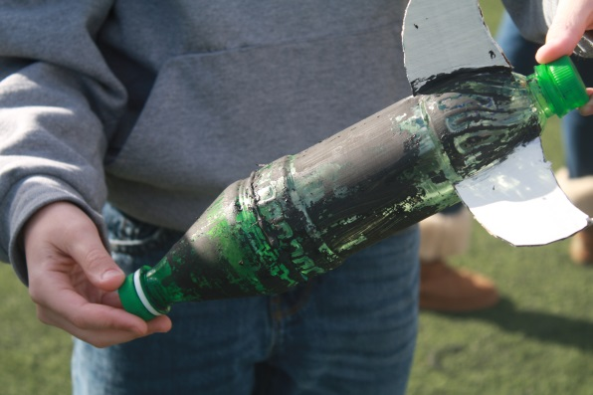
AIR VEHICLES (h.t.a.) BOTTLE ROCKETS: Students will work in teams of two to create a soda bottle rocket.
[ ]
TRANS Tech
Materials include: TWO carbonated beverage bottleS, scissors, hot glue, fin material, GOLF BALL, AND PAINT.

