Slide 1
Principal’s Breakfast
How individual goals, checklists, and rubrics help students understand themselves as learners

Slide 2
Current Research
Two types of goals, mastery and performance goals
Mastery goals foster motivation associated with a deeper level of engagement and helps the student make the connection between effort and achievement, a willingness to engage in the process of learning (effort leads to success)
Performance goals foster a pattern of motivation associated with being successful at a task I (motivation leads to achievement)

Slide 3
What is Student Agency?
Student agency is developing personal motivation to reflect on one’s learning related to a known and understood goal. Students are accountable for their learning related to their goal and can communicate their understanding to others.
Speaking and listening to others help to develop self-reflection and solidify for the student what makes learning fun.
Feedback identifies the strategies and thinking that leads students to ownership of their learning.
Students challenge one another to defend or change their thinking. This work takes place in a safe and teacher supported environment where being an active learner is celebrated.

Slide 4
School Improvement Goals
Implement and evaluate the effectiveness of evidence-based instructional strategies in all content areas.
Build teacher and student agency to deliver intentional targeted feedback in the instructional core (Review/Reflect, Scaffold/Strategy, and Adding On).
Build teacher agency to use and check on learning targets, goals and scales through using specific student goal setting (Marzano).
Teachers will monitor the progress of students thinking within, beyond, and about the text.
School and district administrators, with school-based teams will analyze identified needs to determine the structures, locations, times, and outcomes for staff engaged in the professional learning which will improve intentional feedback in classrooms. Identified needs will be based on anecdotal data, observations and evaluations, and student performance. (Embedded PD) There will be focus on improving the needs of ALL students including those with disabilities, gifted, and English Language Learners.
All school staff will attend at least three professional development opportunities focused on providing authentic feedback to all students related to academic achievement. (Embedded PD)
Teachers in grade 3, curriculum specialists, special educators, and administrators will participate in cross-school professional learning in order to improve their ability to provide intentional feedback. Additional staff will be trained in these expectations at the school level. This training will be coordinated and conducted by the school leadership teams. (Embedded PD)

Slide 5
Indicators of progress
Indicators of Progress: 100% of teachers will meet or exceed their SLO’s IAGD’s. Instructional observations will demonstrate teachers on pace with curriculum expectations and will demonstrate acceptable levels of instructional differentiation for student learning needs by using targeted feedback indicators. 100% of district common assessments will be provided to students and will be scored by appropriate staff. Feedback on literacy and numeracy curriculums will be provided to the appropriate school and district personnel and with parents. Survey results will be studied to determine if workshops and communication throughout the year has changed the parent perceptions about the use of successful strategies during school climate team meetings. Office referrals will decline by 5 percent. All teachers will implement 10% Parent Feedback goal. 100% of teachers achieve at least “Accomplished” score on Parent Feedback 10% area.

Slide 6
Indicators of Progress: All staff will participate in the professional learning expectations as outlined in the SIP. All teachers will work toward the effective implementation of developing individual student goals. All staff will maintain a minimum of proficiency on their professional learning portion of their evaluation. Implement grade level rounds, lead by trained leadership team members, to monitor the progress of feedback given to students across three frames (review/reflect, scaffold/strategy, adding on) in whole class, small group, and one to one instruction across all content areas.

Slide 7
Indicators of Progress: Parent survey results indicate an increase of 10% satisfaction with understanding the resources needed for success. All teachers will make appropriate use of Infinite Campus to communicate student progress to parents. Effective tier one interventions will be identified and used to help students progress in meeting EIP goals. Explore new recording sheets for tier one intervention progress monitoring. Explore options for identifying curriculum modifications for our highest achieving students. Explore additional instructional resources for students in tier two and tier three.

Slide 8
Indicators of Progress: School Improvement Plan aligned to District Improvement Plan. Record of modifications in School Improvement Plan made in response to feedback and data on effectiveness of implementation discussed at data team, grade level, and leadership team meetings. Teachers monitor students thinking beyond and about the task using data collected in 1.4. Grade level teams monitor the progress of student’s ability to use more robust elements in their writing as identified in their grade level goals. Teachers will bring student work to grade level and data team meetings that demonstrate the use and effectiveness of goals, rubrics, and checklists related to their goals and SIP goals.

Slide 9
Indicators of Progress: School Improvement Plan aligned to District Improvement Plan. Record of modifications in School Improvement Plan made in response to feedback and data on effectiveness of implementation discussed at data team, grade level, and leadership team meetings. Teachers monitor students thinking beyond and about the task using data collected in 1.4. Grade level teams monitor the progress of student’s ability to use more robust elements in their writing as identified in their grade level goals. Teachers will bring student work to grade level and data team meetings that demonstrate the use and effectiveness of goals, rubrics, and checklists related to their goals and SIP goals.

Slide 10
Kindergarten

Slide 11
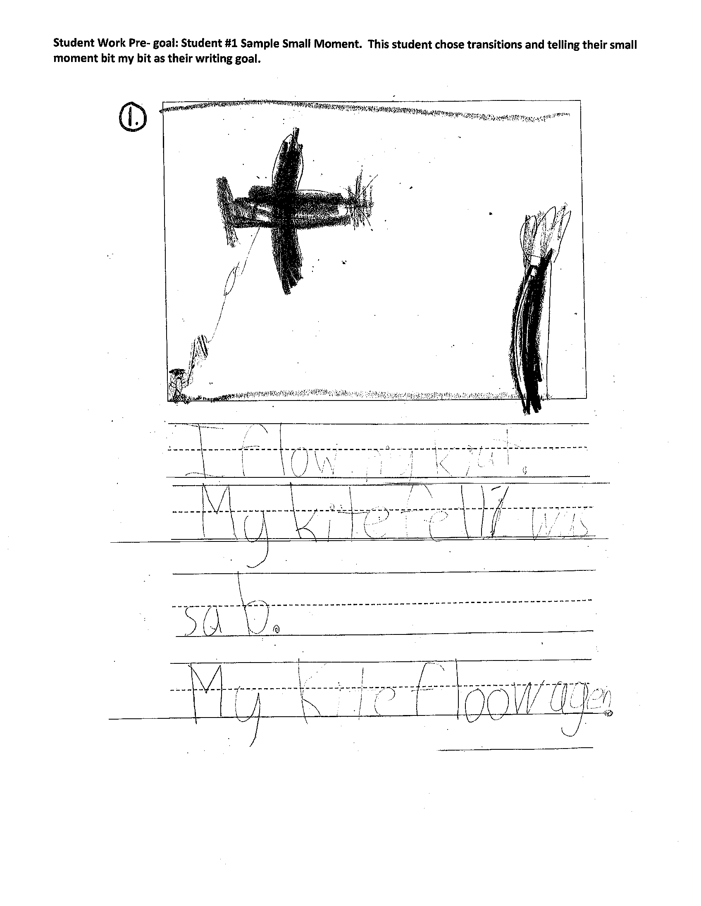
First Grade

Slide 16
Second Grade

Slide 18
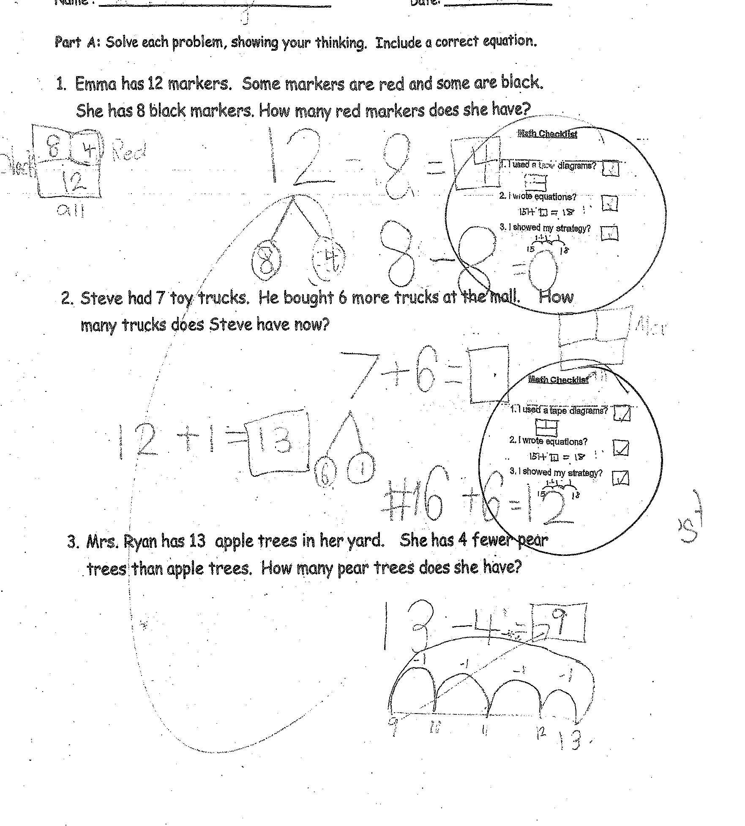

Slide 19
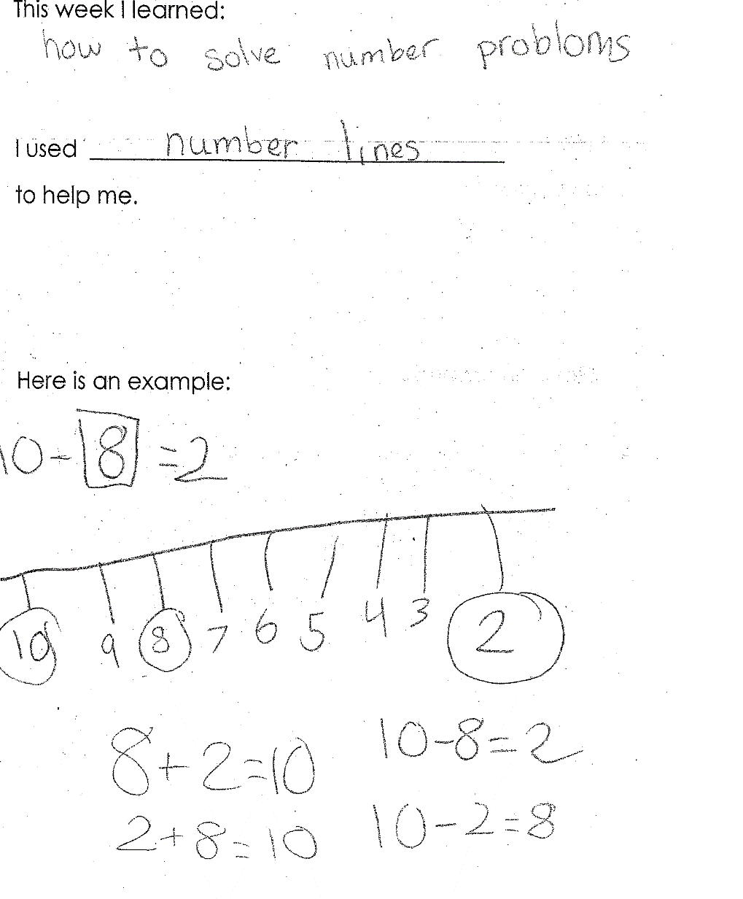
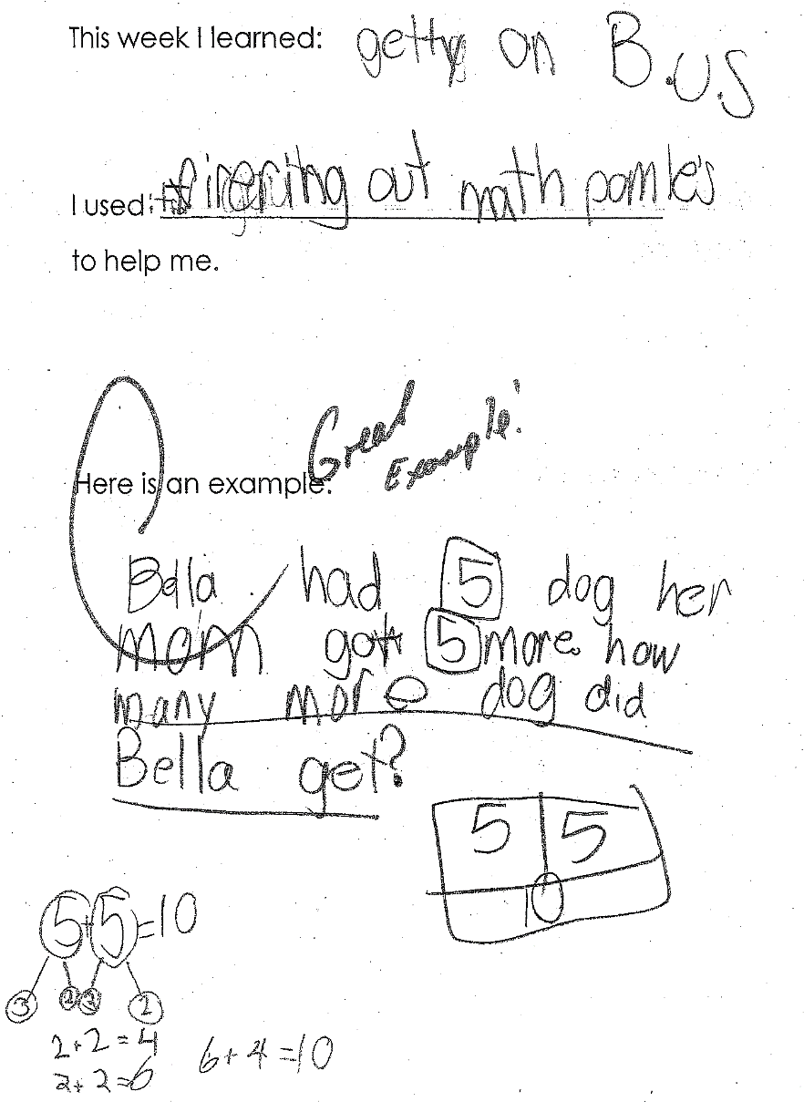

Slide 20
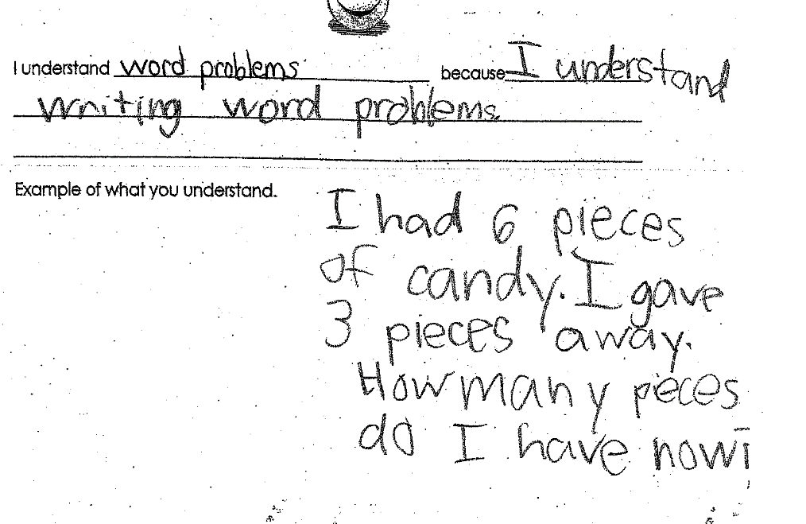
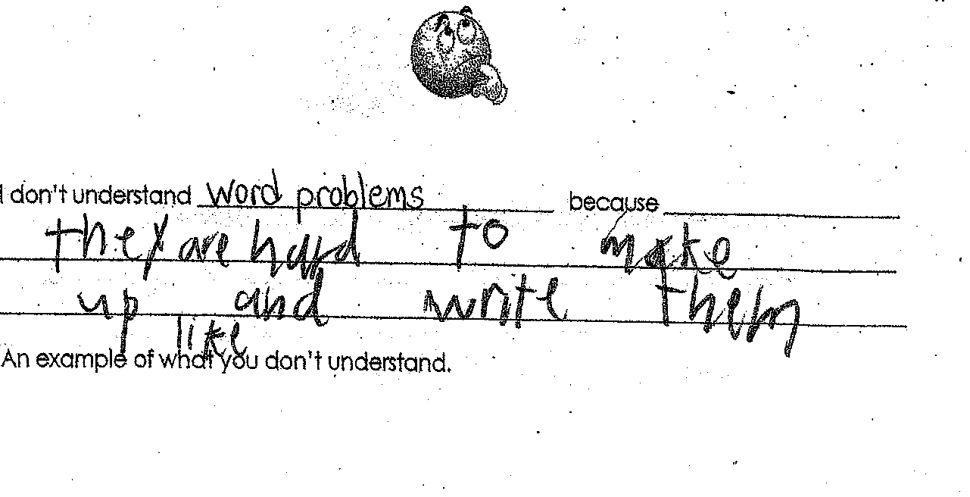

Slide 21
Third Grade

Slide 22
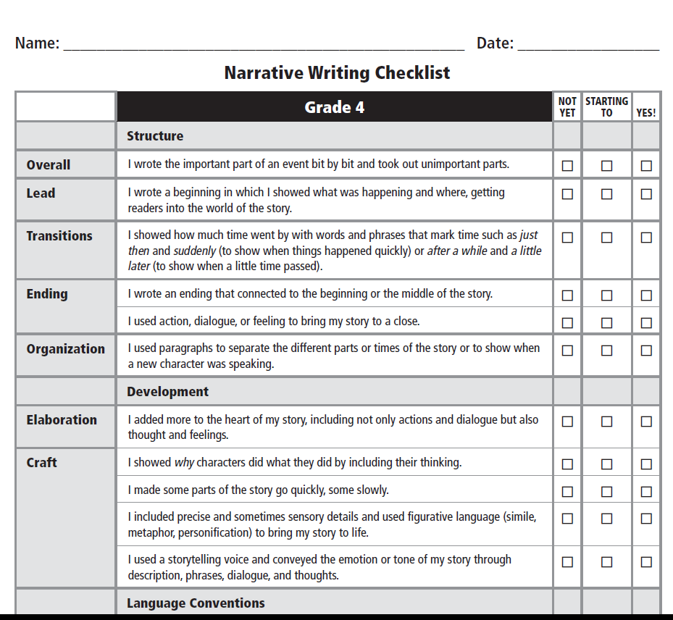
Fourth Grade

Slide 23
Fifth Grade

Slide 26
Questions to Help Support Learning at Home
Review and Reflect
Tell me what you are working on in your…(reading, writing, math)?
Can you help me understand how you are thinking about this problem, book, or math, piece of writing?
What have you tried? Did it work?
What is the problem or task asking you to do?
How did you get your answer? How did you come to that idea/conclusion?
What strategy are you using?
Adding On
Do you think that will always work?
Are there other characters in the book with a different point of view from the main character?
How do you think this part of the story relates to the theme of the book?
Do you think you could come up with a rule that would work every time you have a problem like this?
How could you use numbers to represent the thinking you did when you made this pattern?
Scaffolds and strategies, building a bridge from prior knowledge to new learning
You are making some inference about you character. It is important to have evidence to support your ideas. Can you show me place in your book that supports your ideas?
I see that you are checking the picture as you try to figure out that word. That is an effective strategy because it helps you think about the meaning in the story. Now, let’s look at how the word starts and get your mouth ready.
Yesterday you were using a number line (number bonds) to work through the problem. Will that help you with this problem?
I noticed that you are using counting on as a strategy. It looks like a lot of work. Is there another strategy you can try that is more efficient?

Slide 27
How can you help at home?
Ask questions about what goals your child is working on in school.
Ask your child if they have a checklist or rubric to use to make sure they are completing the work as assigned.
Asking the question, "Can you explain your thinking” is something children hear everyday in every class.
Link learning to real life situations you may have been engaged in with your child (remember last year when we went to the store and the boots you wanted were on sale)
Ask questions about key details in a story or movie. Summarize the story/movie. Find the theme. Discuss main characters and their character traits.
Encourage your child to ask questions to clarify a situation.(What don’t you understand?)
Retell a story about a family experience with as much detail, specific vocabulary, and elaboration (alliteration, similes, metaphors, etc) as possible. Express thoughts, ideas, and feelings clearly. (it was a very hot day, when I opened the creaky front door, it was like a blast from the oven.) Draw a picture about it, write a story too!
Always speak clearly in complete sentences, stretching vocabulary and then asking your child to repeat what you said. Check for understanding of vocabulary used.

Slide 28
Questions, Comments, Concerns?

