Slide 1
Native American Indians
Geographical Regions
Land, Climate, Plants, Animals
2014
Next

Slide 2
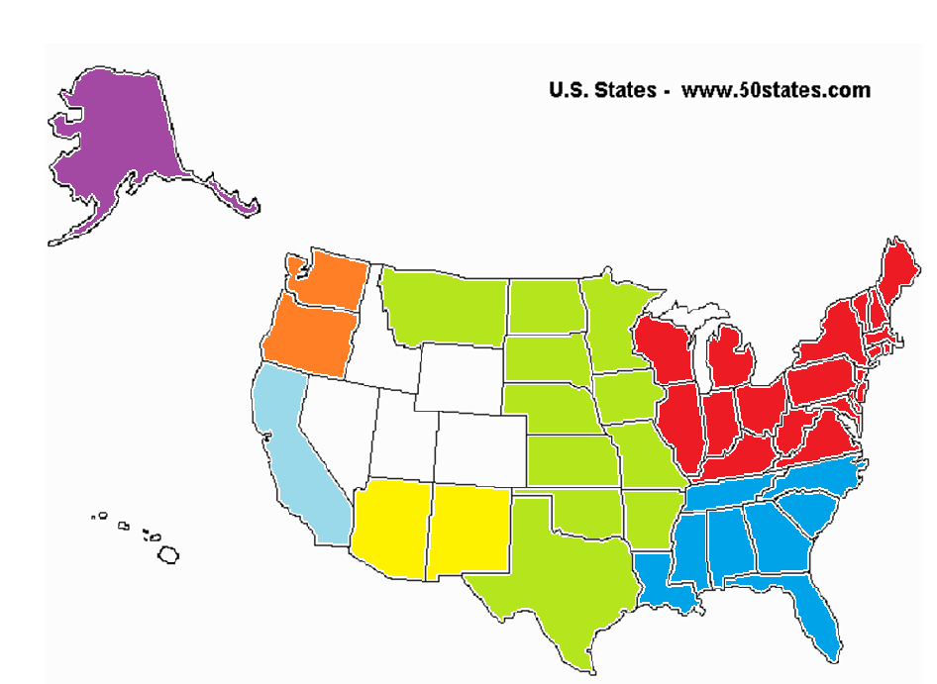
Regional Map
Click on a region
Arctic
Northwest
California
Great Basin
Northeast
Great Plains
Southwest
Southeast

Slide 3
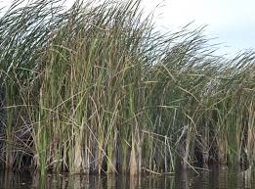
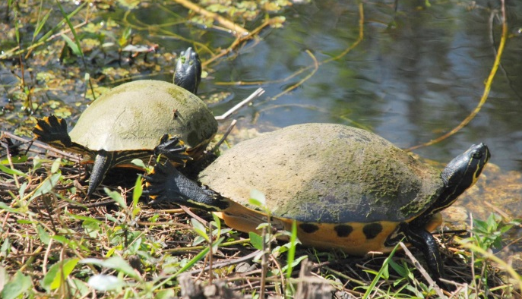
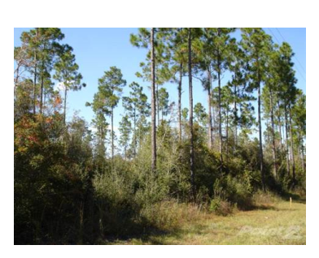
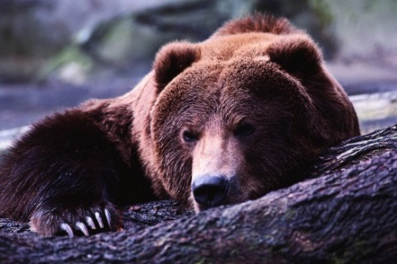
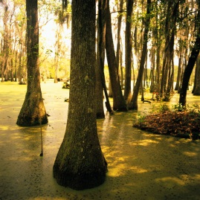
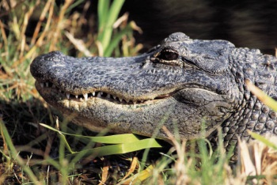
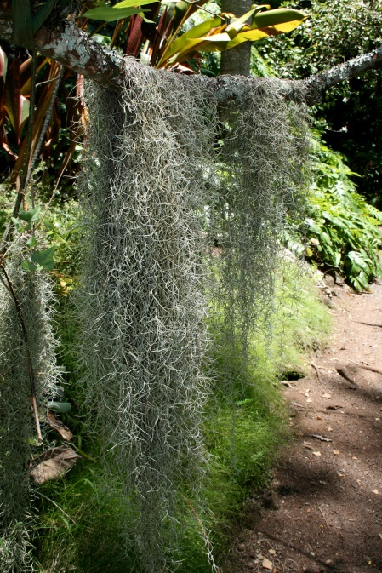
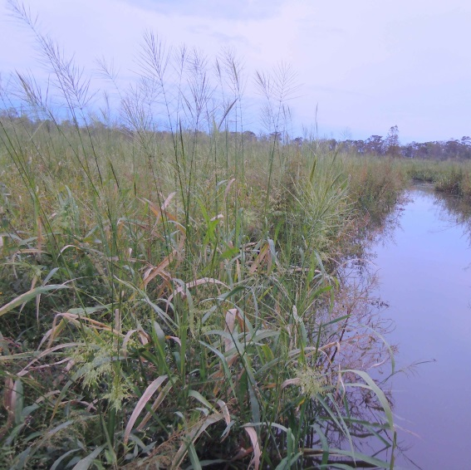
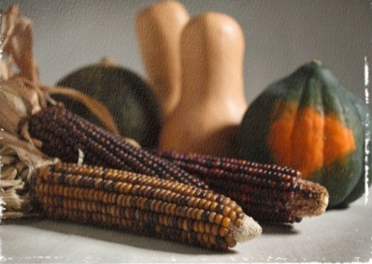
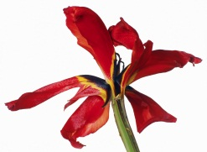
Southeast
sawgrass
Map
turtles
bears
Pine forests
wild rice
alligators
cypress
red iris
blue heron
Spanish moss
Climate/Land | hot; humid/ Appalachian Mountains; the Everglades(swamps); woodlands, Mississippi River Valley, seashore
Plants | cypress trees; Spanish moss; red iris flower; wild rice; tobacco; corn; beans; squash; berries; acorns
Animals | alligator; turtle; blue heron; deer; turkey; duck; bear; fish
Click here for more

Slide 4
More on the Southeast
Map
There is a great deal of rain in the Southeast. The soil is good for growing crops. Native Americans grew corn and tobacco. Tobacco was used in ceremonies.
The cypress tree grows in swamps. The roots of the tree grow out of the water and look like knees.
Spanish moss grows on the limbs of trees in the South.
Deer were very important to Southeast Native Americans.
Southeast Indians collected shells along the seashore to trade.
Southeast Native Americans celebrated a good corn harvest during the Green Corn Festival.

Slide 5
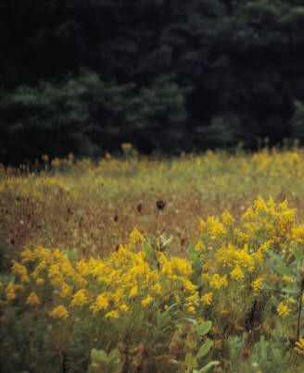
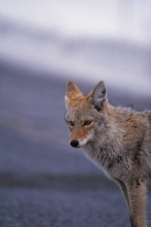
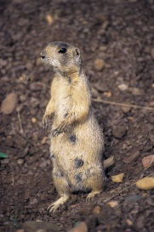
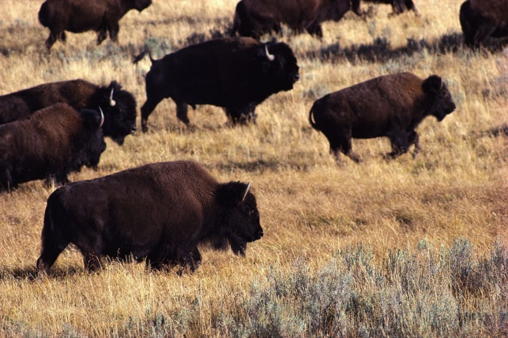
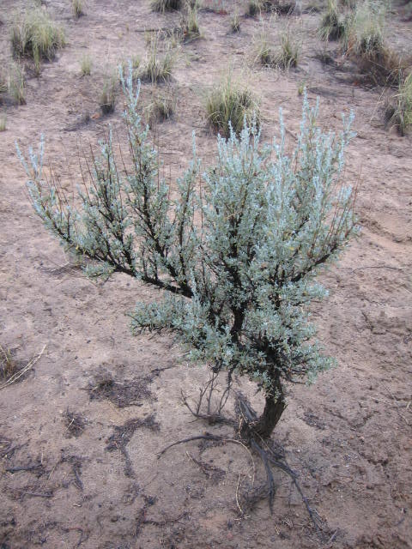
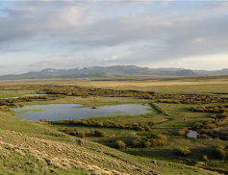
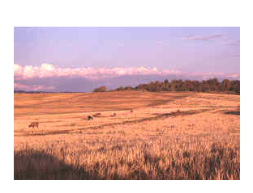
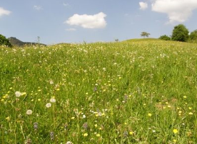
Great Plains
Map
goldenrod
coyote
Prairie dog
buffalo
prairies
Wildflowers
sagebrush
Climate/Land | rainfall varies; high winds at times; warm summers and cold winters. blizzards in winter/ land is flat; lakes; rivers; few trees
Plants | grassy prairies, sage; goldenrod; corn; beans; nuts; wild berries
Animals | buffalo; coyote; prairie dog; deer
Click here for more

Slide 6
More on the Great Plains
Map
The Great Plains are a huge grassland. Snow covers the ground in winter and it gets very cold. It can be very hot in the summer. There are downpours of rain that last only a few minutes.
There are rivers and streams, but very few trees. The trees grow near the rivers.
Wildflowers were used to make medicine to cure stomach aches and headaches.
Buffalo were very important to Great Plains Native Americans. They used every part of the buffalo.

Slide 7
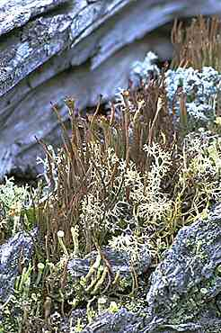
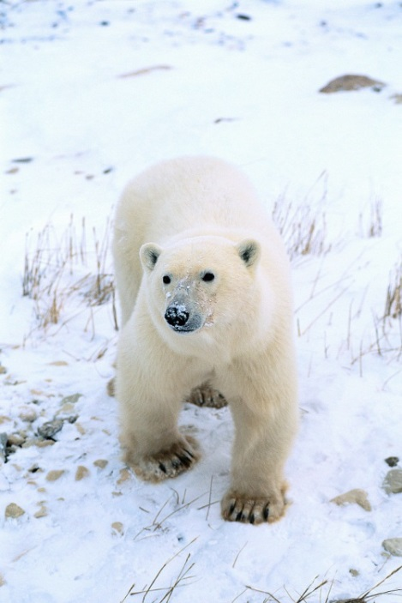
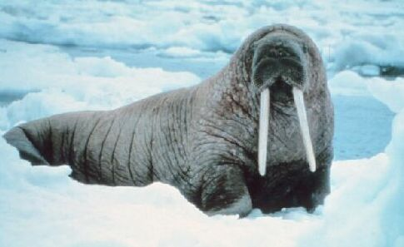
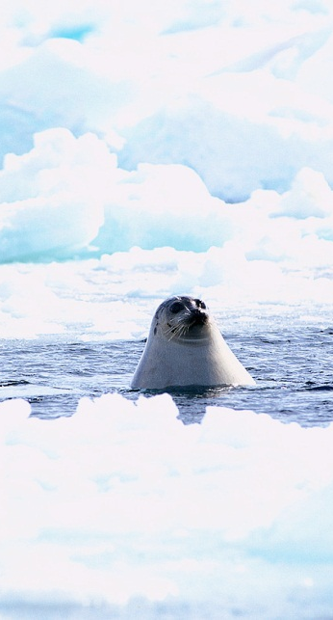
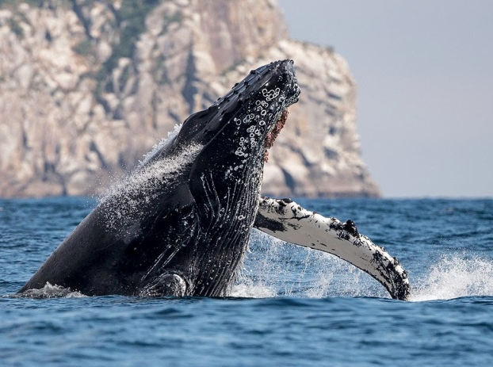
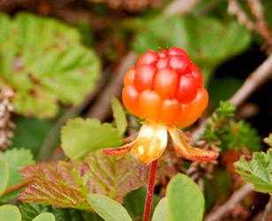
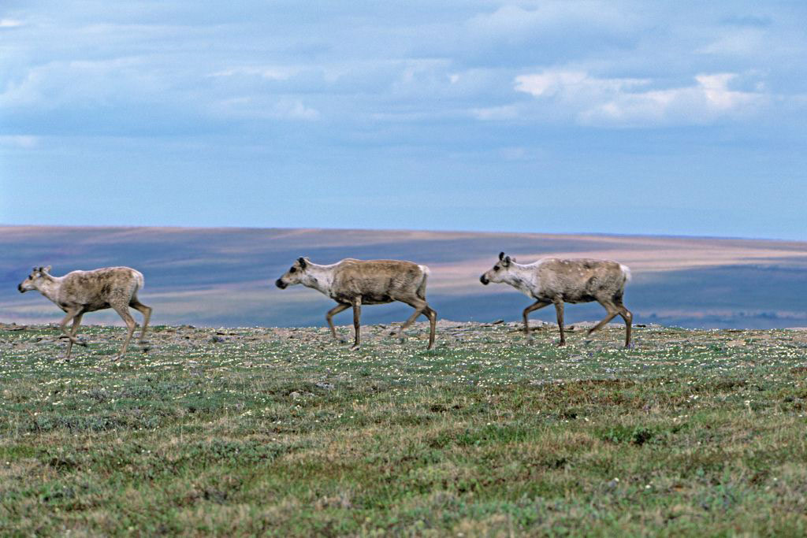
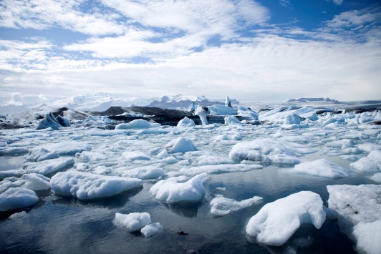
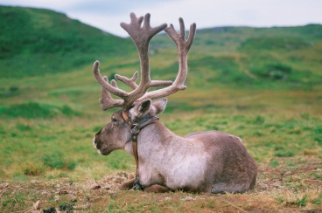
Arctic
lichen
Map
walrus
whale
Cloud berries
Polar bears
seals
reindeer
http://www.roebuckclasses.com
caribou
Climate/Land | Cold. Icy winters with little daylight; everything freezes; Ocean, lakes, streams; blizzards, flat land
Plants | Berries; small shrubs; lichen (like hard moss)
Animals | Seals; walrus; polar bears; caribou, trout
Click here for more

Slide 8
More on the Arctic
Map
The Arctic is in northern Canada, Alaska and Greenland.
Some Inuit moved inland in the summer to gather food like berries.
Inuit collect cloud berries and mix them with seal oil, reindeer or caribou fat, and sugar to make “Eskimo ice cream.”
In the fall, most of the animals went south, to warmer weather. Some Inuit moved their tribes to the shore in winter to hunt sea animals.
Some people call the Inuit, Eskimos. It means “meat eaters”. The Inuit prefer the name Inuit which means “the people.”

Slide 9
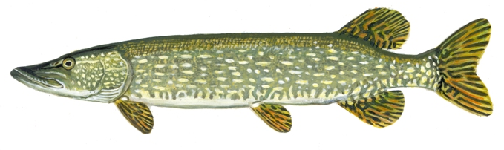
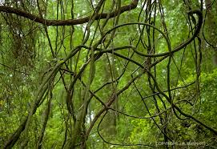
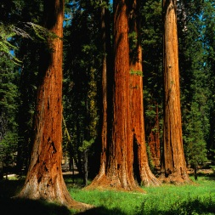
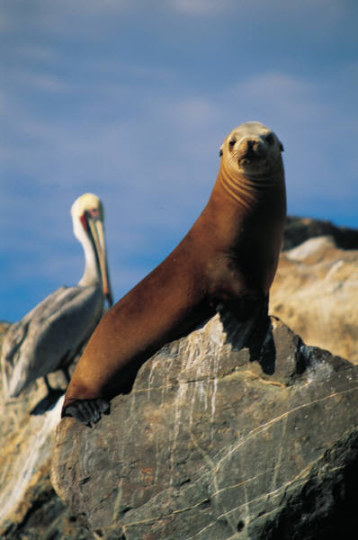
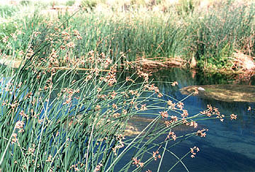
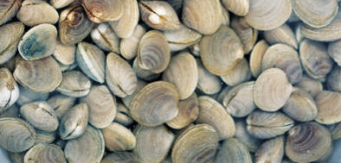
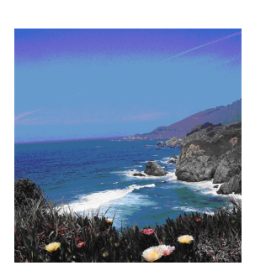
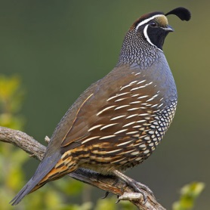
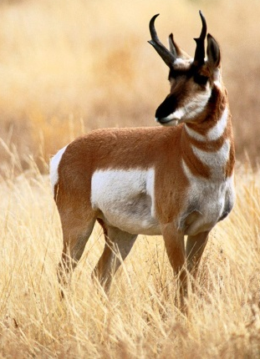
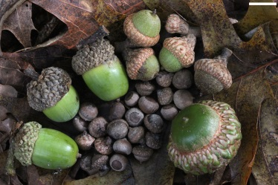
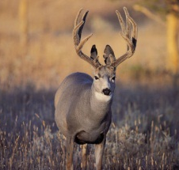
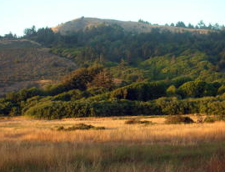
California
Map
pike
grape vine
seals
tule
clams
quail
redwoods
acorns
http://www.nps.gov
pronghorn
Mule
deer
Climate/Land | cool summer and wet winters, sometimes snow/ high mountains; some flat land; forest; inlets (small narrow waterway) and islands
Plants | pine, oak, maple, giant redwood tree, buckeye trees, grapevines, willow, tule
Animals | mule deer, elk, pronghorn, quail, woodpeckers, seals, clams,
Click here for more

Slide 10
More on California
Map
There were many different types of land in California. There were mountains, rolling hills and valleys where plants grew well. Some of the tribes lived near redwood forests, others near forests of pine, oak and maple trees. Acorns from oak trees were an important source of food.
There were also swampy areas where tule grew. This plant was very useful and was used to make canoes, shelters, and even clothing.
The lakes and rivers in California provided lots of fish such as pike. Branches from the willow trees were used to make cone-shaped baskets to trap the fish.
Oysters and clams were picked up on the beaches along the Pacific Ocean.

Slide 11
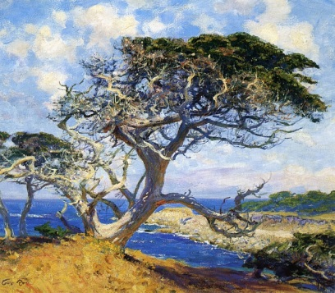
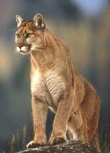
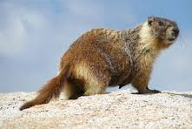
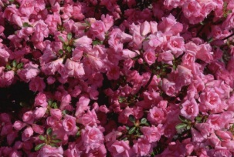
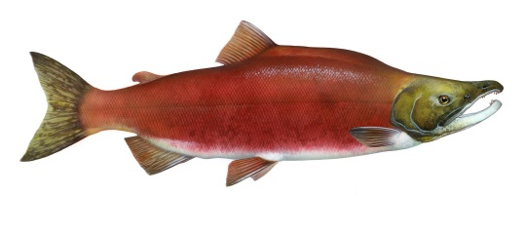
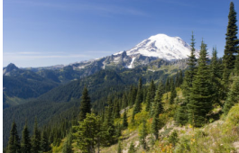
Northwest
Monterey cypress
Map
redwood trees
puma
marmot
seals
Pacific Ocean
salmon
http://www.nps.gov
azalea
mule
deer
Climate/Land | Cool summer and wet winters, sometimes snow/ high mountains; some flat land; forest; inlets and islands; deep canyons (warmer), and fast rivers and streams
Plants | giant redwood tree, Monterey cypress, azaleas; and a variety of berries, wild carrot and potato, bitterroot, and camas root
Animals | puma, marmot, mule deer, elk, mountain goat, pronghorn antelope, bear, rabbit, squirrels, seals, clams, and salmon
Click here for more

Slide 12
More on the Northwest
Map
Cedar trees were the most important tree in the forest for the people of the Northwest. Almost everything was made from wood .
Salmon was a very important food. Whole villages set up camp by rivers when the salmon were swimming up the river in the spring to lay their eggs.
Oysters and clams were picked up on the beach.
Native Americans of the Northwest gathered all the food they needed for the whole year in spring and summer.

Slide 13
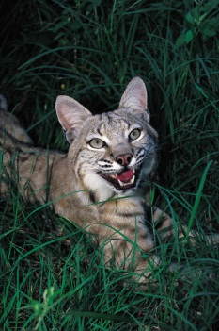
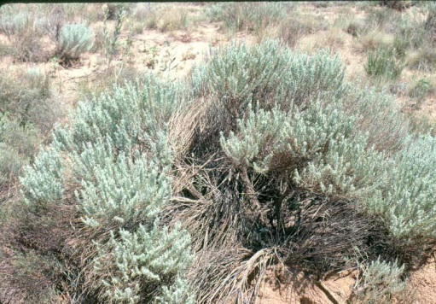
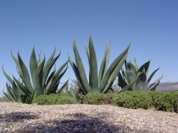
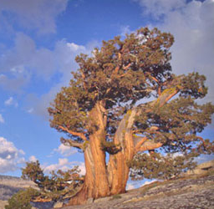







Southwest
Map
Jack
rabbit
sagebrush
agave
juniper
Bob cat
Mesquite tree
cactus
Coral snake
mesa
pronghorn
antelope
canyons
Climate/Land | Very hot and dry in desert. Cold in mountains. flat mesas
Plants | Cactus; mesquite tree; sagebrush, agave: corn: beans, juniper
Animals | Jackrabbit; bobcat; coral snake; coyote, pronghorn antelope, bison
Click here for more

Slide 14
More on the Southwest
Map
Some of the Southwest have tall mountains and deep canyons where rivers flow. The riverbeds are made of clay.
The Grand Canyon is in the Southwest.
Pine forests grow on the mountains.
In the south is mostly desert with sagebrush and cacti. Days can be very hot and nights, very cold. There is not much rain.
The most important foods for the Southwest people were corn, beans, pumpkins and squash.

Slide 15










Northeast
Map
Cranberry
bog
caribou
moose
White tail deer
Atlantic Ocean
grizzly bear
birch
tree
Climate/Land | Warm summers and cold winters. High mountains. Land is flat with some hills.
Plants | cranberry bogs; corn, beans, and squash; fir trees (pine); birch, maple, beech, elm, ash, chestnut, hemlock, and oak trees
Animals | Moose, caribou, white tail deer, squirrel, rabbit, beaver, porcupine, grizzly bear, and turkey
Click here for more

Slide 16
More on the Northeast
Map
It rains often in the Northeast so plants and crops grow very well. There were often heavy snowstorms in the winter.
Trout, bass, salmon, perch, pike, eels, and turtles could be found in streams, rivers, and lakes. Lakes also attracted migrating geese, ducks, and swans.
Wild rice plants grew near the edges of lakes. Women would paddle their canoes to gather the rice.
Northeast Native Americans celebrated a good corn harvest during the Green Corn Festival in late summer. Each spring the people of the Northeast celebrated a Strawberry Thanksgiving

Slide 17







Great Basin
Map
Climate/Land | Very hot and dry in desert; cold in mountains. little rain; lakes; rivers
Plants | Cactus, Joshua tree, sagebrush, nuts, berries
Animals | Puma, mule deer, snakes, lizard, antelope, buffalo, salmon, eagle, hawk
Click here for more

Slide 18
More on the Great Basin
Map
The Great Basin got its name because it is a region between two mountain ranges. The rivers there do not flow to the ocean. It is like a giant bowl.
Flatlands have salty soil and sand. Little grows there but sagebrush. It is very dry and desert like, but cold.
Piñon nuts, agave paste, berries, wild onion and carrots were often eaten.

Slide 19









Great Lakes
Map
Climate/Land | Summer hot and humid and winter cold and snowy; Mostly woodlands, Appalachian mountains; Great Lakes (Huron, Ontario, Erie, Michigan and Superior)
Plants | Corn, squash, beans, maple trees; tobacco; hemlocks; birch trees; Cedar
Animals | Deer, bear, fish; shellfish
Click here for more

Slide 20
More on the Great Lakes
Map
Lake water surrounds the region.
Tobacco was used in ceremonies.
The Great Lakes region has rivers, streams, lakes, and, most of all, trees and plants.
Wild rice grew along the lakes. Women paddled birch bark canoes along the edges of the lakes. They bent the wild rice plants over the canoe and hit the plants so the rice fell into the boat.

Slide 21
Bibliography
"Learn About Native Americans." Index. N.p., n.d. Web. 14 Oct. 2014.
Adil, Janeen R. The Northeast Indians: Daily Life in the 1500s. Mankato, MN: Capstone, 2006. Print.
Englar, Mary. The Great Plains Indians: Daily Life in the 1700s. Mankato, MN: Capstone, 2006. Print.
Englar, Mary. The Southwest Indians: Daily Life in the 1500s. Mankato, MN: Capstone, 2006. Print
Peterson, Judy Monroe. The Northwest Indians: Daily Life in the 1700s. Mankato, MN: Capstone, 2006. Print.
Slusher-Haas, Kathy Jo. The Southeast Indians: Daily Life in the 1500s. Mankato, MN: Capstone, 2006. Print

