Slide 1
Native American Indian
Geographical Regions
Land, Climate, Plants, Animals
Revised in 2013
Next

Slide 2
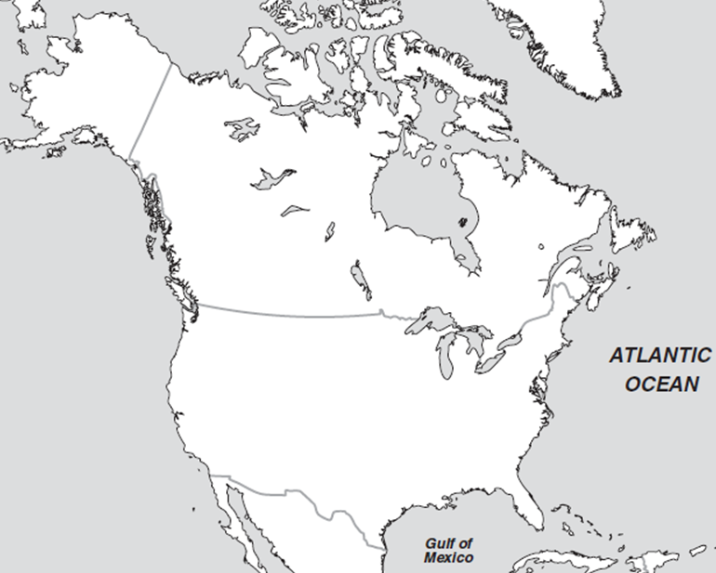
Regional Map
Click on your region
Arctic
Northwest
Northeast
Great Basin
Great Lakes
California
Great Plains
Southwest
Southeast

Slide 3
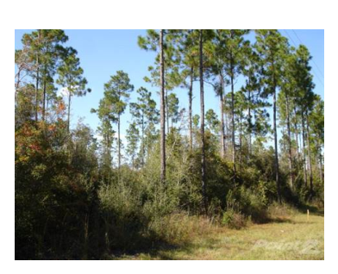
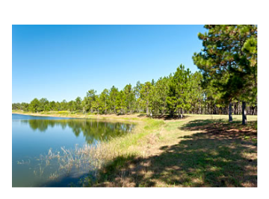
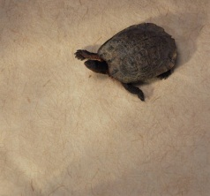
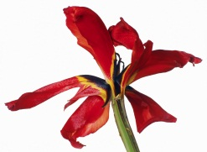
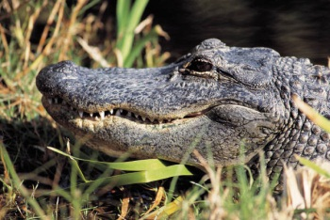
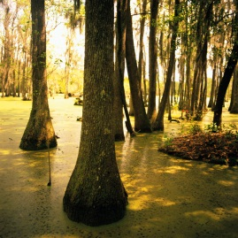
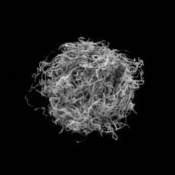
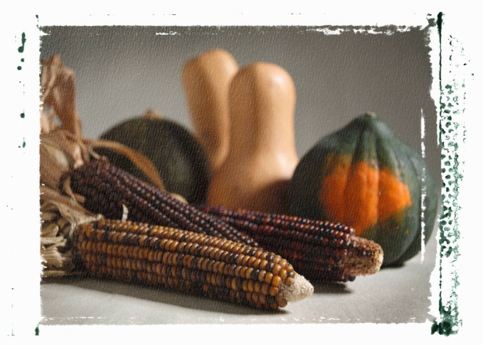
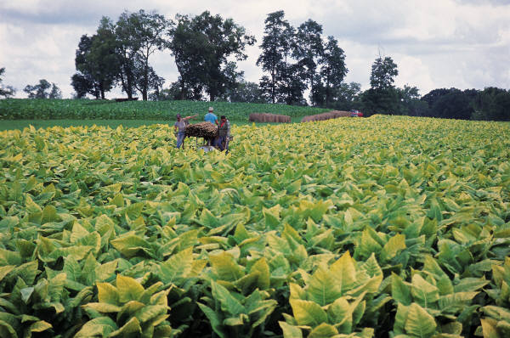
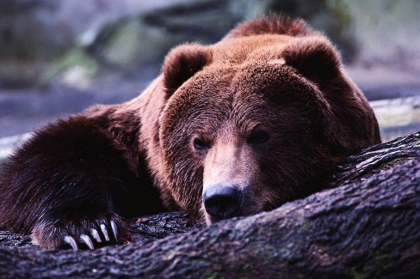
Southeast
Map
Climate/Land | Hot; Humid/ Appalachian Mountains, swamps, woodlands, Mississippi River Valley
Plants | Everglades, cypress, Spanish moss, red iris flower, wild rice, tobacco, corn, beans, squash
Animals | Alligator, turtle, blue heron, deer, turkey, duck, bear, and fish
Click here for more

Slide 4
More on the Southeast
Map
There is a great deal of rain in the southeast. The soil is good for growing crops. Native Americans grew corn and tobacco. Tobacco was used in ceremonies.
The cypress tree grows in swamps. The roots of the tree grow out of the water and look like knees.
Spanish moss grows on the limbs of trees in the south.
Deer were very important to southeast Native Americans.

Slide 5
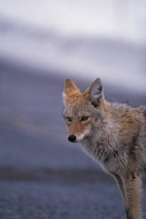
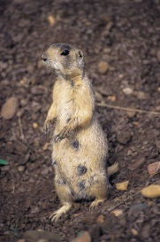
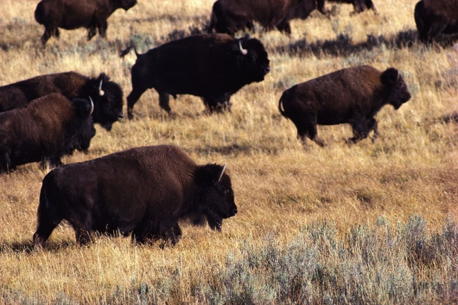
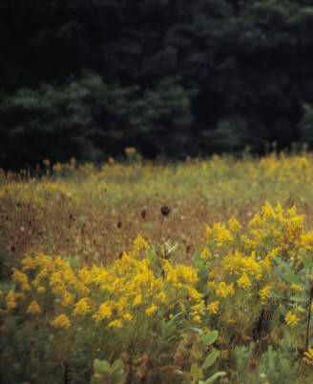
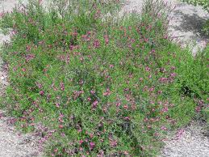
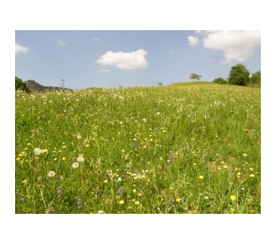
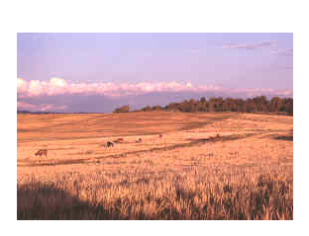
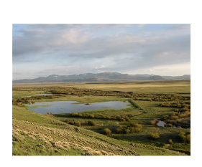
Great Plains
Map
Climate/Land | Rainfall varies; high winds at times; warm summers and cold winters. Blizzards in winter/ land is flat; lakes, rivers, few trees
Plants | Grasses, sage, goldenrod, corn, beans, nuts, berries
Animals | Buffalo, coyote, prairie dog
Click here for more

Slide 6
More on the Great Plains
Map
The Great Plains are a huge grassland. Snow covers the ground in winter and it gets very cold. It can be very hot in the summer. There are downpours of rain that last only a few minutes.
There are rivers and streams, but very few trees. The trees grow near the rivers.
Wildflowers were used to make medicine to cure stomach aches and headaches.
Buffalo were very important to the Plains Native Americans. They used every part of the buffalo.

Slide 7
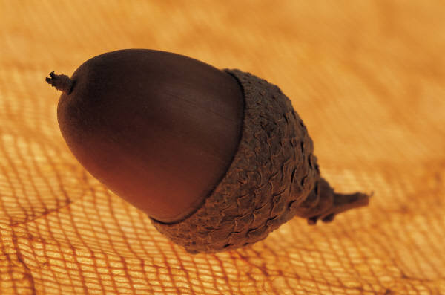
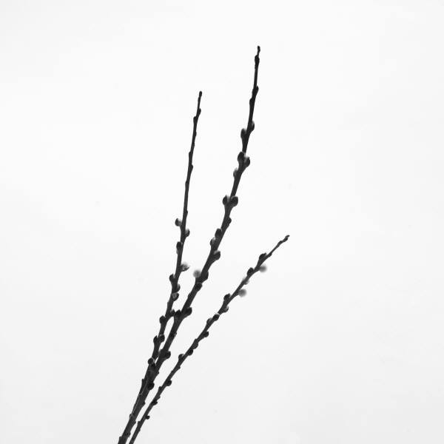
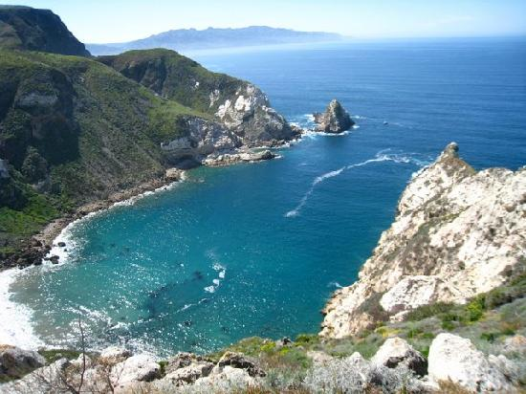
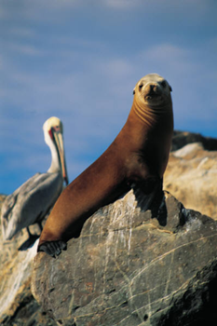
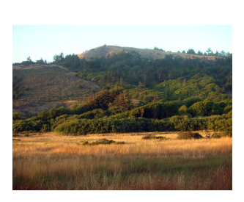
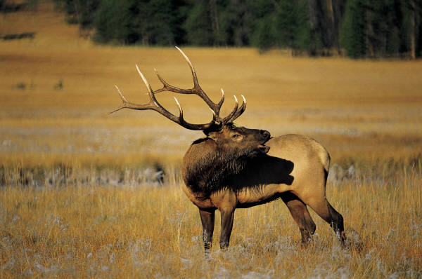
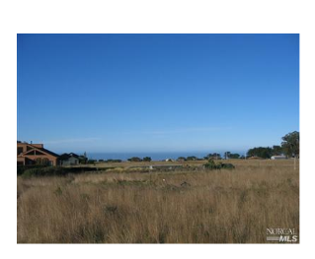
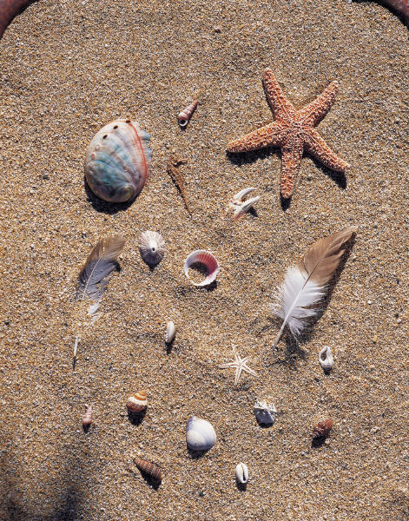
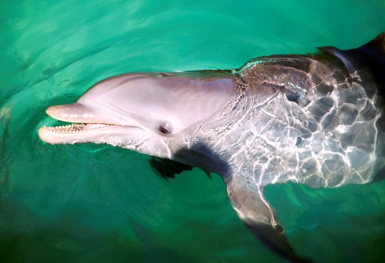
California
Map
http://www.tripadvisor.com
Climate/Land | Southern California is sunny and warm/Pacific Ocean, beaches, dunes, small islands, mountains. rivers
Plants | Acorns, grains, willow
Animals | Seals, whales, elk, deer, rabbits, porpoise, abalone
Click here for more

Slide 8
More on California
Map
Acorns from oak trees were one of the main foods for the California and people. The nuts were gathered in baskets.
Plants provided much of the food for the people. Piñon nuts, berries, wild onion and carrots were often eaten.
The ocean was another place to find food.

Slide 9
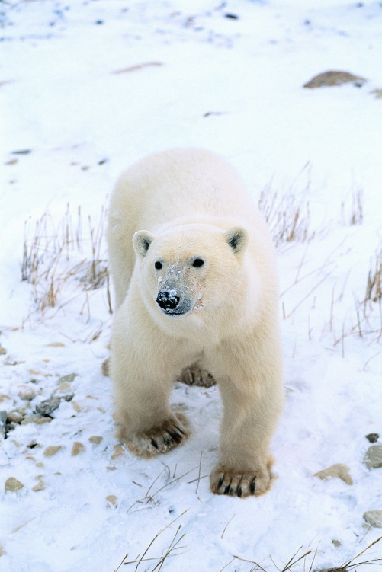
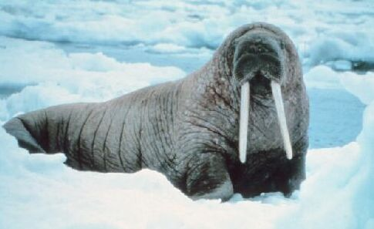
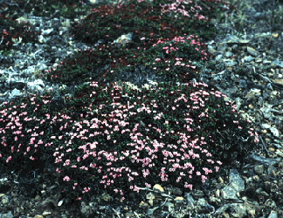
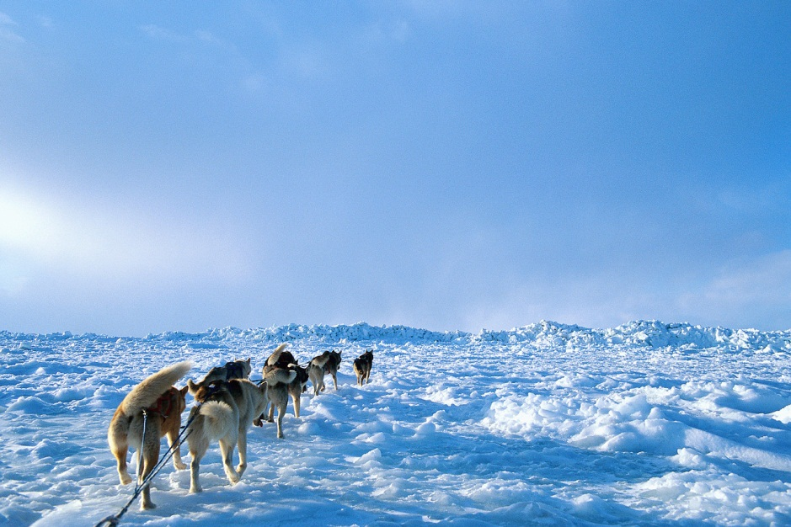
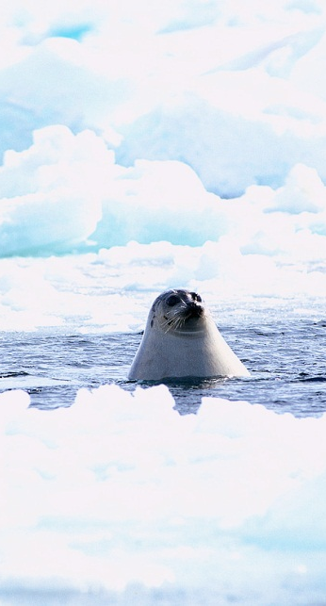
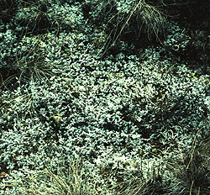
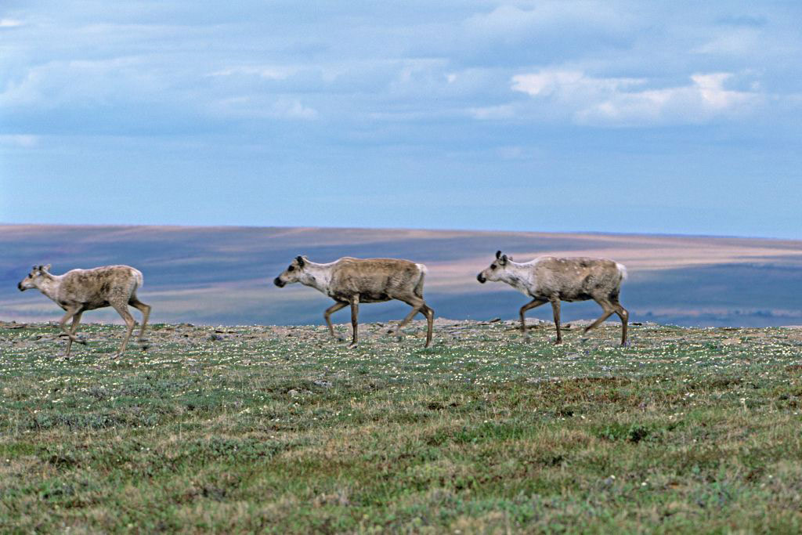
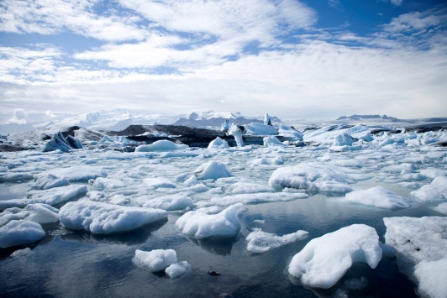
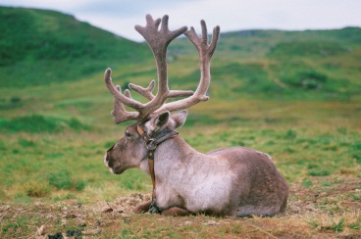
Arctic
Map
http://www.roebuckclasses.com
Climate/Land | Cold. Icy winters with little daylight; everything freezes; Ocean, lakes, streams; blizzards, flat land
Plants | Berries, small shrubs, lichen
Animals | Seals, walrus, polar bears, caribou, trout
Click here for more

Slide 10
More on the Arctic
Map
The Arctic is in northern Canada, Alaska and Greenland.
Some Inuit moved inland in the summer to gather food like berries.
In the fall, most of the animals went south, to warmer weather. Some Inuit moved their tribes to the shore in winter to hunt sea animals.
Some people call the Inuit, Eskimos. It means “meat eaters”. The Inuit prefer the name Inuit which means “the people”.

Slide 11
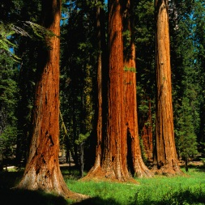
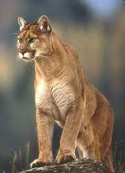
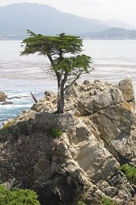

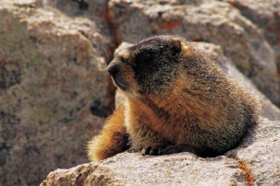
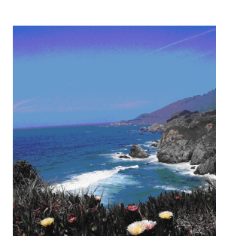
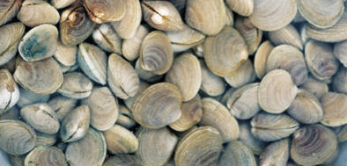
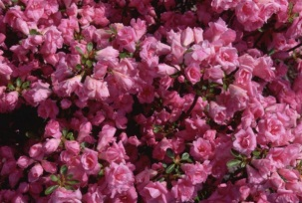
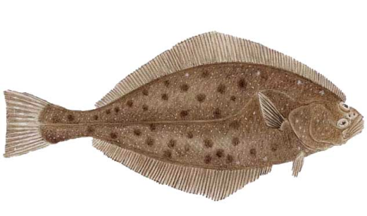
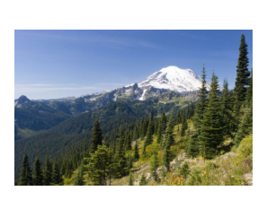
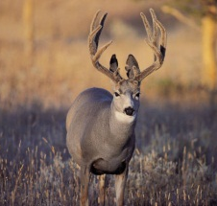
Northwest
Map
http://www.nps.gov
Climate/Land | Cool summer and wet, cold winters, sometimes snow/ High mountains; some flat land; forest; inlets and islands; Deep canyons (warmer), and fast rivers and streams
Plants | Giant redwood tree, Monterey Cypress, azaleas, and a variety of berries, wild carrot and potato, bitterroot, and camas root
Animals | Deer, elk, puma, mountain goat, pronghorn antelope, marmot, rabbits, squirrels, bear, and salmon
click here for more

Slide 12
More on the Northwest
Map
Cedar trees were the most important tree in the forest for the people of the Northwest. Almost everything was made from wood .
Salmon was a very important food. Whole villages set up camp by rivers when the salmon were swimming up the river in the spring to lay their eggs.
Oysters and clams were picked up on the beach.
Native Americans of the Northwest gathered all the food they needed for the whole year in spring and summer.

Slide 13
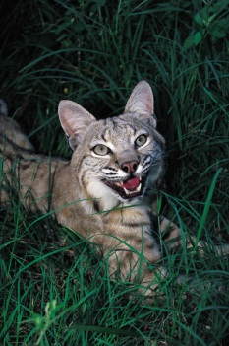
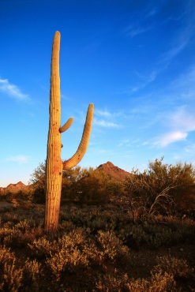
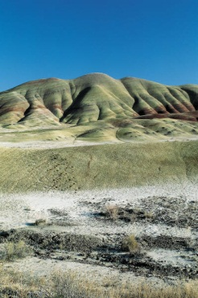









Southwest
Map
http://findmeacure.com
Climate/Land | Very hot and dry in desert. Cold in mountains. flat mesas
Plants | Cactus, mesquite tree, sagebrush, agave, corn, beans, juniper
Animals | Jackrabbit, bobcat, coral snake, coyote, pronghorn antelope, bison,
Click here for more

Slide 14
More on the Southwest
Map
Some of the southwest have tall mountains and deep canyons where rivers flow. The riverbed are made of clay.
The Grand Canyon is in the southwest.
Pine forests grow on the mountains.
In the south is mostly desert with sagebrush and cacti. Days can be very hot and nights, very cold. There is not much rain.
The most important foods for the southwest people were corn, beans, pumpkins and squash.

Slide 15







Great Basin
Map
Climate/Land | Very hot and dry in desert; cold in mountains. little rain; lakes; rivers
Plants | Cactus, Joshua tree, sagebrush, nuts, berries
Animals | Puma, mule deer, snakes, lizard, antelope, buffalo, salmon, eagle, hawk
Click here for more

Slide 16
More on the Great Basin
Map
The Great Basin got its name because it is a region between two mountain ranges. The rivers there do not flow to the ocean. It is like a giant bowl.
Flatlands have salty soil and sand. Little grows there but sagebrush. It is very dry and desert like, but cold.
Piñon nuts, agave paste, berries, wild onion and carrots were often eaten.

Slide 17







Great Lakes
Map
Climate/Land | Summer hot and humid and winter cold and snowy; Mostly woodlands, Appalachian mountains; Great Lakes (Huron, Ontario, Erie, Michigan and Superior)
Plants | Corn, squash, beans, maple trees; tobacco; hemlocks; birch trees; Cedar
Animals | Deer, bear, fish; shellfish
Click here for more

Slide 18
More on the Great Lakes
Map
Lake water surrounds the region.
Tobacco was used in ceremonies.
The Great Lakes region has rivers, streams, lakes, and, most of all, trees and plants.
Wild rice grew along the lakes. Women paddled birch bark canoes along the edges of the lakes. They bent the wild rice plants over the canoe and hit the plants so the rice fell into the boat.

Slide 19








Northeast
Map
Climate/Land | Not too hot or very cold. High mountains. Land is flat with some hills.
Plants | Cranberry bogs; fir trees (pine); birch, maple, beech, elm, ash, chestnut, hemlock, and oak trees
Animals | Moose, caribou, white tail deer, squirrel, rabbit, beaver, porcupine, and bear
Click here for more

Slide 20
More on the Northeast
Map
Trout, bass, salmon, perch, pike, eels, and turtles could be found in streams, rivers, and lakes.
Lakes also attracted migrating geese, ducks, and swans
There was ample rain for crops. There were often heavy snowstorms in the winter.

