Slide 1
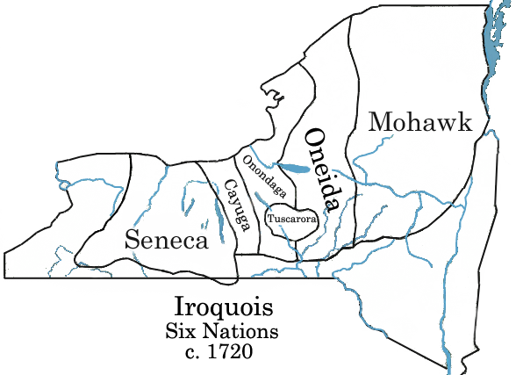
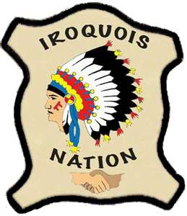
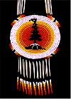
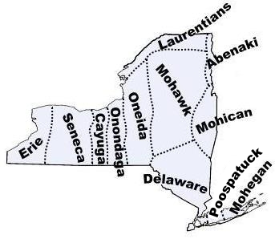
Northeast Woodland Iroquois
Parker, Braeden, Amika, Sophia.D

Slide 2
All about the Natural Resources
Land forests dry/moist | Plants and Animals trees bear turkey
Bodies of Water Mohawk river lake ontario Mississippi river | Climate warm in summer Cold in the winter rain in spring

Slide 3
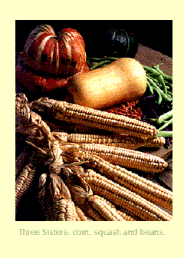
Food
Women gathered berries and honey, also nuts.
Men hunted turkey, also bear , and fish.
Women and men got water from rivers and lakes and also the ocean. Women also got wild rice. and fished trout salmon. Men in the winter would hunt not fish.
Every day they would
Drink strawberry jucie

Slide 4
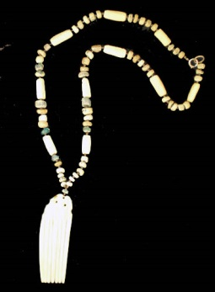
Clothing
“Women decorated their clothing with porcupine quills”. The men wore neckless of hawk claws. The women also wore clothing of deer skins. The Iroquois made clothing from natural materials. Men and women had winter robes of bear, buffalo or elk hide.

Slide 5
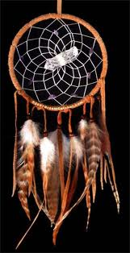
Traditions
The Iroquois believed that everything everywhere had a spirit. They held ceremonies to celebrate all the seasons. “They held a ceremony for when the first ear’s of corn were ready to harvest.” “They also believed that Sky Woman fell through a hole in the sky.” “A flock of geese-like spirits saw Sky Woman falling.” “The geese placed Sky woman on the back of the Great Turtle.
This is a picture of a campfire. It was important to my tribe because during the green corn ceremony they used campfires to cook there food to help celebrate. They would dance around the campfire happily.

Slide 6
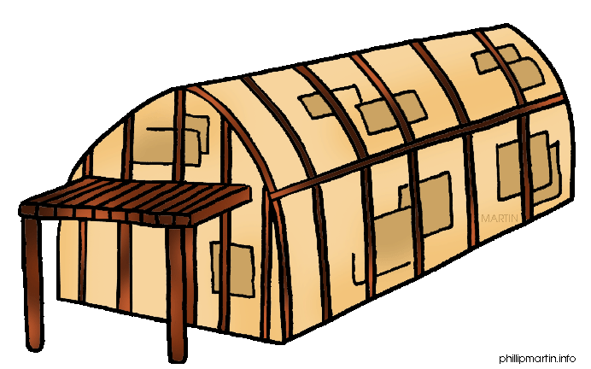
Shelter
The Iroquois used trees to build houses called longhouses or wigwams (sometimes). 2 materials that they used were elm trees and oak trees. “Most people in the Iroquois tribe lived in their villages almost all year.” Longhouses can be even longer than a football field and 20 feet to 6 meters.”

Slide 7
Bibliography (Work Cited)
E-books and Books we used:+
Englar, Mary. The Iroqouis, The Six nations. New York: Capstone Press, 2003.
Adil, Janeen. The Northeast Indians. Minnesota: Capstone Press, 2006.
Gainers , Richard. IROQUOIS. Minneapolis: ABDO, 2000.

