Slide 1
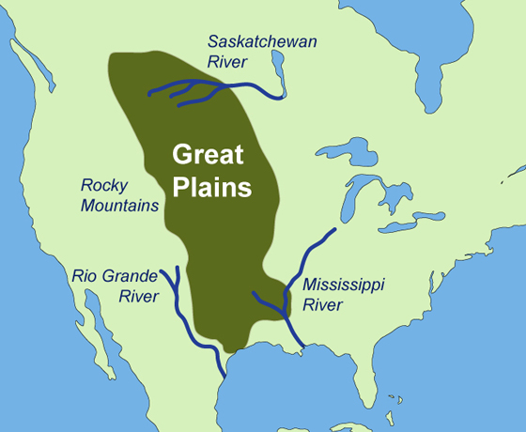
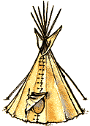
Great Plains Sioux
Sophia S , Jarratt , Owen

Slide 2
All about the Natural Resources
Land They lived in the Black Hills of South Dakota and the woodlands and flat prairies. They also lived in the forests in the mountains. | Plants and Animals They had deer and wild turkey but also they had wild horses, buffalo, wolfs , coyotes , They had daises, sunflowers , wild berries, corn crops,
Bodies of Water streams, rivers, ponds | Climate They had cold winters in the plains.

Slide 3
Food
Some of the foods they ate were buffalo sausage, dried meat into powder, jerky pemmican, berries, moose, elk , deer, rabbit, pronghorn, quail, bison, corn , beans, squash, sunflowers, and fish. They hunted with bows and arrows and spears.

Slide 4
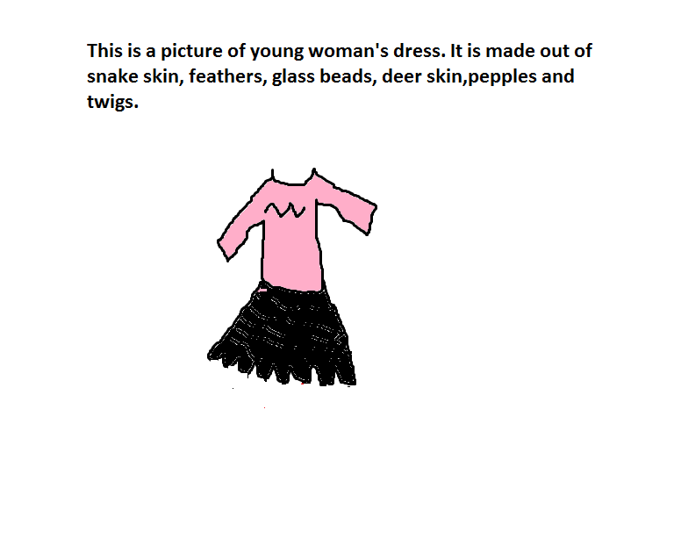
Clothing
Men wore short leggings made out of buffalo skins , Also with bird feathers in their hair.
They made clothes from different animals in their home land.
Young women wore short skirts made out of deer skins and buffalo skins.
Also for shirts they wore deer skin shirts and glass beads attached to their shirts. The animal skins kept them warm in the cold winters.
They wore paint from smeared berries.

Slide 5
Traditions
The Sioux believed that the earth, sun, and sky had spirits. They believed that they needed to protect nature and keep peace with nature.
Some men danced to honor their promises to the spirits.
Most Sioux tribes hold a sun dance.
Singers and drummers performed as people danced.

Slide 6
Bibliography (Work Cited)
E-books and Books we used:
Englar, Mary. The Great Plains Indians. Minnesota: Capstone Press. 2006.

