Slide 1
Southwest Region Pueblo
Harry, Maggie, Annie, Bradley

Slide 2
All about the Natural Resources
Land They had canyons, deserts, and mountains. They also had mesas which were flat land on top of a hill. | Plants and Animals Plants where very scarce and it was dry so there weren’t very many. They had deer, buffalo, rabbit, and bear. They also had wild nuts and berries.
Bodies of Water The had the Rio Grande River but not many others. They were in a mostly dry region. | Climate It was hot because it was the desert. Summer temperatures reaching over 100 degrees.

Slide 3
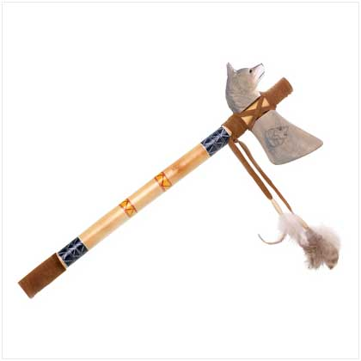
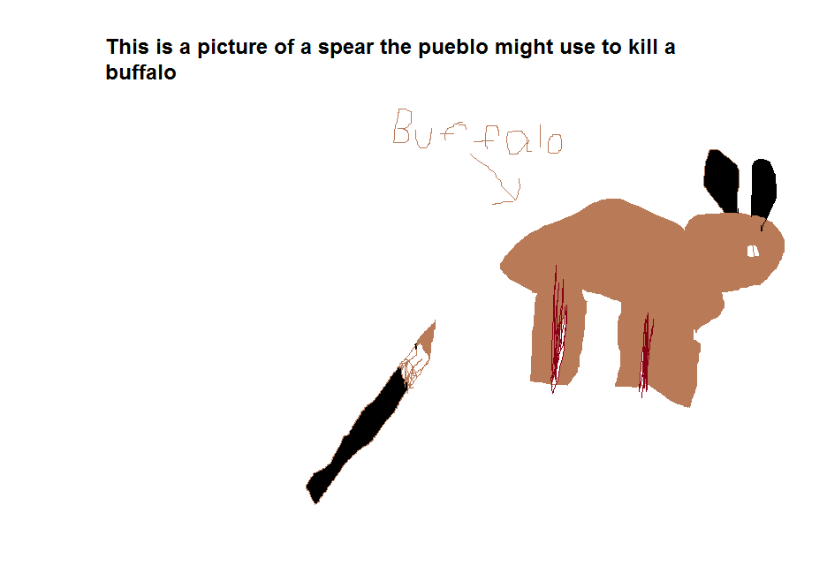
Food
They hunt deer, rabbit, buffalo and other furry animals.
Some vegetables they ate are corn and beans also squash.
Some other foods they ate are wild nuts and berries
The pueblo used stone knifes to kill there food

Slide 4
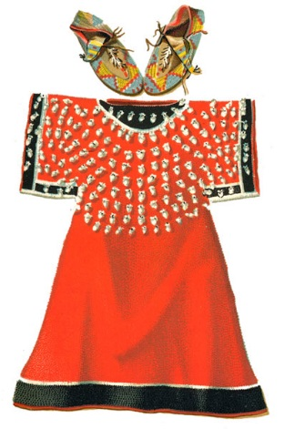
Clothing
They made there clothing out of cotton.
They wore beaded necklaces.
The women did the weaving.
They also made there clothing out of deerskin and cloth.

Slide 5
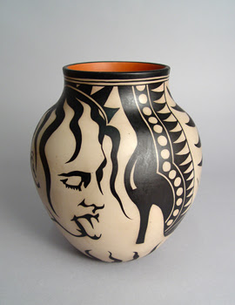
Traditions
The Pueblo believe that spirits live in everything, even rocks.
One dance is called the kasha rainbow dance.
A kachina was the living spirit form of a certain thing.
The Pueblo babies were carried on cradleboards.

Slide 6
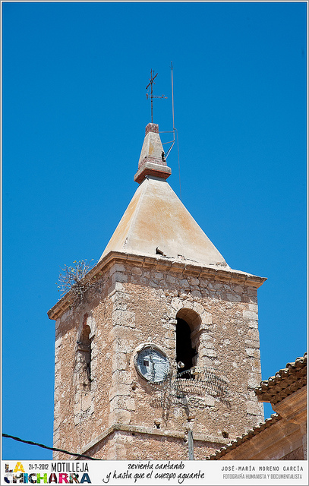
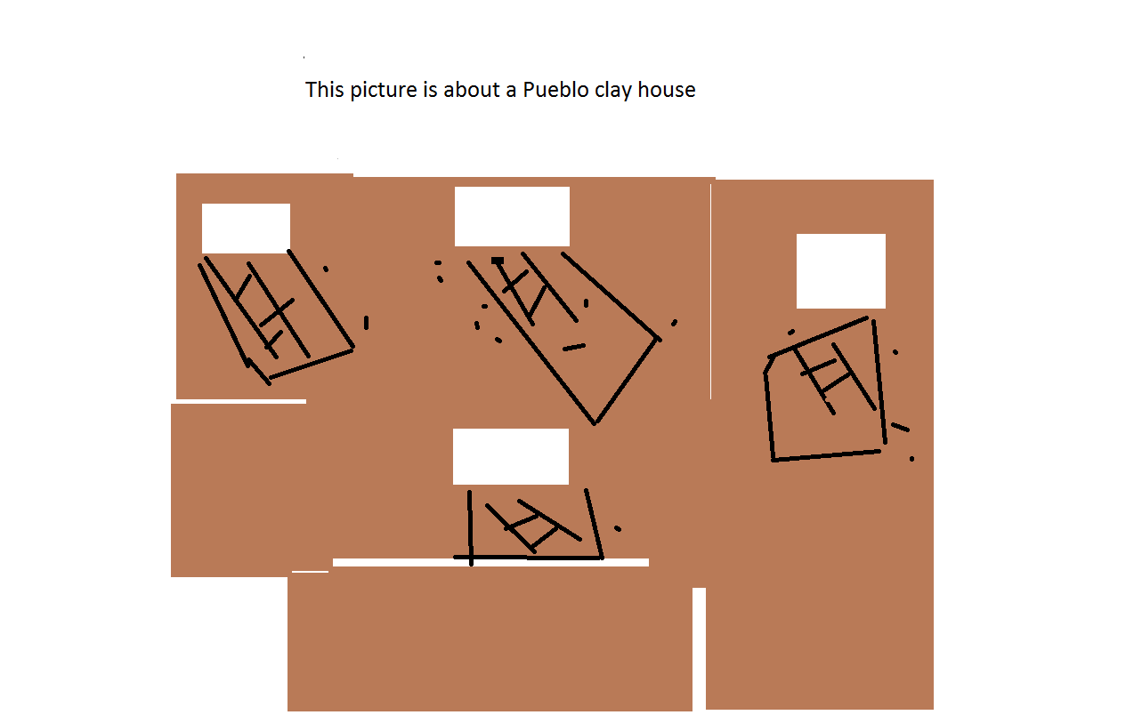
Shelter
Mud held bricks and blocks in place. They also used stone covered with think mud and clay fro the earth.
Pueblo houses were simple homes.
Pueblo people often used ponderosa pines to hold kiva roofs.
The Pueblo Indians made good use of the small space that they had in there homes.

Slide 7
Bibliography (Work Cited)
E-books and Books we used:
Press, Petra. The Pueblo. Compass Point Books. 2001.
Prezzler, June. Pueblos, USA. Capstone Press. 2005.

