Slide 1
Northeast Woodland Iroquois
By: Addison, Devin, Olivia, Jacob, and A.J.

Slide 2
All about the Natural Resources
Land Plenty of rain fell on their land Some land is flat and some hills and mountains. | Plants and Animals Deer , bear, turkey, rabbit, beaver, squirrel, and porcupine Maple, beech, elm, ash, oak, chestnut, birch, pine, and hemlock trees covered their land. Lots of bushes and shrubs
Bodies of Water Many of streams and rivers flow into lakes In Lake Ontario there are trout, pike, perch, bass, salmon, turtles, and eels | Climate In the winter there are heavy snowstorms In the summer it is very hot They have seasons like us

Slide 3
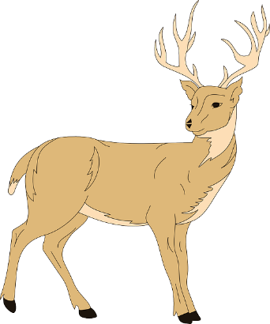
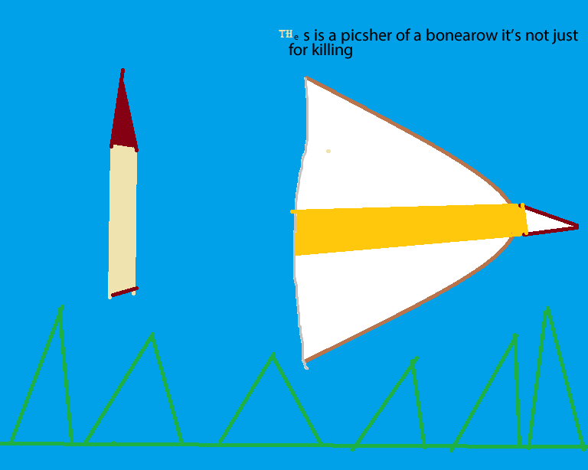
Food
The Iroquois set snares (trap) to catch rabbits, squirrels, beavers, ducks, and geese.
The Iroquois gathered wild leeks, berries, nuts, and squash.
This is a picture of a bow and arrow. A bow and arrow is used for hunting animals for food.
This is a picture of a bow and arrow. It was very important to the tribe because they killed a lot of different animals with bow and arrows to survive.

Slide 4
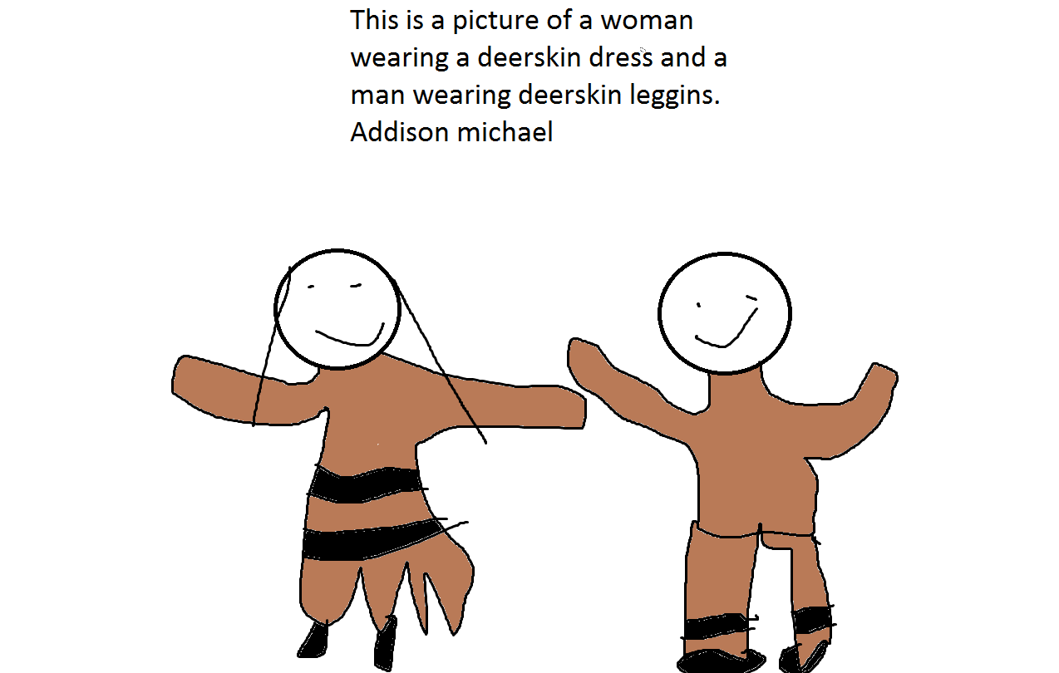
Clothing
Iroquois made clothing from natural materials like furs, elk, and deer hides.
Women wore deerskin, dresses, or long deerskin blouse with a skirt or knee high leggings and moccasins.
Men wore a tanned leather breechcloth. It wrapped around their waist and hung down in the front and back. They also wore deerskin leggings.
Children wore clothes similar to adults. Babies wore a diaper made from the fat end of a cattail.
Addison Michael
Deerskin
Leggings

Slide 5
Traditions
The Iroquois made Wampum which was used as money. They traded it with other tribes to get things they didn’t have.
Men and women were called keepers of the Faith.
This is a wampum. It was important to the tribe because it was used for money. They traded it with other tribes for things they needed.

Slide 6
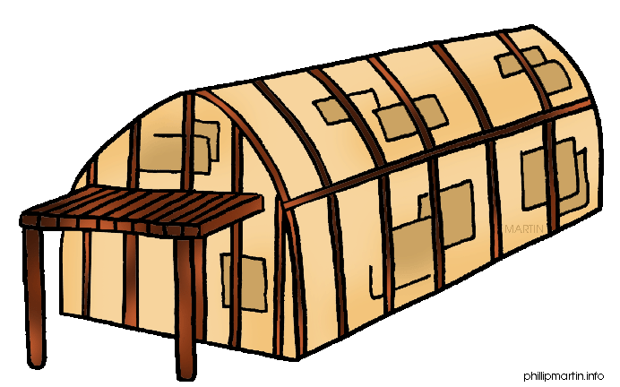
Shelter
A longhouse is made from the bark of elm trees.
A longhouse is 15 to 25 feet high
A longhouse can hold 100 people at one time.
A long house is as big as two foot ball fields.
A longhouse has two doors

Slide 7
Bibliography (Work Cited)
E-books and Books we used: The Iroquois by Richard Gaines. City of Publication: USA . Publishing Company: ABDO Publishing. Copyright Date: 2000

