Slide 1
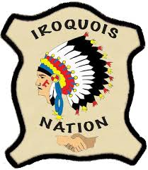
Northeast Woodland Iroquois
By: Addison, Devin, Olivia, Jacob, and A.J.

Slide 2
All about the Natural Resources
Land Plenty of rain fell on their land Some land is flat and some hills and mountains. | Plants and Animals Deer , bear, turkey, rabbit, beaver, squirrel, and porcupine Maple, beech, elm, ash, oak, chestnut, birch, pine, and hemlock trees covered their land. Lots of bushes and shrubs
Bodies of Water Many of streams and rivers flow into lakes In Lake Ontario there are trout, pike, perch, bass, salmon, turtles, and eels | Climate In the winter there are heavy snowstorms In the summer it is very hot They have seasons like us

Slide 3
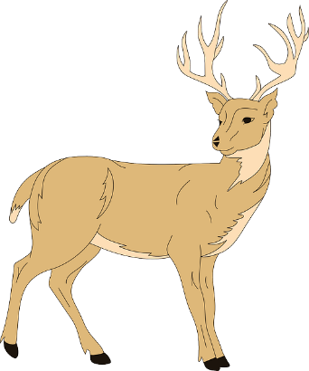
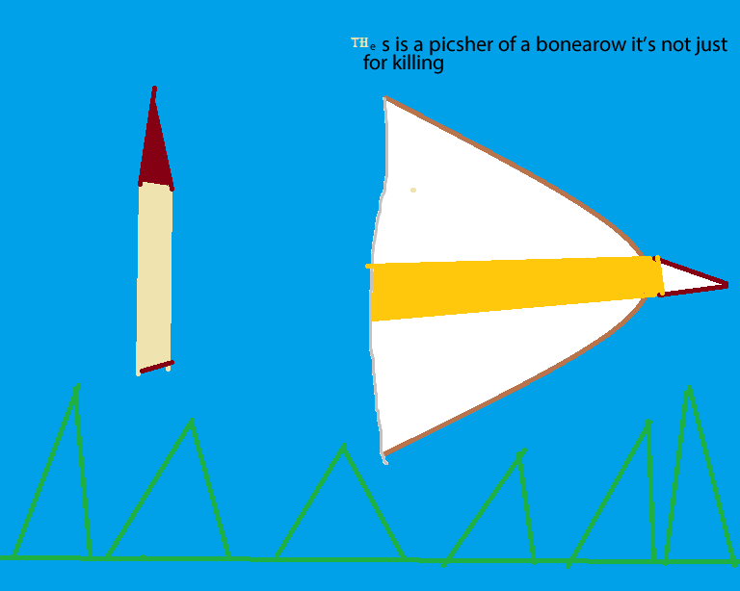
Food
The Iroquois set snares (trap) to catch rabbits, squirrels, beavers, ducks, and geese.
The Iroquois gathered wild leeks, berries, nuts, and squash.

Slide 4
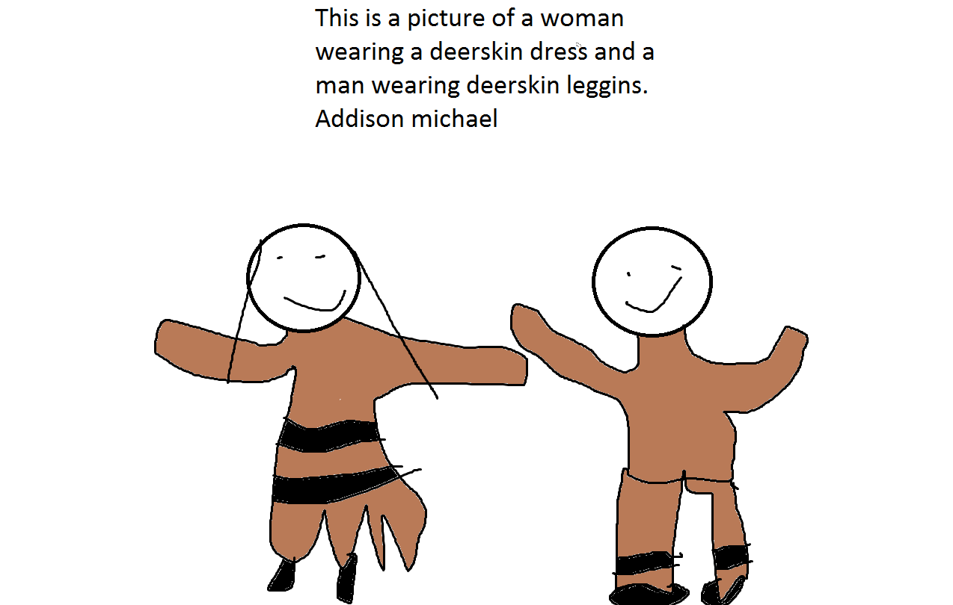
Clothing
Iroquois made clothing from natural materials like furs, elk, and deer hides.
Women wore deerskin, dresses, or long deerskin blouse with a skirt or knee high leggings and moccasins.
Men wore a tanned leather breechcloth. It hung down in the front and back and they wore deerskin leggings.
Children wore clothes similar to adults. Babies wore a diaper made from the fat end of a cattail.

Slide 5
Traditions
The Iroquois made Wampum is used as money, they gave it to other tribes to get things they don’t have.
Men and women were called keepers of the Faith.

Slide 6
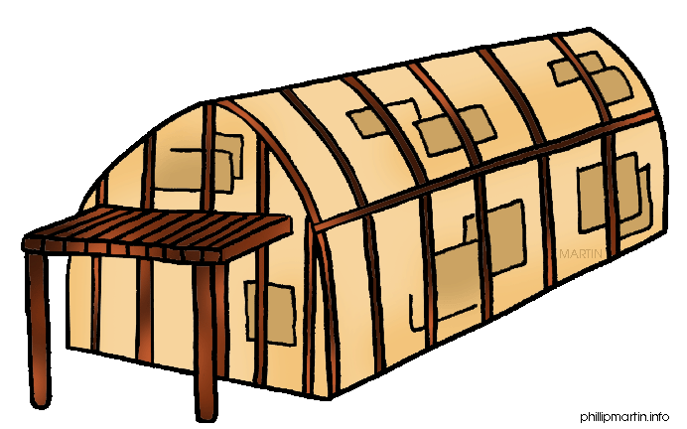
Shelter
A Longhouse is made from Elm tree.
A Longhouse is 15 to 25 feet high
A Longhouse can hold 100 people at one time.
A Long house is as big as two foot ball fields.
A Longhouse has two doors

Slide 7
Bibliography (Work Cited)
E-books and Books we used: The Iroquois by Richard Gaines. City of Publication: USA . Publishing Company: ABDO Publishing. Copyright Date: 2000

