Slide 1
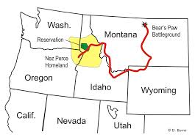
North West Coast Nez Perce
By Mikayla, Natalie, Cole and Steven

Slide 2
All about the Natural Resources
Land Rocky mountains Forested Mountains Grassy fields Lots of plants canyons | Plants and Animals Sock eye salon Killer whales Strawberries Elderberries Black berries Wild carrot Huckleberries Wild potato Camas Deer Elk Bear Mountain goats Buffalo Snake Birds Fish Bison Rabbits Squirrels And later horses
Bodies of Water River Lake Streams | Climate Warm in summer Cold in winter which made it hard to travel

Slide 3
Food
Some of the food the Nez Perce ate was salmon, strawberries, elderberries, blackberries, huckleberries, gooseberries, bitterroot, wild carrots, wild potato, camas, deer, elk, bear, mountain goats, buffalo, snake, birds, killer whales, fish, snake river sock eye salmon. These foods all came from the land or rivers. They also trapped rabbits, and squirrels.

Slide 4
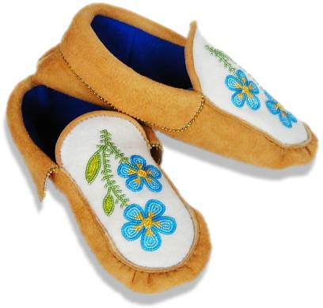
Clothing
Some of the clothing they wore were buckskin fringed shirts, breech cloths, leggings, gloves, and moccasins, which were often decorated with rosettes, porcupine quills, elk teeth, shells ,glass beads. They also wore sea otter coats. They made blankets with geometric designs.
This is a picture of moccasins. It was very important to the tribe because they covered and protected their feet.

Slide 5
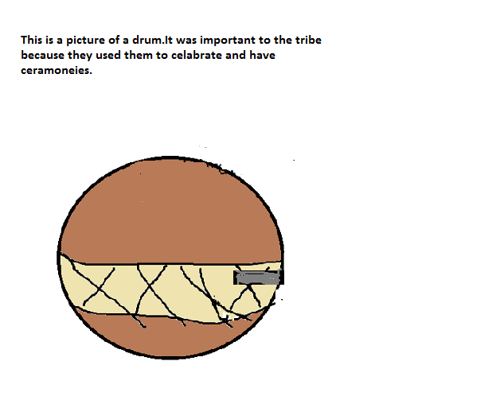
Traditions
This is a picture of a drum. It was important to the tribe because they used them to celebrate and have ceremonies.
These are the traditions of the Nez Perce
Men and woman often painted their faces bright red and yellow before ceremonies.
They named their villages after rivers.
They played games that are kind of like tag.
The head was an elder.
They selected three or four members to sit on the village council along with the leaders.
The dancers wore beautifully decorated clothes at ceremonies.

Slide 6
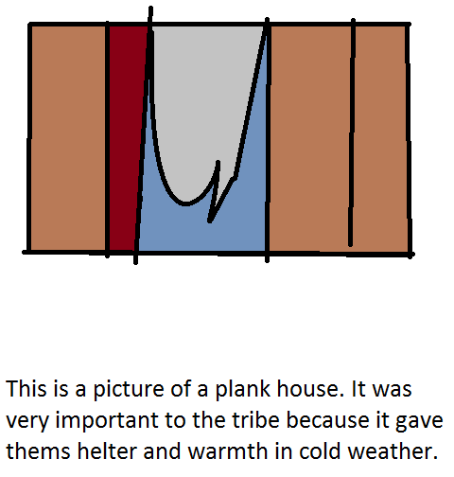
Shelter
The Nez Perce lived in long houses , tipis and pit houses. They were made mostly of wood. They lived in villages. A tribe mostly had two villages, one for the winter and one for the summer.

Slide 7
Bibliography (Work Cited)
E-books and Books we used:
Gaines, Richard. Nez Perce. USA:ABDO Publishing,2000.

