Slide 1
North West Coast Nez Perce
By Mikayla, Natalie, Cole and Steven

Slide 2
All about the Natural Resources
Land Rocky mountains Grassy fields Lots of plants Warm canyons | Plants and Animals Sock eye salon Killer whales Strawberries Elderberries Black berries Wild carrot Bitter root Goose berries Huckleberries Wild potato Camas Deer Elk Bear Mountain goats Buffalo Snake Birds Fish Bison Rabbits Squirrels And later hores
Bodies of Water Rivers Lakes Oceans And swift flowing streams | Climate Warm in the summer And FREEZING in the winter. But it was not like here in C.T. It was so cold that it was hard for the Nez Perce to travel.

Slide 4
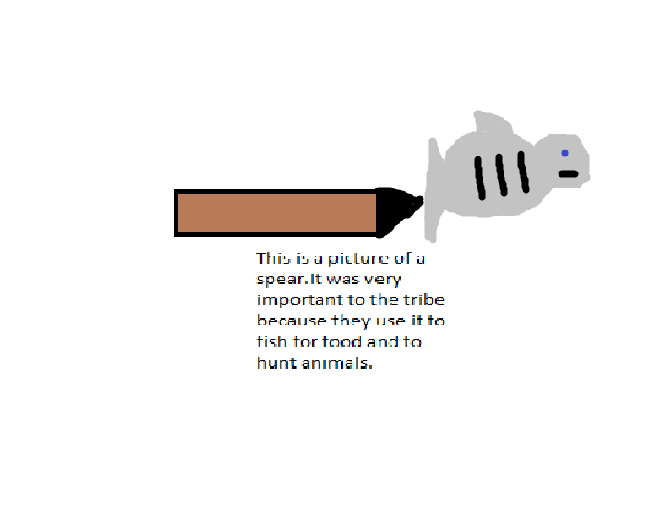
Food
Salmon ,strawberries ,elderberries ,blackberries ,huckleberries ,gooseberries ,bitterroot ,wild carrots ,wild potato ,camas ,deer ,elk ,bear ,mountain goats ,buffalo ,snake ,birds ,killer whales ,fish ,snake river sock eye salmon ,they trapped rabbits ,and squirrels.

Slide 5
Clothing
Fringed shirts, breech cloth, leggings, gloves, moccasins, rosette, porcupine quills, elk teeth , buck skin, woven hats, belts, tusk shells ,glass beads, sea otter coats , geometric designs, chickat blankets.

Slide 6
Traditions
These are the traditions of the Nez Perce
Men and woman often painted their faces bright red and yellow before ceremonies.
They named their villages after rivers.
They played games that are kind of like tag.
The head was an elder.
They selected three or four members to sit on the village council along with the leaders.
The dancers wore beautifully decorated cloths.

Slide 7
Shelter
Plank houses, pit house and tipis gave the Nez Perce shelter
and warmth on long cold nights.

Slide 9
Bibliography (Work Cited)

