Slide 1
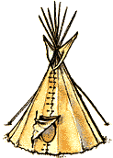
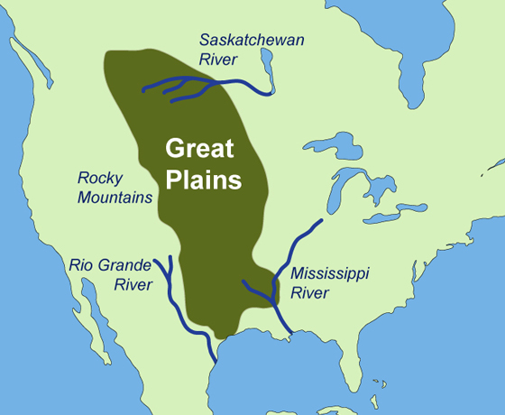
GREAT PLAINS SIOUX
By AVA ,CATE,EVA ,JACK,JARED.

Slide 2
All about the Natural Resources
LAND Most of the Sioux lived near the black hills of South Dakota. The land was flat and there was a lot of open space. | Plants and Animals The Sioux didn’t waste any of the material they got from the common animals such as buffalo and wild boar.
Bodies of Water They also lived along the Mississippi river to the Canadian Saskatchewan river. When describing bodies of water, we can say that there were streams and rivers near the places they lived. | Climate The climate was mild in the summer and spring and cold in the fall and winter. The climate in the Great Plains area was warm in the day and cooler in the night.

Slide 3
Food
The Sioux used buffalo from their environment.
They used horses to hunt buffalo.
They dressed up as wolves to hunt buffalo.
They ate deer but their main food is buffalo and they used all parts of it.
This is a picture of a man hunting with a bow and arrow. He is hunting his food- the buffalo.

Slide 4
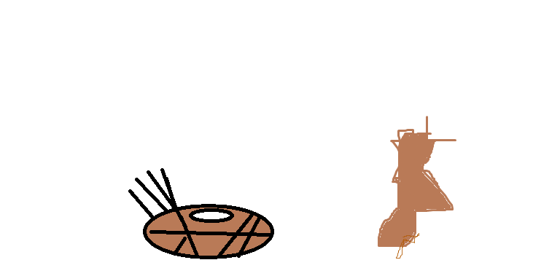
Clothing
Tribes often decorated their clothes. Sioux and Blackfoot Indians used elk teeth to decorate shirts.
They used tough hides from buffalo to make clothes.
The Sioux wore feather headdresses and elk skin dresses.
Moccasins and elk skin made their feet and bodies warm. The elk skin was important because they could make clothing to keep them warm.

Slide 5
Traditions
The Sioux believed that everything in nature had a spirit. Mountains, trees, and rocks were land spirits. Snakes, turtles, and beavers were water spirits. The grizzly bear, elk, and golden eagle were animal spirits. Finally the sun, and thunder were sky spirits.
sometimes

Slide 6
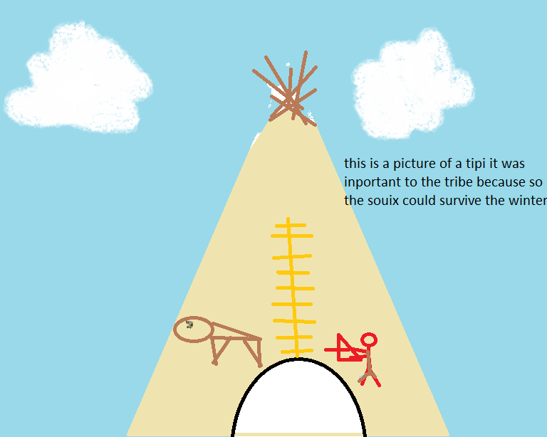
Shelter
The Tipi was important to the Sioux because it was their home and when winter comes they would not survive because there is limited food.`
The Sioux would use buffalo hides for the covering of the tipi.
The Sioux used something called a travois to move the tipi on it so they can move it when the buffalo move.
Wigwams were more popular than the tipi although the tipi was a more efficient home.
There are two flaps on the tipi that are left open so smoke from the fire can escape.
Tepees are mostly home to one family. The most people in one tipi is six people.
This is a picture of a tipi,
It was important to the tribe because the Sioux could be protected and survive the winter.

Slide 7
Bibliography (Work Cited)
E-books and Books we used:
Preszler, June. Tepees. Capstone Press, 2005.
Englar, Mary. Sioux Manlacato , Minnesota. Cappstonepress 2006
Freedman, Russell. Buffalo Hunt. Usa, 1988.
Gaines, Richard. Sioux. USA, Abdo publishing, 2000.
Hagman, Ruth. The Sioux. Canada,1990.

