Slide 1
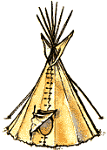
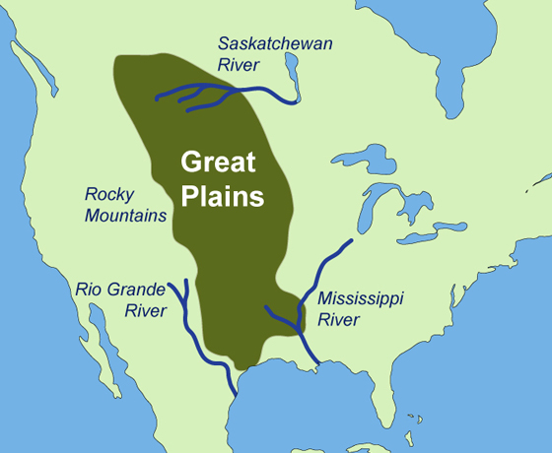
GREAT PLAINS SIOUX
By AVA ,CATE,EVA ,JACK,JARED.

Slide 2
All about the Natural Resources
LAND Most of the Sioux lived near the black hills of South Dakota. The land was flat and there was a lot of open space. | Plants and Animals The Sioux didn’t waste any of the material they got from the common animals such as buffalo and wild boar.
Bodies of Water They also lived along the Mississippi river to the Canadian Saskatchewen river. When describing bodies of water, we can say that there were streams and rivers near the places they lived. | Climate The climate was mild in the summer and spring and cold in the fall and winter. The climate in the Sioux area was warm in the day and cooler in the night.

Slide 3
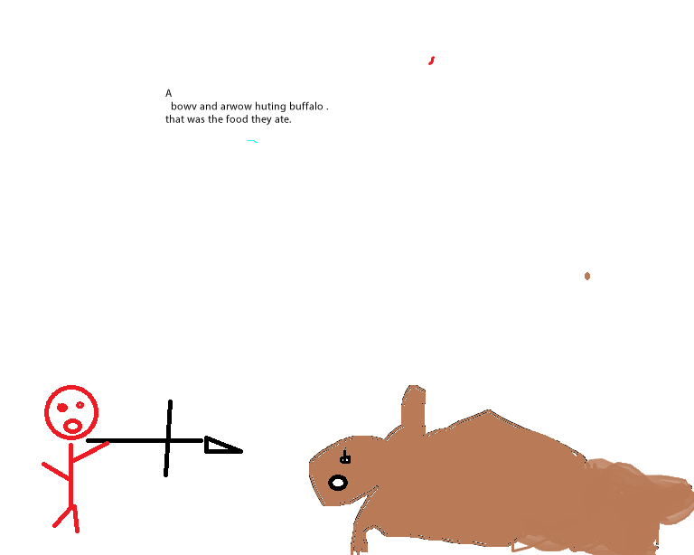
Food
The Sioux used buffalo from their environment.
They used horses to hunt buffalo.
They dressed up as wolves to hunt buffalo.
They ate deer but their main food is buffalo and they used all parts of it.

Slide 4
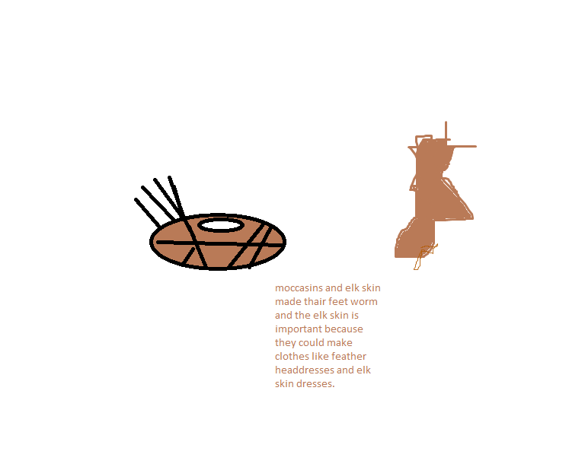
Clothing
Tribes often decorated their clothes Blackfoot Indians used elk teeth to decorate shirts.
They used tough hides to make cloths
The Sioux whore feather headdresses, elk skin dresses.

Slide 5
Traditions
The Sioux believed that everything in nature had a spirit. Mountains, trees, and rocks were land spirits. Snakes, turtles, and beavers were water spirits. The grizzly bear, elk, and golden eagle were animal spirits. Finally the sun, and thunder were sky spirits.

Slide 6
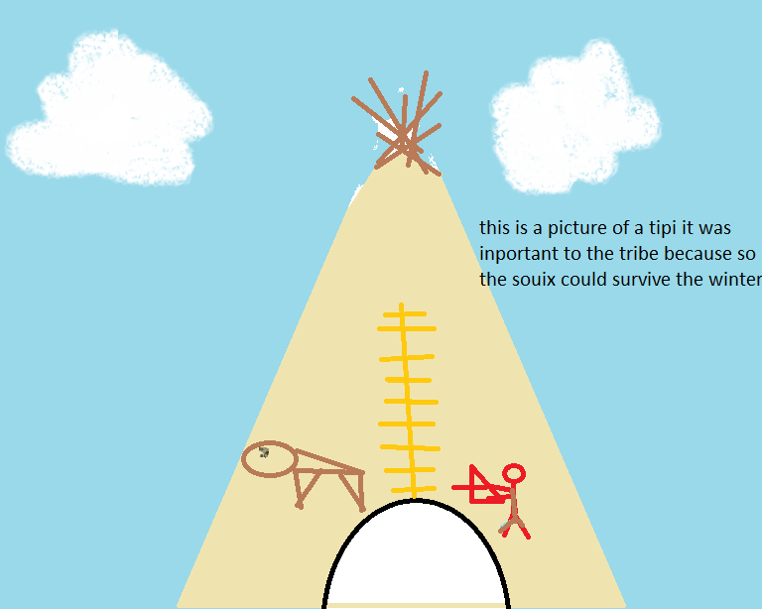
Shelter
The Sioux would use buffalo hides for the covering of the tipi.
The Sioux used something called a travois to and put the tipi on it so they can move it when the buffalo move.
Wigwams were more popular than the tipi although the tipi was more efficient homes.
There are two flaps on the tipi that are let open so smoke from so the fire can escape.
Tepees are mostly home to one family. The max of people in one tipi is six people.

Slide 7
Bibliography (Work Cited)
E-books and Books we used:
Preszler, June. Tepees. Capstone Press, 2005.
Englar, Mary. Sioux Manlacato , Minnesota. Cappstonepress 2006
Freedman, Russell. Buffalo Hunt. Usa, 1988.
Gaines, Richard. Sioux. USA, Abdo publishing, 2000.
Hagman, Ruth. The Sioux.Canada,1990.

