Slide 1
Southwest Pueblo
Mia, Lucas, Sean, and Henry

Slide 2
All about the Natural Resources
Land The land was mostly canyons, mountains, and dry because they were in the desert. | Plants and Animals Some of the animals that lived in this dry region were deer, rabbit, bear, and duck.
Bodies of Water They did not have much water and used the Rio Grande River to drink and wash themselves. | Climate It was hot but they also had a cold winter.

Slide 3
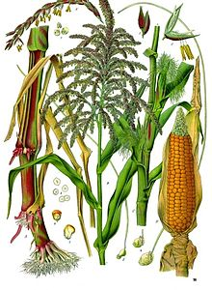
Food
The Pueblo people used dry farming since there was not a lot of water.
The Pueblo people planted veggies deep in washes, or beds which were holes deep in the ground where any water would collect.
They also hunted animals like deer and rabbits.
They had gardens of corn and squash and beans, known as The Three Sisters.

Slide 4
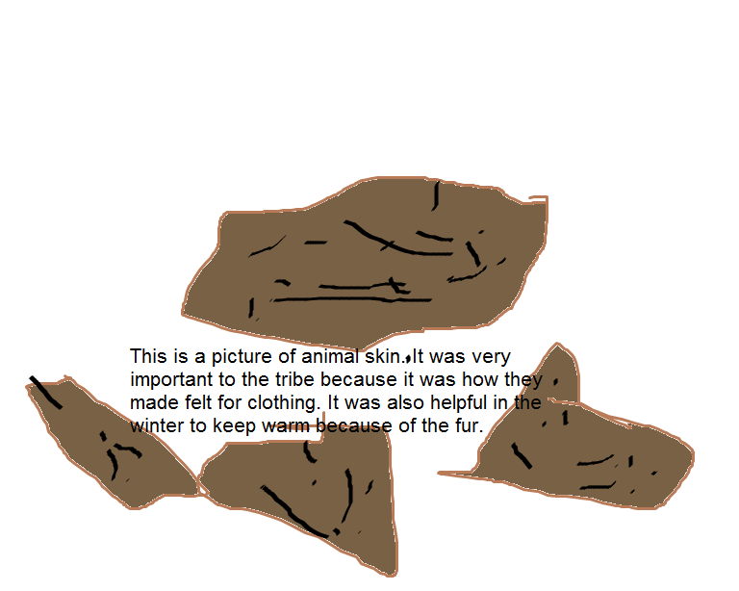
Clothing
Antelope skin was used to make clothing.
Men wore buckskin leggings.
They wore sandals from leaves.
In winter they would wear rabbit fur moccasins.
This is a picture of any kind of animal skin . It was very important to the tribe because it was how they made felt for clothing. It was also helpful in the winter to keep warm because of the fur.

Slide 5
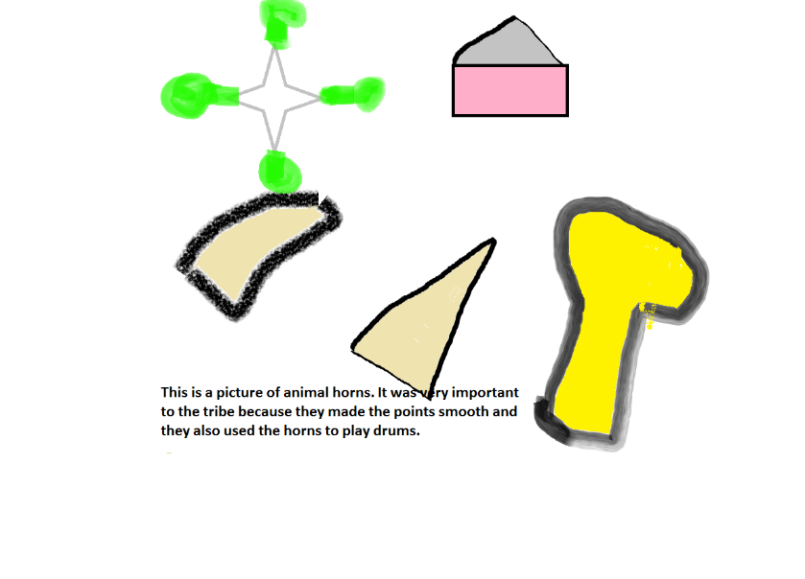
Traditions
The Pueblo Indians held meetings in underground rooms called kivas.
The Pueblo Indians liked to tell stories. They were known to be great story tellers.
The Pueblo people thought that Dawa and Spider Woman created people.
This is a picture of animal horns.It was very important to the tribe because they used the horns to play drums in ceremonies.

Slide 6
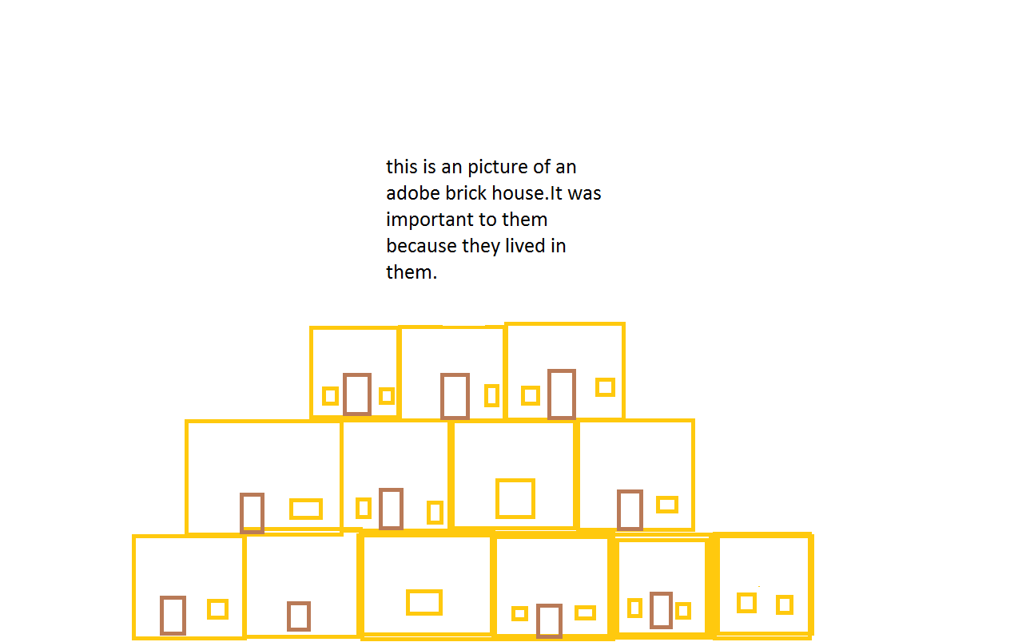
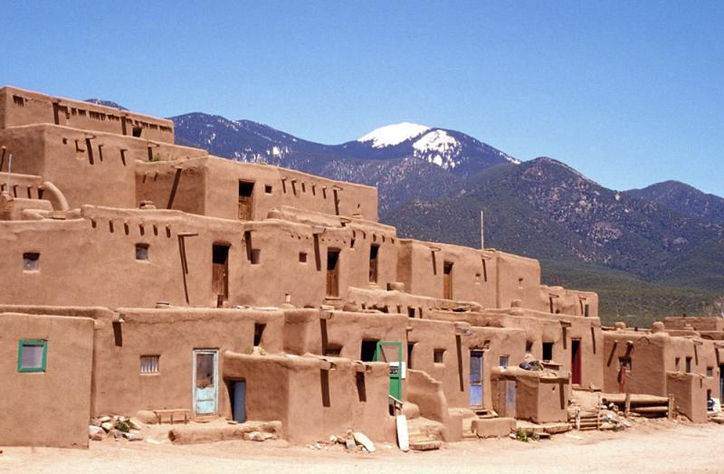
Shelter
The Pueblo Indians made their homes out of bricks with clay, water and straw, which were called adobe bricks.
Walls of houses were made from mud and clay, and lots of layers. The roof and the floors were made of logs that had grass and clay.
Each house had at least one under ground room.
a.

Slide 7
Bibliography (Work Cited)
E-books and Books we used:
Gray-Kahatiiosh, Barbara. Pueblos. USA: ABDO Publishing, 1963.

