Slide 1
Southwest Pueblo
Mia, Lucas, Sean, and Henry

Slide 2
All about the Natural Resources
Land The land was mostly canyons, mountains, and dry because they were in the desert. | Plants and Animals Some of the animals they had were deer, rabbit, bear, and duck.
Bodies of Water They did not have much water and used the Rio Grande River. | Climate It was hot but they also had a cold winter too.

Slide 3
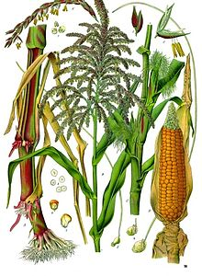
Food
They used dry farming since there was not a lot of water.
The planted veggies deep in washes which were holes deep in the ground.
They also hunted animals like deer and rabbits.
They had gardens of corn and squash and beans.

Slide 4
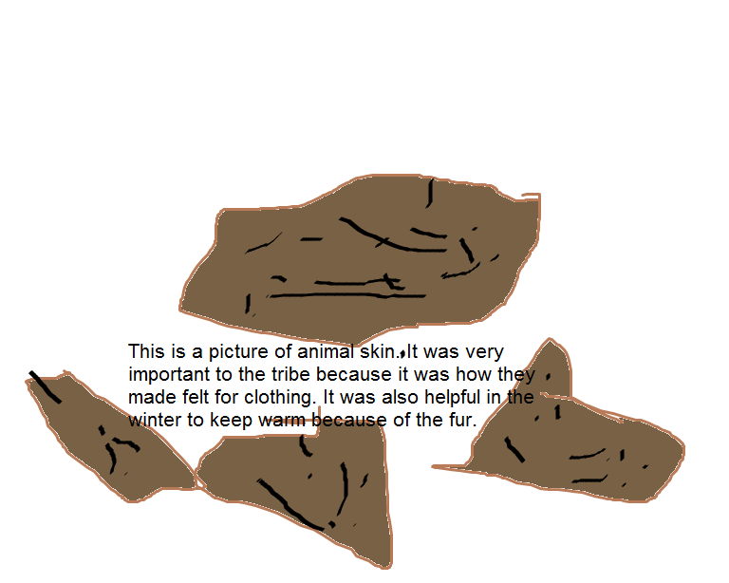
Clothing
Antelope skin was used to make clothing.
Men wore buckskin leggings.
They wore sandals from leaves.
In winter they would wear rabbit fur moccasins.

Slide 5
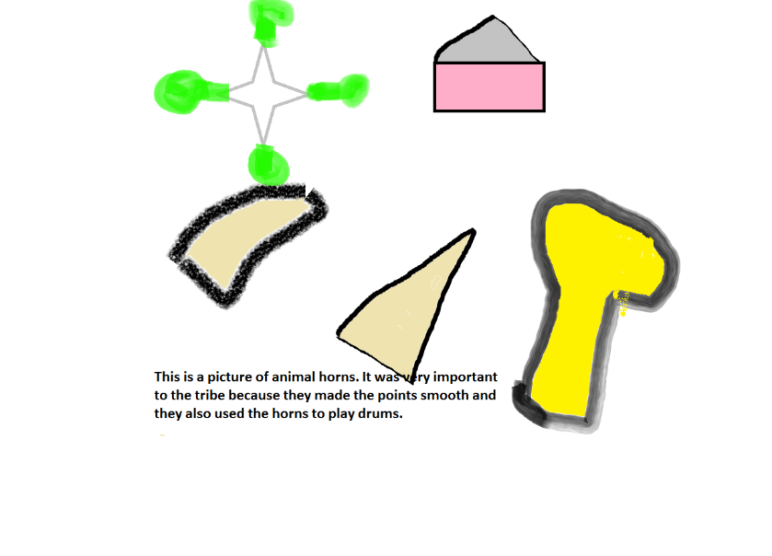
Traditions
The Pueblo Indians held meetings in underground rooms.
The Pueblo Indians liked to tell stories.
The Pueblo people thought that Dawa and Spider Woman created people.

Slide 6
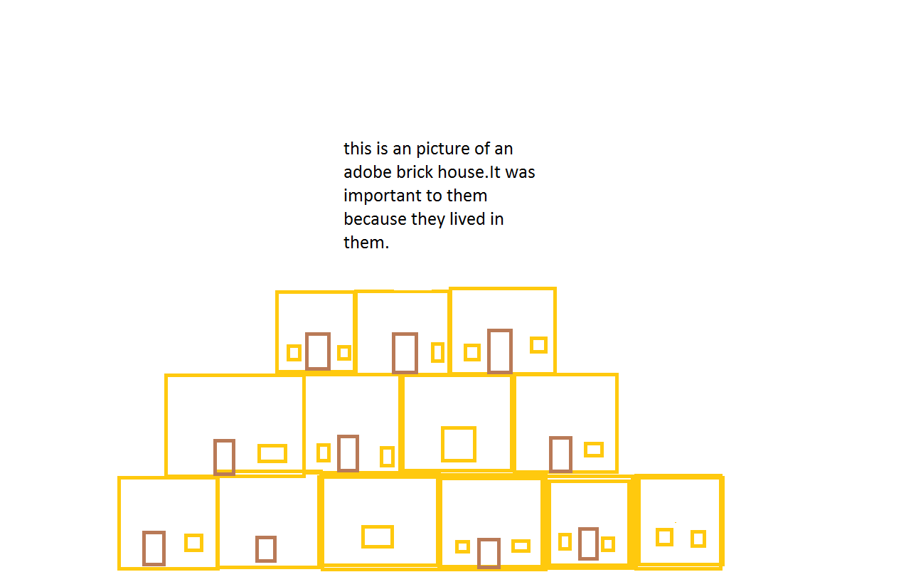
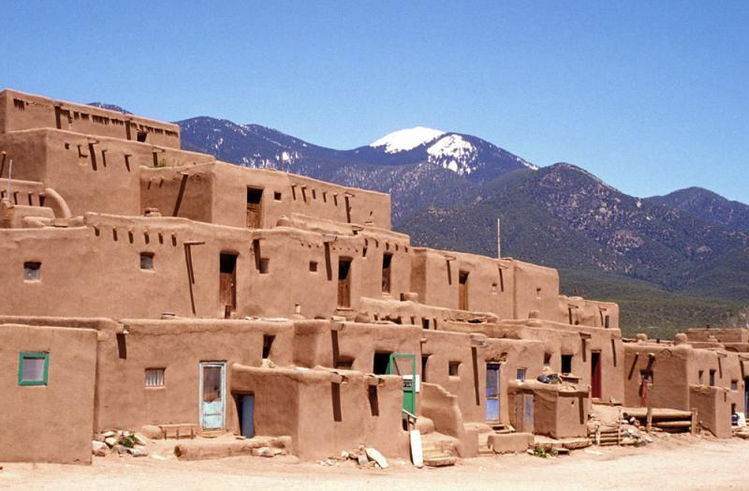
Shelter
Walls of houses were made from mud and clay, and lots of layers. The roof and the floors were made of logs that had grass and clay.
Each house had at least one under ground room.
The Pueblo Indians made their homes out of bricks with clay, water and straw, which were called Adobe bricks.

Slide 7
Bibliography (Work Cited)
E-books and Books we used:
Gray-Kahatiiosh, Barbara. Pueblos. USA: ABDO Publishing, 1963.

