Slide 1
Southeast Region Cherokee
By Clara,Cooper,Andrew and Jack F.

Slide 2
All about the Natural Resources
Land Lived in the Appalachian mountains. They had forests, flat areas and valleys between mountains. The Cherokee hunted in the forests. | Plants and Animals The men went Fishing They made corn bread and stews. Women planted corn, squash and beans.
Bodies of Water They fished in the cold mountains They fished in the many streams and rivers. The streams and rivers were full of fish | Climate In the summer it was warm. In the winter it was cool.

Slide 3
Food
The men hunted turkey, bear and deer with bow and arrows.
The women gathered berries, fruits and nuts from the forest.
The three main foods were corn, beans, and squash.
They made corn bread and stews.
They picked greens and herbs.
The men went fishing.
This is a picture of a bow and arrow. It is important to my tribe because they used it to hunt for food.

Slide 4
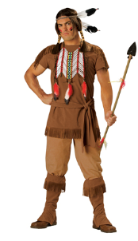
Clothing
This is a picture of a dress. It is very important to the tribe because it made the girls and women warm.
Women and girls wore a skirt wrapped around their waists and shirts.
Men and boys wore only breechcloths.
In the cold winter, men and boys wore only buckskin leggings and shirts.
In the cold winter, the women and girls wore soft skirts and dresses made out of deerskin.
Both men and women wore fur robes to keep warm.
They wore jewelry made of bones , shells and beads.

Slide 5
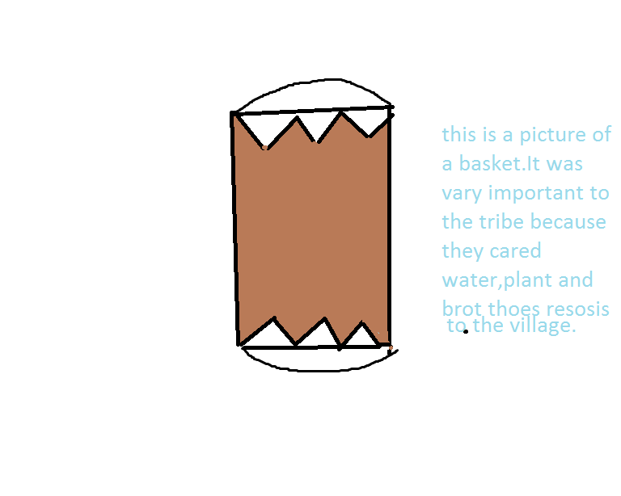
Traditions
The Cherokee were very religious.
They prayed a lot. There were ceremonies before hunting, before they went to war or playing a ball game.
They told stories and they danced a lot.
This is a picture of a basket. It was very important to the tribe because they carried the water , plants and brought those resources to the village.

Slide 6
Shelter
The Cherokee lived in circular homes made of poles, sapling trees, mud and wattle mats.
The Cherokee covered the roof with thatch.
They also used things from the land like mud, animal hair, grass, and clay.

Slide 7
Bibliography (Work Cited)
Gaines, Richard. Cherokee, USA: ABDO Publishing, 2000.

