Slide 1
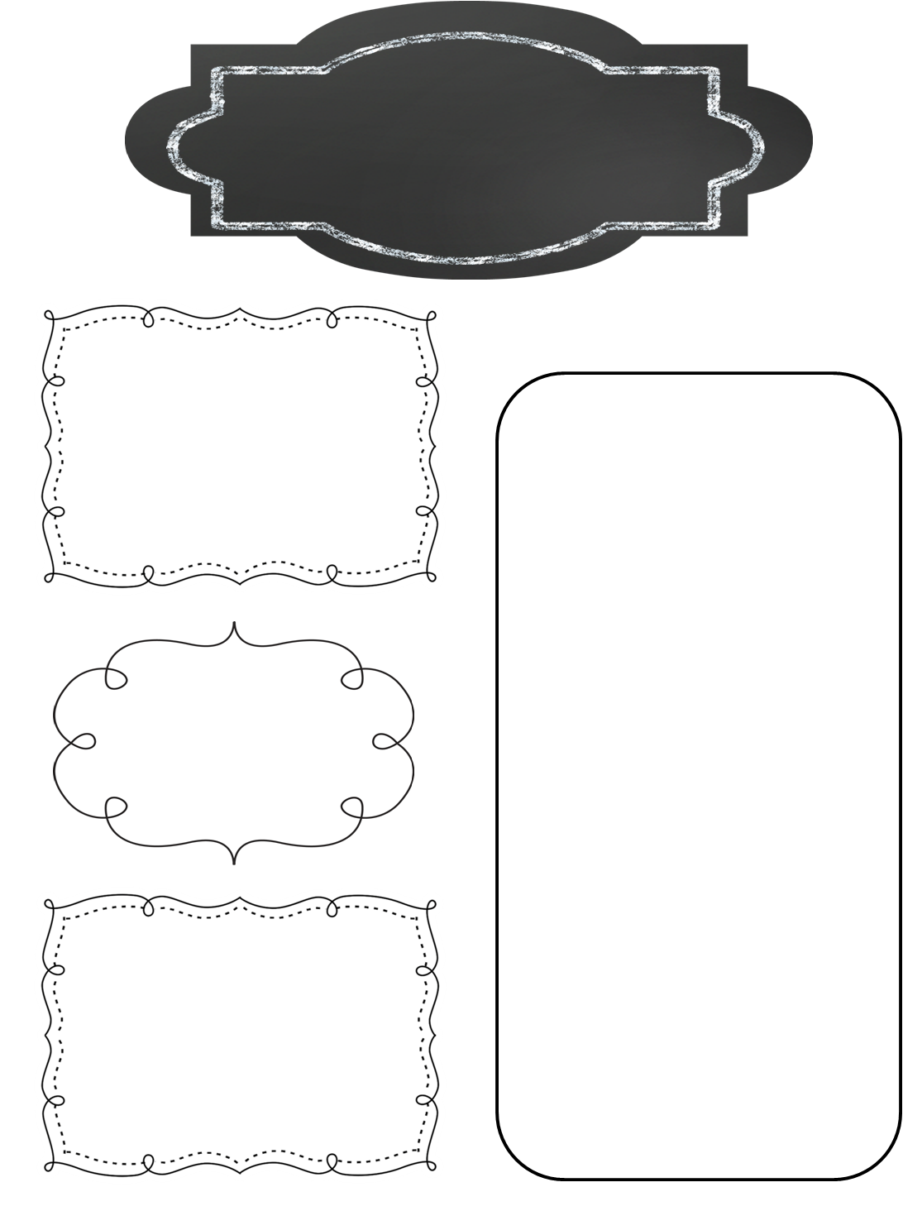
Ms. Hoyt’s
Kindergarten Class
10/14/2016
Reminders
10/18 and 10/20 are early dismissal days. We dismiss at 1:40.
Our first parent conferences are on 10/20. I will send home reminder slips next week.
Reading
We have begun noticing patterns in the words of our books.
We are using the pictures for clues to help us figure out the words.
We shared our favorite books, and talked about our favorite places to read and people to read with!
Book orders are due by Monday at the end of the school day.
Writing
We have been working hard to add at least two labels to each picture.
We are writing sentences about the things we have done.
Writing partners discuss the 3 important things we put in each story: who, what, and where.
The Walk-a-thon was a huge success! The kids had so much fun, and got some great exercise. It was nice to see so many of you there!
Math
We have been comparing numbers to see which is more.
We have begun trying to determine how much more one number is than another.

