Slide 1

Student Tools and
Features
Notes:
Embedded Universal Tools and Online Features

Slide 2
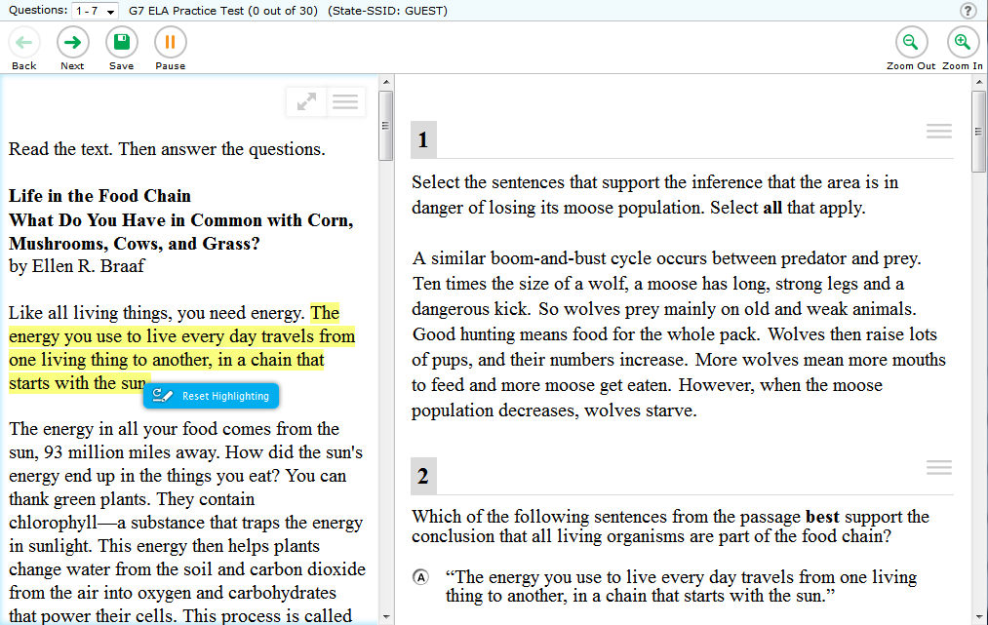

Highlighter
Notes:
Highlighter

Slide 3
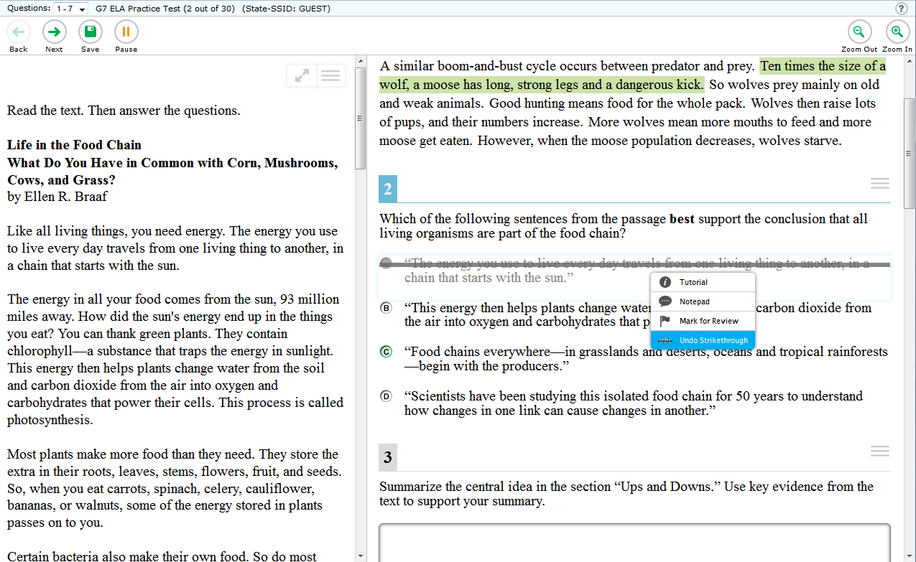
Strikethrough
Notes:
Strikethrough

Slide 4
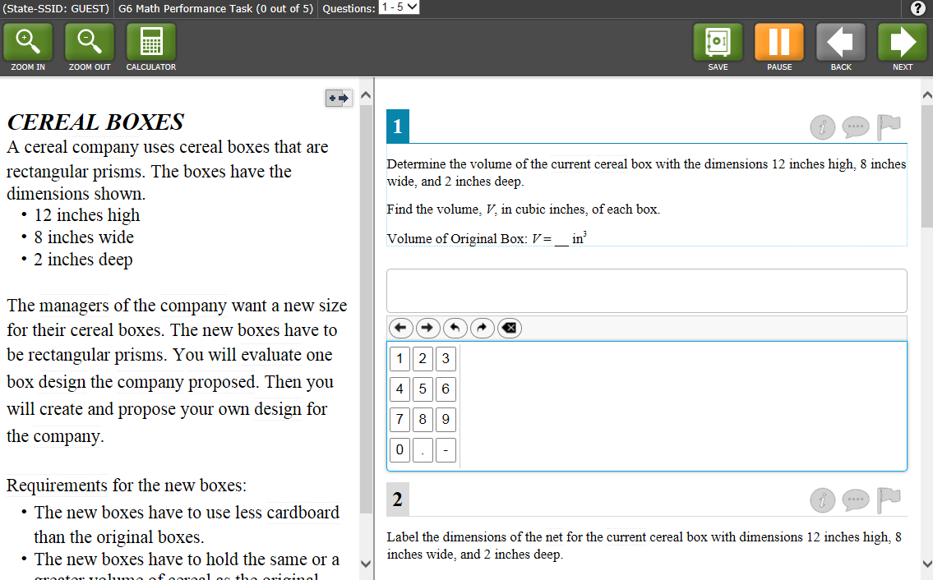
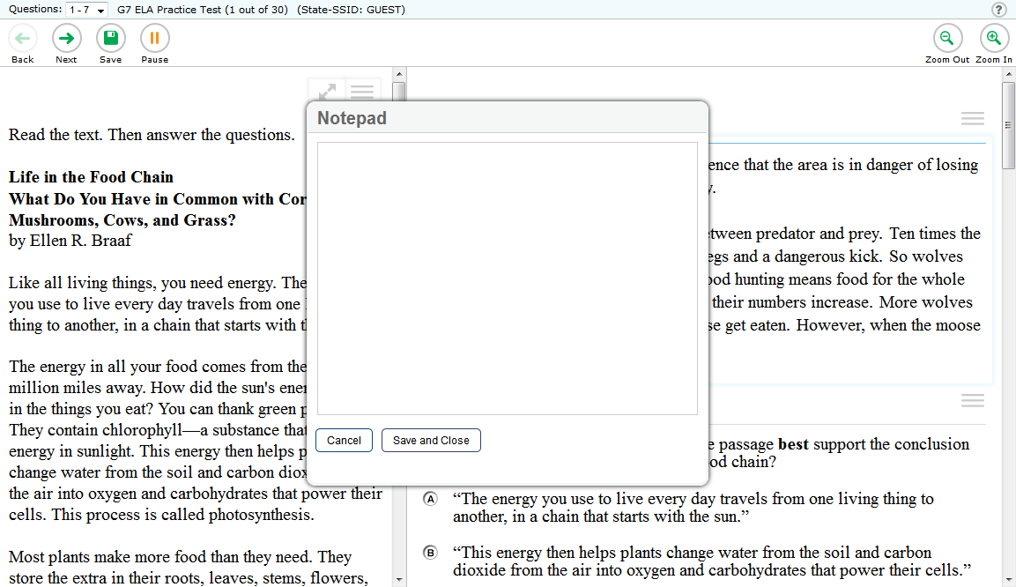
Type your notes here….
Digital Notepad
Notes:
Digital Notepad

Slide 5
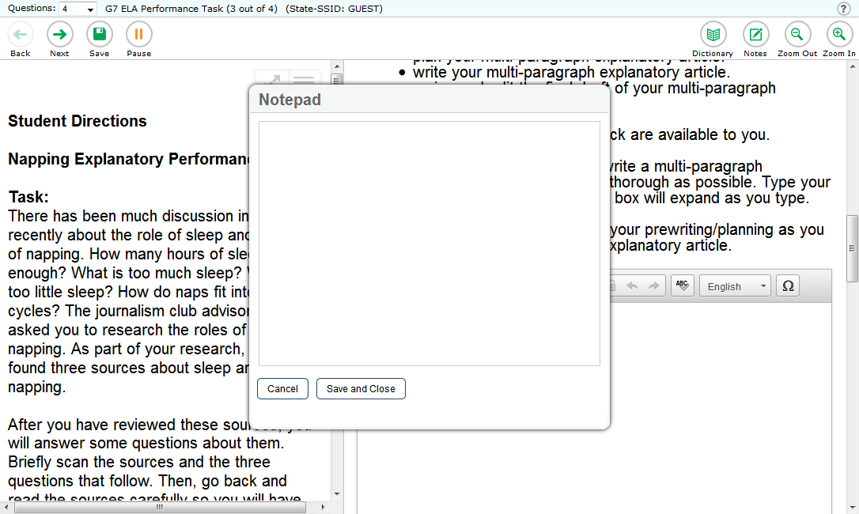
Global Notes for ELA Performance Task
Type your notes here….
Global Notes for ELA Performance Task
Notes:
Global Notes for the ELA Performance Task

Slide 6
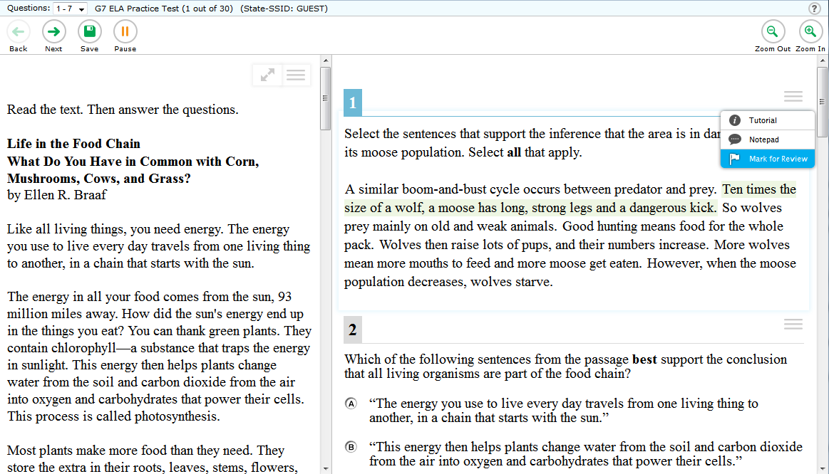
Mark for Review
Notes:
Mark for Review

Slide 7
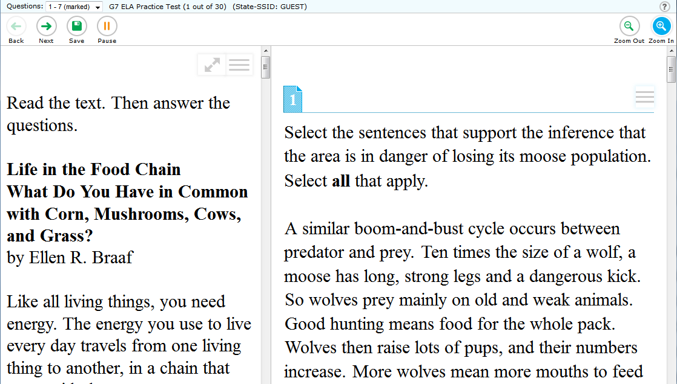
Zoom
Notes:
Zoom to enlarge or reduce the text size

Slide 8
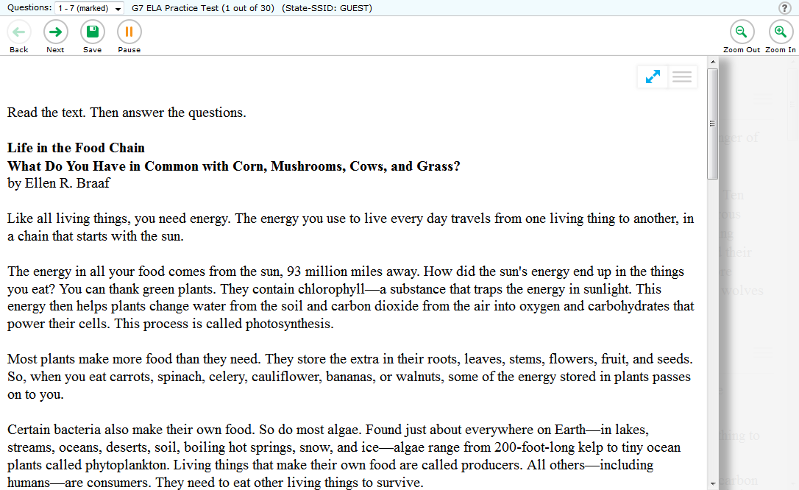
Expandable Passages
Notes:
Expandable Passages

Slide 9
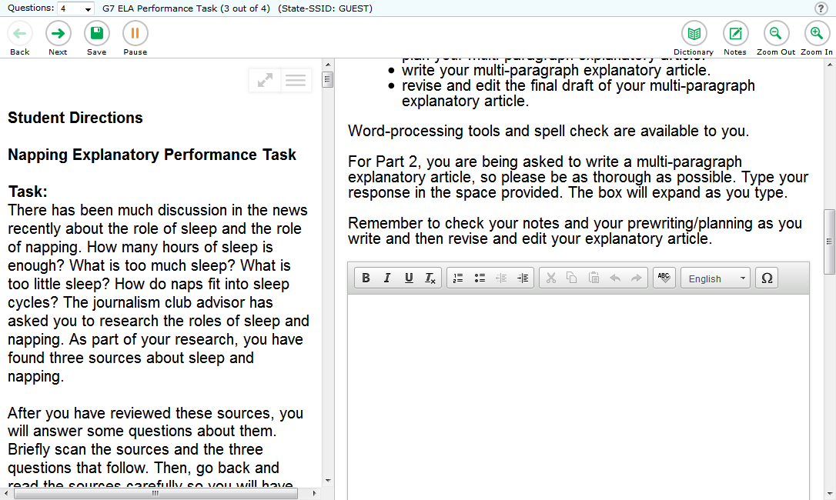
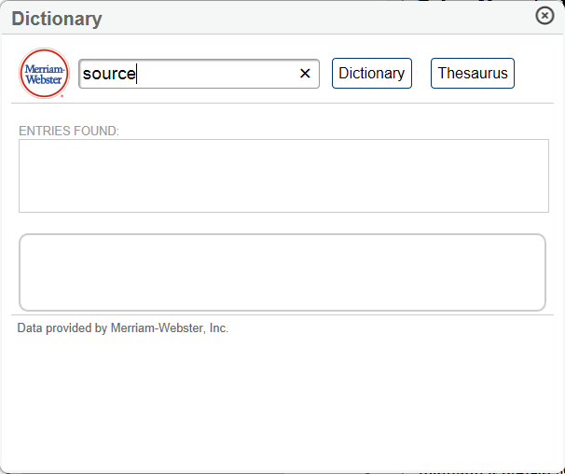
Dictionary and Thesaurus
Notes:
Dictionary and Thesaurus

Slide 10
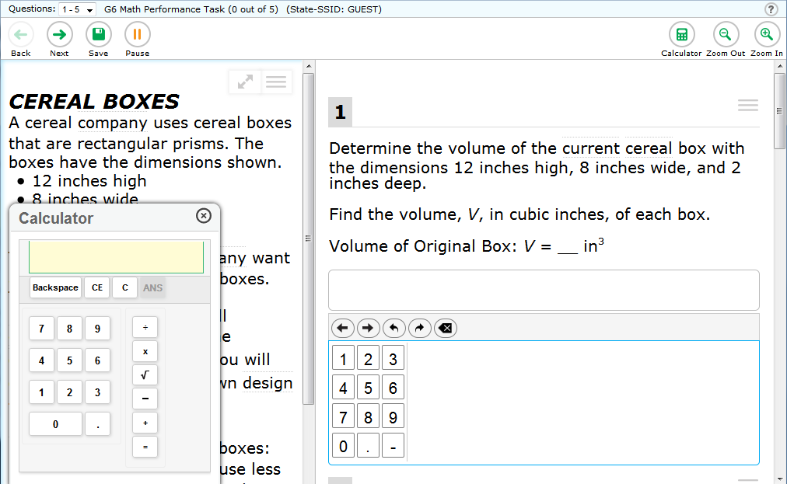
Calculator
Notes:
Calculator, which is available for this mathematics item, but is not available for all mathematics items.

Slide 11
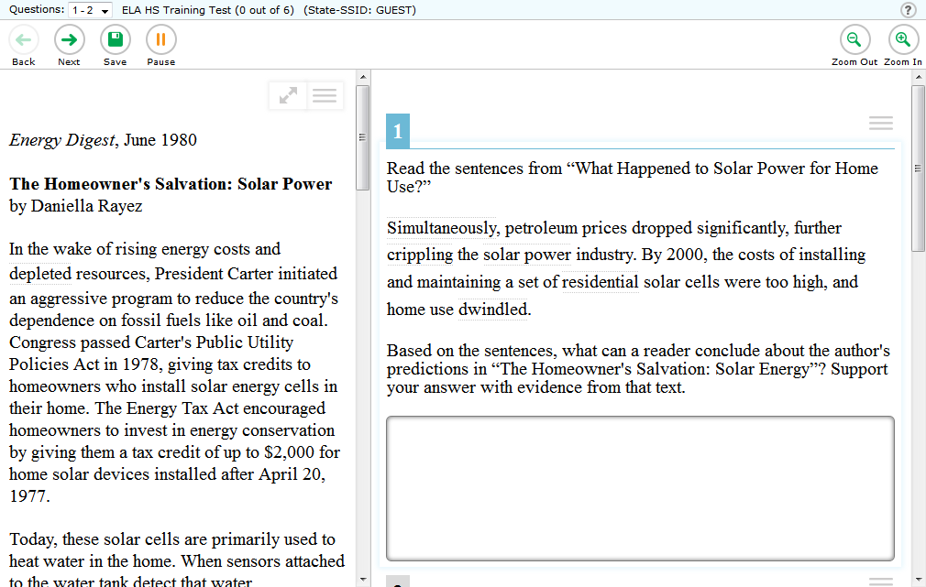
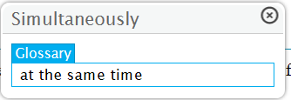
English Glossary
Notes:
English Glossary

Slide 12
Writing Tools
Notes:
Writing Tools: bold, italics, underlining, bullets, undo/redo, and spell-check where allowed.

Slide 13
Online Features Overview
Notes:
Online Features Overview

Slide 14
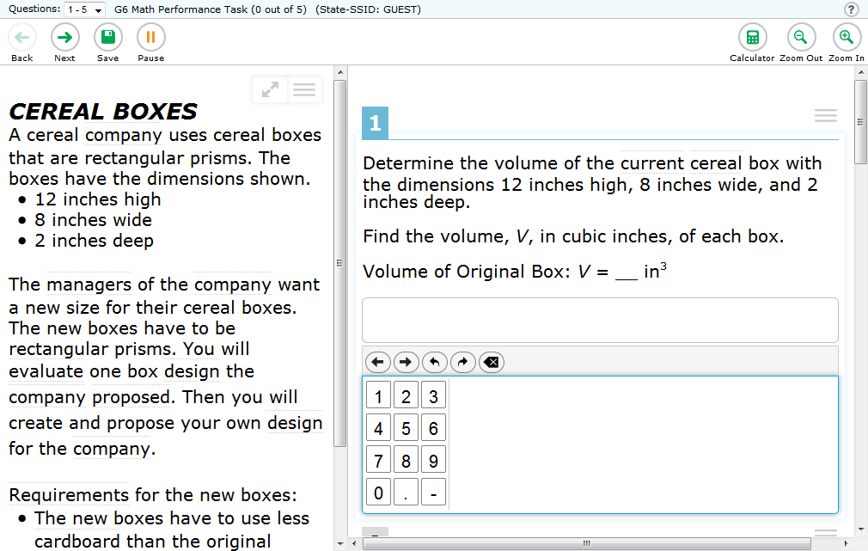
Let’s look at online features next.
Notes:
In addition to the embedded universal tools, there are online features that you should also know about.
Let’s look at the online features on these sample screens. These online features will help you navigate through the test, give you more information, and work in conjunction with the universal tools.

Slide 15
Question mark/
Help Guide
Notes:
The first online feature is the question mark icon. You can click on the [question mark] icon to view the Help Guide.

Slide 16
Question drop down list
Notes:
An online feature that can be used in conjunction with the embedded universal tool, Mark for Review, is the question drop down list.
This online feature allows you to go back and forth between questions within a segment on a test and shows you questions you’ve already answered.
When you click the drop-down list, questions marked for review will show “Marked” next to the question number.
This will allow you to easily make changes to previously answered questions by taking you directly to the pages containing the marked questions.

Slide 17
Save button
Notes:
The [Save] button—this online feature will appear only for certain item types.
For longer responses, make sure to save your answer or writing frequently.

Slide 18
Pause button
Notes:
The [Pause] button - this online feature can be used to pause your test for a short break.
When you pause your test, a pop-up message will appear asking you to confirm that you want to pause the test. You will be logged out when your test is paused. Some rules apply, so be sure to talk with your Test Administrator before using the [Pause] button.

Slide 19
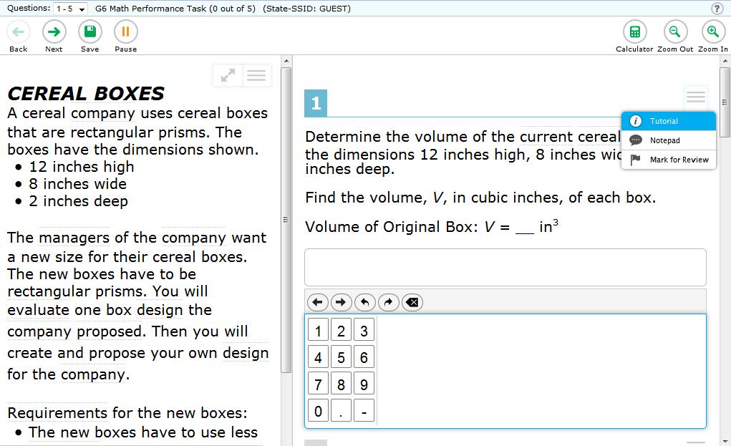
Item Tutorial
Notes:
The Item Tutorial online feature gives you more direction on what you are to do for a particular item type. Open the context menu for a question and select the [Tutorial] option.

Slide 20
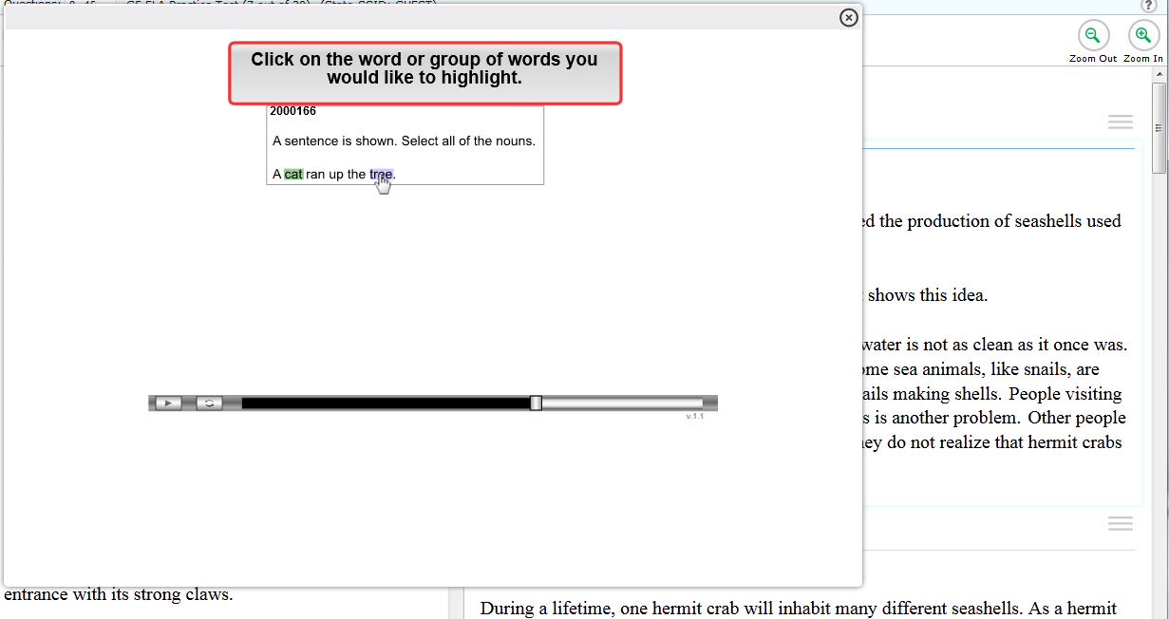

Notes:
Clicking the [Tutorial] online feature will tell you how a particular type of question works.
For example, it may inform you how to select an answer, drag and drop answers, or type an answer in a student response answer space.

Slide 21
Back and Next
Notes:
[Back] and [Next]- this online feature allows you to click these buttons to move between pages.

Slide 22
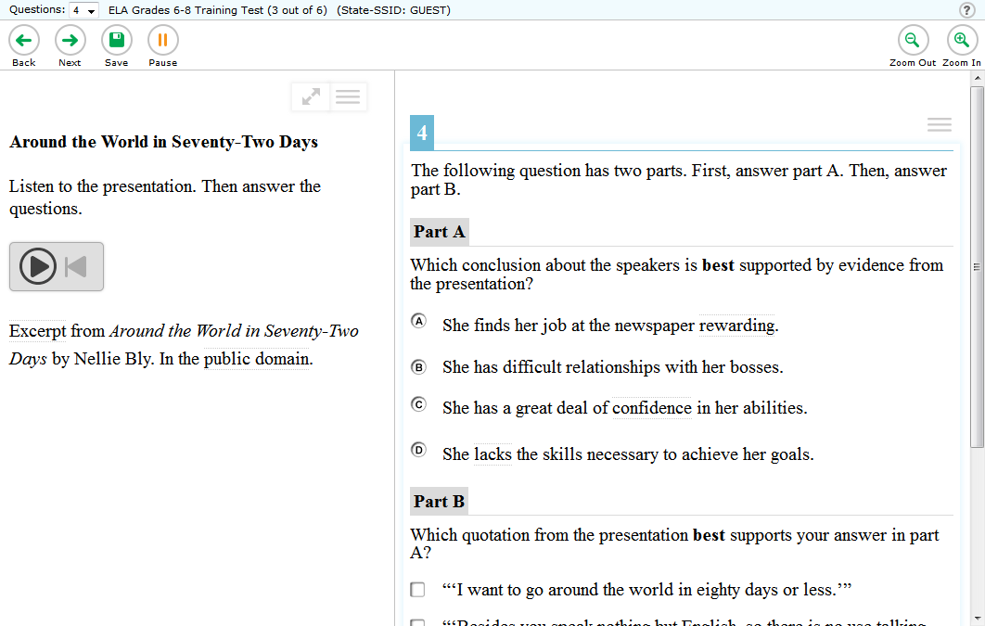
Listening Item buttons
Notes:
Lastly, you may have some items that require you to listen to audio - the listening item online feature helps with that.

Slide 23
Notes:
To play the audio, click the circle with the right arrow in it.

Slide 24
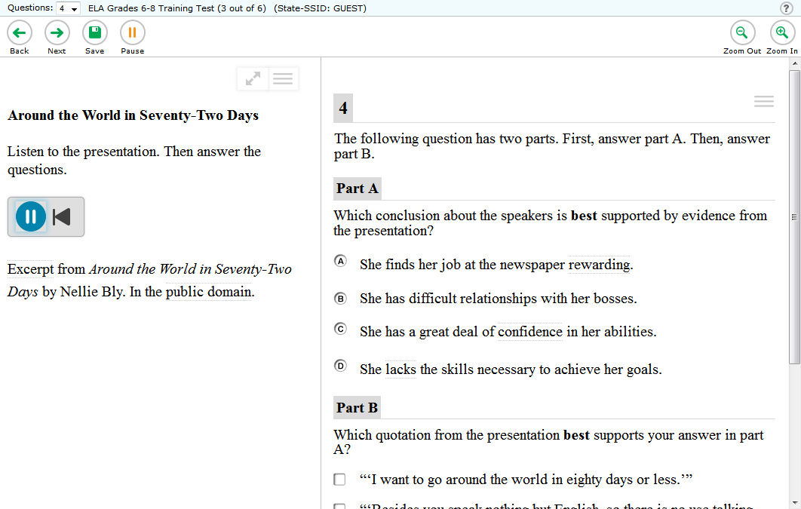
Notes:
To pause the audio, click the circle with the two vertical lines that appears once the audio clip has started playing.

Slide 25
Notes:
To stop or start the audio clip over, click the left arrow with the line to the left of it.

Slide 26
For more information
please visit:
www.smarterbalanced.org
Notes:
For more information please visit:
www.smarterbalanced.org

