Slide 1
Article Research
Debate Topics Explored
Through ICONN and EBSCO

Slide 2
TMS Virtual Library to ICONN
Links from school with no password
Incentive to get sources today and tomorrow
Using ICONN from home requires a library card

Slide 3
Click on Middle Search Plus

Slide 4
Topic- School Uniforms

Slide 5
Limiters

Slide 6
Advanced Search - Keywords

Slide 7
Without Middle Search

Slide 8
Keeping Track of Articles

Slide 9
Save to a Word or Google Document
Copy and Paste the Permalink to a Word or Google Doc
Keep a record of the link and you can always find the article

Slide 10
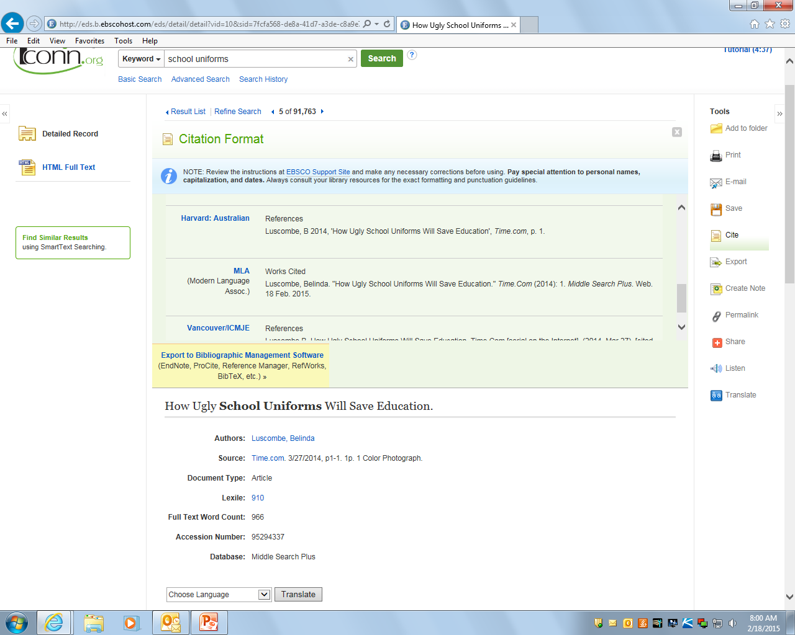
Citations – Select MLA

Slide 11
Export to Easy Bib – with Abstract

Slide 12
Printing Articles – Add Printer B&W

Slide 13
Resources from Home
iCONN – Virtual Library at home need a library card
Issues and Controversies – user name and password is on the Virtual Library right under the link and it is
User – tomlinsonmc Password – facts
Web Path Express – through Destiny
Go to the Virtual Library, Click on Destiny in the top left hand corner, Click on Tomlinson, Click on Catalog, Click on Web Path Express on the left hand side

