Slide 1
Mitosis and Cell Division

Slide 2
Cell Cycle-What is it?
Life cycle of the cell
The cell cycle begins when the cell is formed and ends when the cell divides and forms new cells.

Slide 3
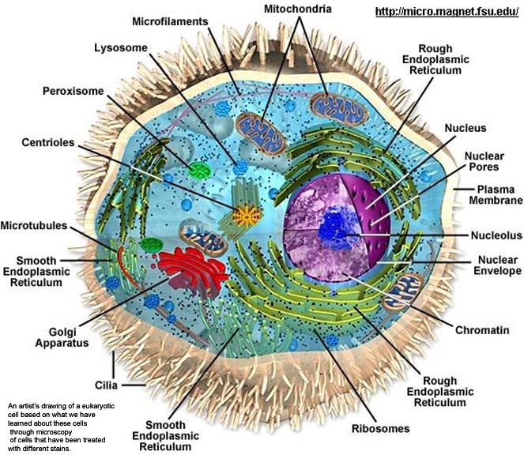
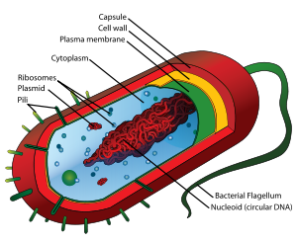
What is DNA-organized?
DNA is the hereditary material that controls all cell activities.
Organized in structures called chromosomes.

Slide 4
Making more prokaryotes
Prokaryotes – have no nucleus
Have ribosomes and circular ring of DNA
Divide by binary fission – “splitting in two parts”
http://www.classzone.com/books/hs/ca/sc/bio_07/animated_biology/bio_ch05_0149_ab_fission.html

Slide 5
Eukaryotic cells and their DNA
Eukaryotic cells contain more DNA than prokaryotic cells
More complex eukaryotic cells don’t necessarily have more chromosomes than less complex
Fruit flies – 8 chromosomes, potatoes – 48 chromosomes, humans – 46 chromosomes
Homologous chromosomes – pairs of similar chromosomes

Slide 6
Making more eukaryotic cells
Interphase
Mitosis
Cytokinesis

