Slide 1
Current Events
Find four articles for your Current events report.
International= world news
National= news anywhere in the USA
Local=news anywhere in Ct NY or NJ-New England too.
Sports/Entertainment- DUH
What I Think=WIT= Your opinion on ONE of the articles
you reported on.
You can use a variety of news sources either online or
FROM AN ACTUAL NEWSPAPER!!!!!!!!!!!!!!!!!
Here are some helpful sites: NyTimes.com, cnn.com,
wsj.com, westonforum.com, usatoday.com, foxnews.com,
Newyorkpost.com, connecticutpost.com,washingtompost.com,
Philadelphiaenquirer, bbcworldnews etc. etc. etc.

Slide 2
Read and Take notes
Once you have selected your articles, download them and read them, taking notes using the grid below:
WHO/WHAT: Person or event in the news
WHAT:- what was the event? A brief description of what happened. –
WHERE: Where did this take place?
WHEN: When did this event occur?
WHY/HOW: Here is where you write the details about this event and
include statistics from the article.
Once you have the facts, you will write a paragraph using them.

Slide 3
Choose a Quote to add
After you have written your paragraph, add a meaningful quote where it will fit into your text.
Highlight this quote in your paragraph.
Don’t forget to put quotation marks around it. THIS IS THE ONLY TIME YOU CAN COPY TEXT WORD FOR WORD!!
Each of the four articles (international, national, local and sports/entertainment) should contain a quote.
Your What I Think does not need one.

Slide 4
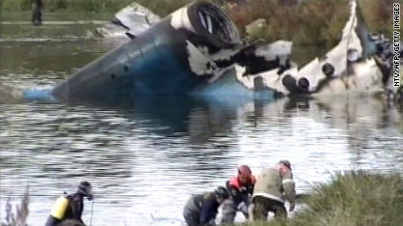
Choose One Picture to Include
Find a picture that pertains to ONE of your stories and include it with a caption.
Russian hockey team crashes. Forty hockey players are killed.

Slide 5
Where did you get your information?
Please include the articles you used to get your information.
Don’t forget to highlight the quotes you chose in those too.

Slide 6
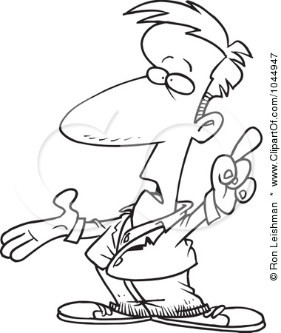
Presentation
You will present your report in front of the large map.
You must be able to point to each place you are covering on the map.

