Slide 1
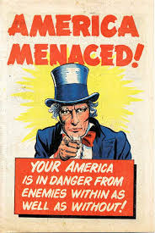
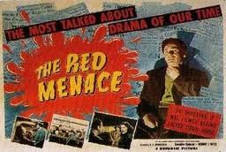
The Red Scare
By Chase Burke

Slide 2
What was the red scare and who was involved?
The Red Scare was a term used during the Cold War to identify all of the communists in America who posed as threats. Many Americans were fearful that there were enemies inside of America that they could not see. At the time of the Cold War, the US was an enemy to the Soviet Union, so many Soviets in America were treated like an enemy even if they were innocent.
The US government was heavily involved in the Red Scare. One of the main people against communism was Senator Joseph McCarthy. Joseph was determined to get rid of communists. However, he used intimidation and gossip to get information. He often had little evidence when he accused people of working for the Soviet Union. Soon after, McCarthy was fired for conspiracy and ruining peoples lives.

Slide 3
What places are associated with the red scare?
Russia is associated with the Red Scare because America and the Soviet Union were at war. Many Soviets lived in America, so the Red Scare was a big problem there because of the fear of a terrorist attack.

Slide 4
Important dates
The Red Scare began in 1919 after several anarchist bombings in the US. Many Americans became afraid of more terrorist attacks and the Red Scare began. Just as quickly as the Red Scare began, it died down in 1920, only one year later. When workers began to strike, many people blamed communism. A number of people were arrested just because they were thought to have communist beliefs.
Another important date in the Cold War was February 9, 1950, when Joseph McCarthy claimed he had a list of 205 people in the State Department who were known members of the American Communist Party. The citizens of America went crazy with the thought of there enemies living within the United States, and wanted them to be found and killed.

Slide 5
Why did the red scare exist?
The Red Scare existed because many Americans were scared that there were communists living among them. The US citizens were also concerned because of all of the resent terrorist attacks. According to the History Learning Site, The fear of communism increased when a series of strikes occurred in 1919. The police of Boston went on strike and 100,000’s of steel and coal workers did likewise. The communists usually always got the blame.

Slide 6
WAS AMERICA CHANGING?
The Red Scare was a sign that Americans were resisting change because they did not want anyone from the Soviet Union in America because they were seen as potentially dangerous.

Slide 7
Bibliography
"The Cold War." For Kids: Red Scare. N.p., n.d. Web. 15 Dec. 2014.
"The Red Scare." The Red Scare. N.p., n.d. Web. 14 Dec. 2014.

