Slide 1
Causes of the Dust Bowl Review
The pan handle of Oklahoma, covered in buffalo grass, was one of the last (and least attractive) areas of the United States to be populated
It is an area with little rainfall, prone to draught and therefore not well suited to farming wheat

Slide 2
Causes of the Dust Bowl Review
Immigrant farmers, looking for their piece of the American dream, rushed to claim the inexpensive homesteads available in the pan handle.
In a cruel twist, rainfall in the 20s was unusually high. The amount of land farmed increased throughout the 20s.

Slide 3
Causes of the Dust Bowl Review
When the Great Depression started, the price of wheat fell.
Farmers grew more crops to make up for the lower prices, which stripped more land of the anchoring protection of buffalo grass and drove the prices even lower.

Slide 4
Causes of the Dust Bowl Review
From 1932 through much of the 30s, there was a severe drought that only added to the problems facing the farmers
As crops dried up in the fields and what little crops were harvested continued to be worth less at market than the cost to produce, more and more farms and ranches failed and were deserted.

Slide 5
The Dust Bowl
This led to vast areas of land with no protective covering of grass or crops, covered only in dirt. Dirt that would be gathered up in the wind to become storms of unimagined size. Storms that would impact cities as far away as New York City and ocean liners miles away from port.
The area generating these storms, which happen on a smaller scale EVEN TO THIS DAY, will forever be remembered as the “Dust Bowl”

Slide 6
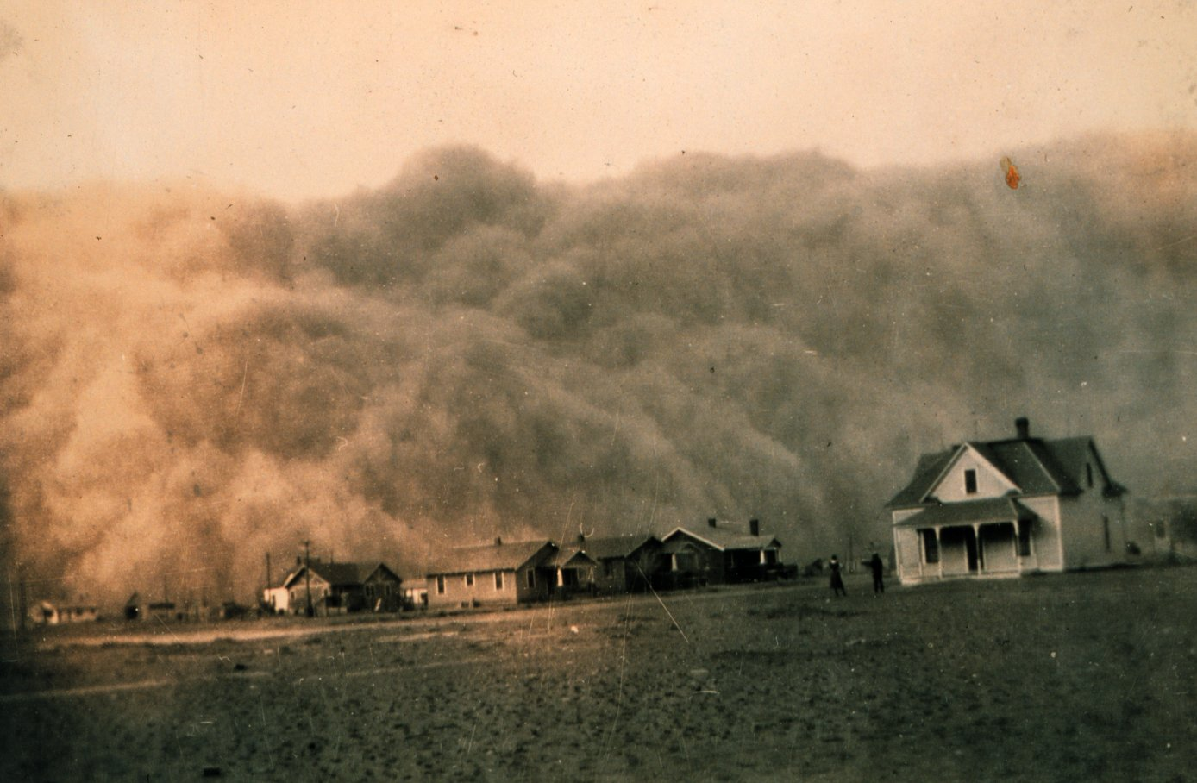
If you saw this coming, how would you react?

