Slide 1
Pearl Harbor
Unit 5 – World At War

Slide 2
The Preamble (the first part) of the US Constitution sets out to
“secure the Blessings of Liberty to ourselves and our Prosperity”

Slide 3
President Roosevelt said we were at peace with Japan and that the attack was unprovoked. Is that entirely accurate?

Slide 4
We were not officially at war with Japan but we had imposed a trade embargo with Japan. Japan is a small island nation with limited resources. The U.S. banned the export of scrap iron, oil and steel to Japan.

Slide 5
Embargo:
Embargo – imposing a ban on trade with a country (textbook page 306, also on my website). Trade embargos are used today. This action has been recently used against Russia.

Slide 6
Why did Japan need those resources?

Slide 7
Japan, like Italy and Nazi Germany, was imperialistic and nationalistic. (the definitions of nationalism and imperialism are on my website).

Slide 8
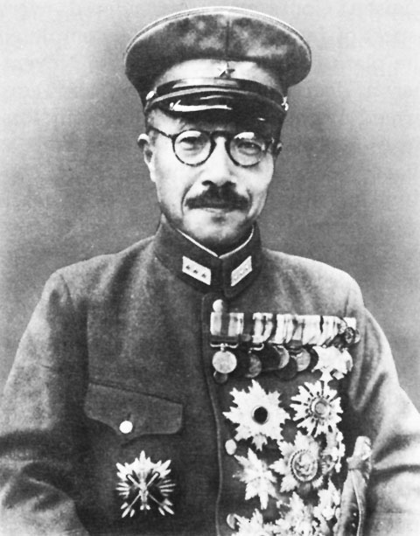
Tōjō
Prime Minister of Japan from 1941-’44 (equivalent of US president). Under his command, the government worked for a “Greater East Asia” program which, like the Nazis, was racially motivated.

Slide 9
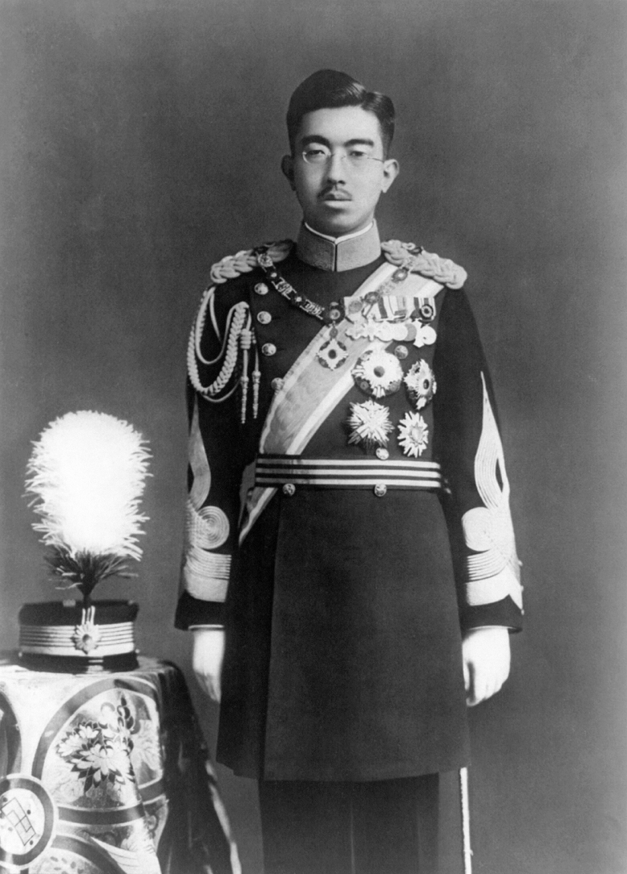
Hirohito
Emperor of Japan
In Japanese tradition the Emperor is viewed as a God

Slide 10
Causes of WWII

Slide 11
The sides of WWII
Axis:
-Japan
-Germany
-Italy
Allies
-Great Britain
-USA
-Soviet Union (Russia and the lands it controlled)

Slide 12
What had been the foreign policy of the United States before the attack on Pearl Harbor?

Slide 13
Isolationism
Avoiding involvement in the affairs of other nations (textbook page 640)

Slide 14
Was the US really isolationist?

Slide 15
No!
Roosevelt famously had said “I hate war” but eventually it became clear that the US had to intervene
Even before Pearl Harbor congress had passed the Lend-Lease Act, which allowed the US to offer weapons and other war supplies to Britain and later the Soviet Union to fight against the Axis Powers

Slide 16
How did the rest of the world react when Hitler took over land?

Slide 17
The allies took a policy of appeasement:
Giving in to an aggressor to preserve the peace

