Slide 1
1946-1991= The Cold War
1955-1975= U.S. involvement in Vietnam
1954-1968= The Civil Rights Movement

Slide 2
Where in the world is Vietnam?
Southeast Asia
South of China
Known as “Indochina” while under French rule

Slide 3
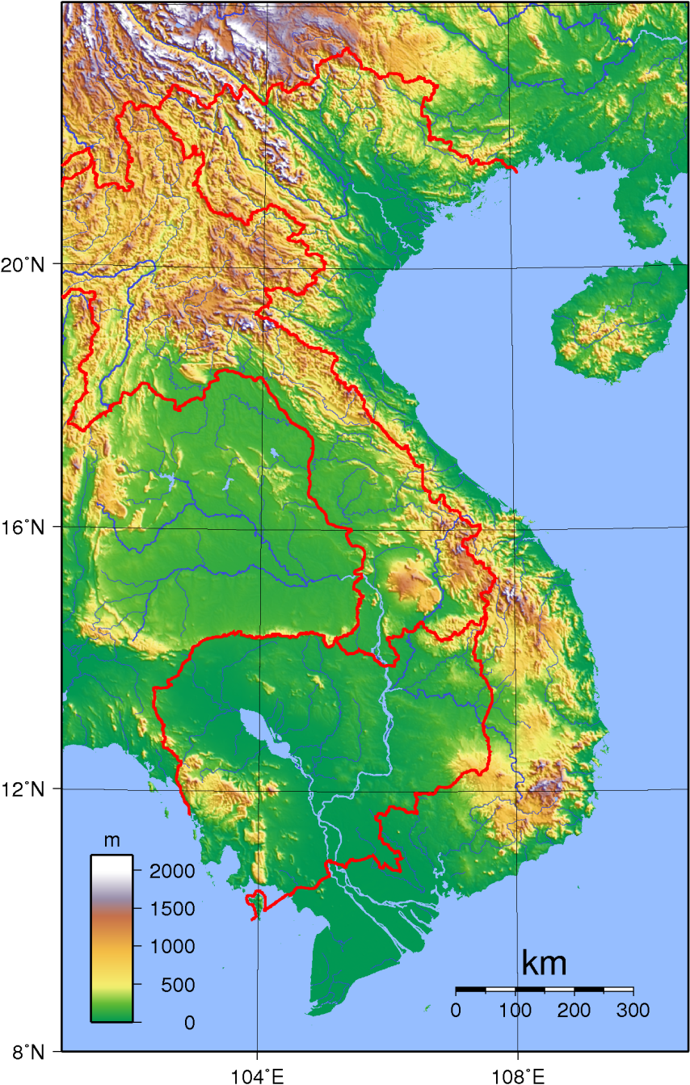
Location, Climate and Geography
Vietnam is covered with mountains, jungles, wooded areas, and rivers. The coastline even shifts at different times of the year
Vietnam is sub-tropical. It is very humid.

Slide 4
An extremely brief history of Vietnam
Vietnam first gained its independence in 1975. Prior to that, it had almost always been controlled by another country.
111 B.C.
China conquers Vietnam
1883: France takes control of Vietnam
1940: WWII breaks out--Japan Takes control of Vietnam
1946: France tries to take Vietnam back; is defeated at Dien Bien Phu
1954: Vietnam divided in two
1965: America sends combat troops to Vietnam

Slide 5
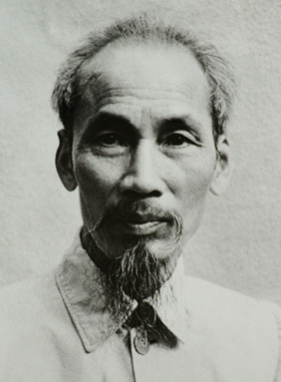
Ho Chi Minh
Born: Nguyen Sinh Cong in 1890
Studied in France and worked in America
Believed in communist ideals
Wanted a free and independent Vietnam
Asked the United States multiple times for help against French imperialism…He was ignored.

Slide 6
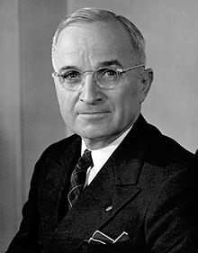
Ho Chi Minh: Freedom Fighter?
Ho Chi Minh fought for an Independent and united Vietnam against the Japanese (during WWII), the French, and again against the Americans/South Vietnamese
Declared Vietnam free and independent after defeating the Japanese in 1946
Modeled their declaration after the American Declaration of Independence.
“We hold the truth that all men are created equal, that they are endowed by their Creator with certain unalienable rights, among them life, liberty and the pursuit of happiness. This immortal statement is extracted from the Declaration of Independence of the United States of America in 1776. These are undeniable truths.”

Slide 7
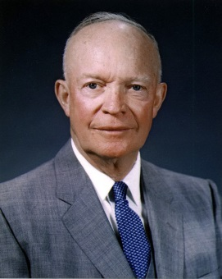
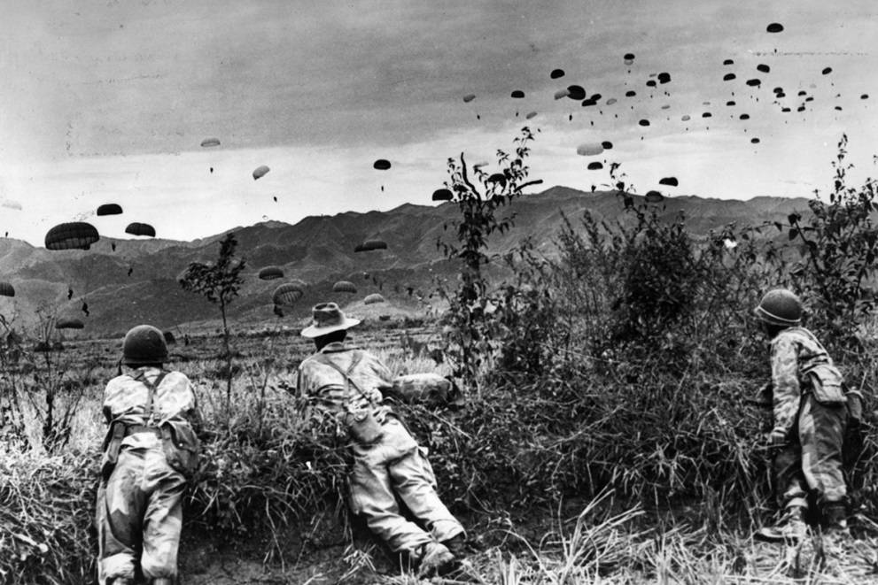
Shortly after Vietnam declares independence in 1946 the French try to regain control of Vietnam due to its precious resources (tin, rubber)
The French are defeated by the Vietnamese led by Ho Chi Minh at the battle of Dien Bien Phu in 1954

Slide 8
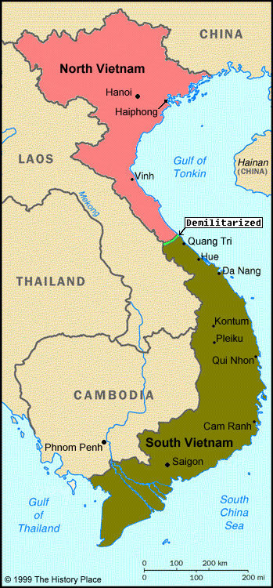
Geneva Accords (1954)
Peace agreement that:
Divided Vietnam in half
North Vietnam
Controlled by Ho Chi Minh
Communist form of government
South Vietnam
Controlled by Ngo Dinh Diem
Democratic Republic form of government
Backed by the United States
Called for free elections in two years (1956)

Slide 9
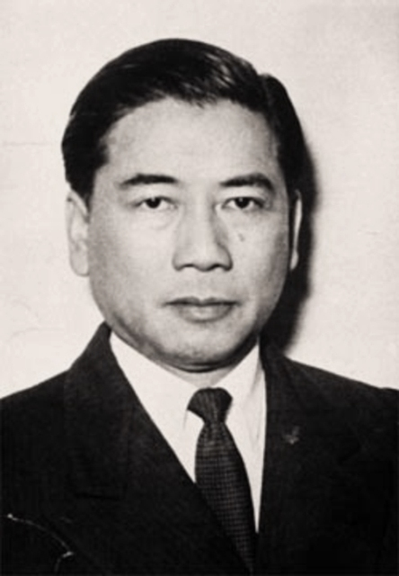
Ngo Dinh Diem
President of South Vietnam
Ignored Geneva Accords and did not agree to hold free elections in 1956
Knew how wildly popular Ho Chi Minh was and that Diem would lose in an election
Attacked Communists in South Vietnam
Communists responded by forming the Viet Cong
militant supporters of Ho Chi Minh who live in the South
Viet Cong begins a war on the Diem government

Slide 10
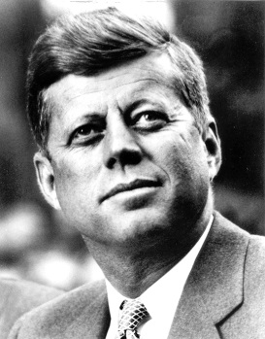
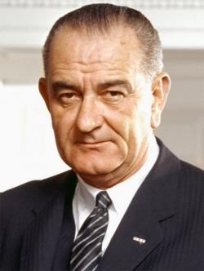
The Role of the U.S.
Truman Doctrine - A promise that the U.S. would help any nation resist Communist aggression
Sent billions of dollars in aid to the South during the 1950s
Sent 100s of soldiers to advise and train the South Vietnamese (but not to fight)
Domino Theory –if one country falls to Communism, surrounding countries will fall too (like dominoes)

Slide 11
Diem and the U.S.
U.S. pressured Diem to help the South Vietnamese poor in order to make communism less appealing
Diem ignored this
Diem took rights away from the Vietnamese
Persecuted Buddhists because they “were helping communists”
Outcry and protests begin against Diem including self-immolation by Buddhist monks

Slide 12
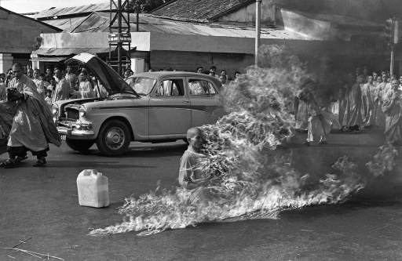

Slide 13
U.S. withdraws its support
By 1963, the United States (under Kennedy) no longer supported Diem and encouraged the South Vietnamese military to overthrow him.
Not only did the military overtake the government, they assassinated Diem—which the U.S. did not support.
The United States sends an additional 15,000 military advisors to the South following Diem’s assassination as well as navy vessels to patrol the seas
Kennedy dies in November of 1963

Slide 14
The Gulf of Tonkin Incident
In the summer of 1964, a U.S. Navy destroyer, the U.S.S. Maddox, on routine patrol in the Gulf of Tonkin (off the coast of Vietnam), was said to have been fired upon suddenly and without provocation by North Vietnamese ships.
President Lyndon Banes Johnson quickly urged congress to give him approval to defend United States interests in Vietnam. 504 out of 506 members of the Congress approved. This approval is known as the Gulf of Tonkin Resolution

Slide 15
The Gulf of Tonkin Mystery
The U.S.S. Maddox showed no damage upon inspection
Some believe that either Johnson magnified the issue or the episode was completely fabricated

